Slide 1
Treatment of MSI-H locally
advanced colon cancer: have we found a niche for
neoadjuvant immunotherapy?
Jenny Seligmann
Univeristy of Leeds, United Kingdom

Slide 2
DECLARATION OF INTERESTS
Jenny Seligmann
Consultancy/ Advisory: Astra-Zeneca, Boehinger-Ellison, BMS, GSK, Pierre Fabre Medicament, Merck Serono, Seagen, Servier, Takeda,
Speaker Fees: GSK, Merck Serono, Pierre Fabre Medicament, Servier, Takeda
Research Funding: Amgen, Pierre Fabre Medicament, Merck-Serono, GSK
Travel: Takeda
CME: GI Connect, OncLive
Jenny Seligmann
Content of this presentation is copyright and responsibility of the author. Permission is required for re-use.

Slide 3
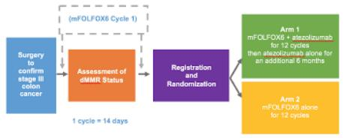
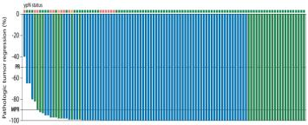
MSI-H locally advanced colon cancer (LACC) in 2024
1. In MSI-H mCRC some patients are being cured with
immunotherapy
2. The role of adjuvant IO is not established
3. Neoadjuvant IO is superior to adjuvant in other tumor types
4. Neoadjuvant immunotherapy
results in impressive short term efficacy
5. Heterogeneity within LACC
ATOMIC trial
Andre, NEJM, 2020; Sinicrope, ASCO GI 2019; Patel, NEJM, 2023; Chalabi, NEJM, 2024;

Slide 4
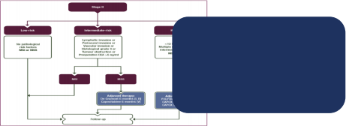
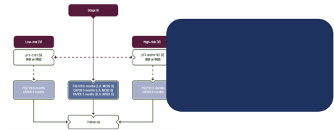
Pre-ESMO evidence MSI-H LACC
Stage II Standard of
Care:
Surgical resection
then observation
Stage III Standard
of Care:
Surgical resection
then adjuvant OxFp

Slide 5
Current outstanding questions for MSI-H LACC
Short-term Longer term
• Optimal duration of pre-operative treatment?
• Single agent vs combination immunotherapy?
• Optimal patientselection
• What is the magnitude of risk for severe toxicity?
• Does short term efficacy
translate into long term cancer control?
• Do you require a cPR for
longer term cancer control?
• Is adjuvant treatment required?
• Are there long term toxicity concerns
What
evidence is
required for
practice
change?

Slide 6
How does the current data progress the field?
Inclusion/ exclusion criteria
• MSI-H/ dMMR localized non-metastatic colon
cancer*
• Radiologically staged II-III / cT3 and/ or N+
• No obstruction or perforation
• No contraindications to immunotherapy
Imhotep included some rectal cancer patients

Slide 7
Study designs:
Study | Study drug | Duration of pre-op | Post-op IO | Primary endpoint
IMHOTEP (n=89) | Pembrolizumab | 6-12 weeks | ✅ | pCR rate
NICHE 3 (n=59) | Nivolumab + Relatlimab | 4 weeks | No | Path response (<50% RVT)
NICHE 2 (n=115) | Nivolimab + Ipilimumab | 4 weeks | No | Safety & 3 yr DFS
De la Fouchardiere, ESMO Meeting 2024; Gooyer, ESMO Meeting 2024; Chalabi, ESMO Meeting 2024

Slide 8
Patient characteristics
17% of patients over 80 - frailer patient population than recruited in other trials
Study Design |  |  | Median age |  | PS >0 %cT4 % N+ % Lynch
IMHOTEP (n=89) | Peri-op pembrolizumab |  | 66 41.9% |  |  |  | 31.5% 78.7% 20.7%
Pre-op Nivolumab + Relatlimab |  |  |  | 65 29% 68% 63% 19%
NICHE 2 (n=113) | Pre-op Nivolimab + Ipilimumab |  |  | 60 13% |  | 65% 67% 31%
 |  | High proportion of high risk patients
NICHE 3 (n=59)
De la Fouchardiere, ESMO Meeting 2024; Gooyer, ESMO Meeting 2024; Chalabi, ESMO Meeting 2024

Slide 9
Key Delivery & Safety Outcomes
Study | Design | % grade 3/4 IO toxicity | % ANY grade 3+ toxicity | Pre-op tumor complication | Pre- op Death
IMHOTEP (n=89) | Peri-op pembrolizumab | 13.5% | 40.4% | Yes | 5.6%
NICHE 3 | Pre-op Nivolumab + relatlimab | 10% | 24.0% | No | 0%
NICHE 2 | Pre-op Nivolimab + Ipilimumab | 4% |  | Yes | 0%
De la Fouchardiere, ESMO Meeting 2024; Gooyer, ESMO Meeting 2024; Chalabi, ESMO Meeting 2024

Slide 10
Key Efficacy Outcomes
Consistent with previous studies
Study | Design | R0 resection | pCR rate in eligible pts * | mPR | 3 year DFS
IMHOTEP (n=77) | Peri-op pembrolizumab | 100% | 52.8% |  | -
NICHE 3 (n=59) | Pre-op Nivolumab + Relatlimab | 100% | 68% | 92% | -
NICHE 2 (n=113) | Pre-op Nivolimab + Ipilimumab | 100% | 68% | 95% | 100%
No difference in efficacy
Eligible pts in IMHOTEP = 77
De la Fouchardiere, ESMO Meeting 2024; Gooyer, ESMO Meeting 2024; Chalabi, ESMO Meeting 2024

Slide 11
Strengths and limitations
Study | Strengths | Limitations
IMHOTEP (n=87) | Generalizable Describes real world pathways | Non randomized Protocol violations Change in treatment duration Lacks long term data Downstaging data uninterpretable with no contol
NICHE 3 (n=59) | 1st report of neoadjuvant LAG-3 | Non-randomized No longer term data Less generalizable
NICHE 2 (n=113) | Long term data reported ctDNA data additive to clinical interpretation | Non-randomized Less generalizable
De la Fouchardiere, ESMO Meeting 2024; Gooyer, ESMO Meeting 2024; Chalabi, ESMO Meeting 2024

Slide 12
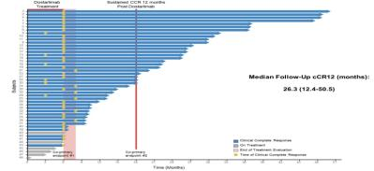
What is the optimal duration for pre-operative anti-PD-1?
Study | Design | pCR rate
Xu et al | Sintilimab 4 weeks | 47.7%
IMHOTEP | Pembrolizumab 6 weeks | 46.0%
NEOPRISM (n=32) | Pembrolizumab 9 weeks | 53%
PICC (n=34) | Toripalimab +/- celecoxib 12 weeks | 76.5%
IMHOTEP | Pembrolizumab 12 weeks | 68.2%
Ludford (n=27) | Pembrolizumab 24 weeks | 79%
Duration to cCR with Dostarlimab in MSI-H rectal cancer
Xu, ASCO Meeting 2024; Shiu, ASCO Meeting 2024; Ludford, JCO, 2023; Hu, Lancet Gastro Hep, 2022; Cercek, ASCO Meeting 2024

Slide 13
Single agent vs combination neoadjuvant immunotherapy?
Study Design pCR rate
PICC Toripalimab +/- celecoxib (12 weeks) |  | 76.5%
Ludford Pembrolizumab (24 weeks) |  | 79%
NEOPRISM Pembrolizumab (9 weeks) |  | 53%
IMHOTEP Pembrolizumab (6 weeks) |  | 46.0%
IMHOTEP Pembrolizumab (12 weeks) |  | 68.2%
Xuetal Sintilimab (4 weeks) |  | 47.7%
NICHE 2 Nivolimab + ipilimumab (4 weeks) |  | 68.0%
NICHE 3 Nivolumab +. Retalimab (4 weeks) |  | 68.0%
 | Xu et al IBI310 + Sintilimab (4 weeks) | 80%
Kasi et al Botensilimab + bastilimab (4 weeks) |  | 100%
• Over shorter treatment
duration combination appears superior
• Lesser difference in pCR if longer treatment of anti-PD1 delivered
• Heterogeneity in study designs limit definitive conclusions
Xu, ASCO Meeting 2024; Shiu, ASCO Meeting 2024; Ludford, JCO, 2023; Hu, Lancet Gastro Hep, 2022; Cercek, ASCO Meeting 2024, Kasi, ASCO GI Meeting, 2024

Slide 14
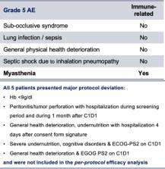
What is the magnitude of risk for emerging safety concerns?
• Risk of grade 5 IO toxicity small but important risk.
• Caution with baseline patient frailty
• Risk of tumor related
complications - can be associated with response
• Low grade endocrinopathies can mean life-long treatment
• However, overall good tolerability & completion rates
De la Fouchardiere, ESMO Meeting 2024; Gooyer, ESMO Meeting 2024; Chalabi, ESMO Meeting 2024, Platt, ESMO Open 2024

Slide 15
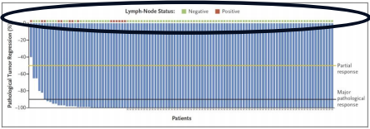
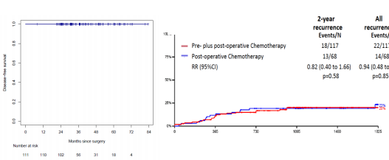
Does short term efficacy translate into long term cancer control?
• Unprecedented 100%
recurrence free at 3 years
• Early event in NICHE 3
• 15-20% recurrence in
similarly selected patients in FOxTROT
• pCR may not be critical for longer term cancer control with surgery
(19.1%) (15.4%)
Chalabi, ESMO 2024; Morton, JCO, 2023

Slide 16
Can ctDNA aid decision making in this pathway?
To select high risk patients
To assess response to therapy
• At Baseline 92% of patients were ctDNA positive
• No difference in baseline levels by response
• Not additive in terms of identifying the high risk patient
• Fallin ctDNA levels correlates with level of response
• Pts +ve prior to surgery may be lymph node positive
• All pts negative after surgery
• ctDNA may in future aid:
• Identification of those who require longer duration, post-operative or alternative
treatment
• Supportive to radiology & endoscopy for organ preservation strategies
Chalabi et al, ESMO Congress 2024, Xie et al, JNCCN, 2023

Slide 17
Does this data merit practice change?
Compared with post-op
chemotherapy, immunotherapy has
• Improved short-term efficacy
• Is likely to correspond to
superior longer term cancer control
• Usually better tolerated
cT4b tumors
T3/ T4a
tumors
Difficult to achieve
R0 resection without
multivisceral
resection
What is the benefit
compared with
current standard of
care?
PATIENT
VOICE
What is needed for regulators?
• Design
• Specific
population & drugs
YES – well
represented in
NICHE
Jenny Seligmann
Content of this presentation is copyright and responsibility of the author. Permission is required for re-use.

Slide 18
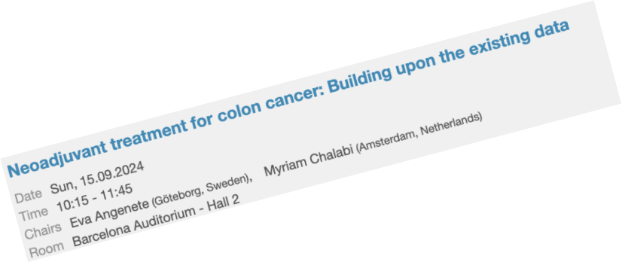
How to progress to practice change?
Evidence generation & consolidation
• Recruit to randomized trials in progress
• Strategization
• Collaboration on data available
• Explore novel methodologies
• Industry engagement
• Ensure generalisability
Implementation
• Patient pathways will need to alter in most centres to deliver this treatment
• Confidence inpatientselection
• Reflex MSI testing
What do
we do if
adjuvant
trial is
positive?

Slide 19
Conclusions
• For MSI-H LACC the body of evidence is accumulating and is consistent
• Consistent impressive short term efficacy
• NICHE 2 suggests this correlates with long term cancer control
• IMHOTEP supports caution with patientselection
• Potential paradigm changing results will be balanced against treating good prognosis patients
• Current data is unlikely to be sufficient for regulatory approval
• We await results of randomized trials

Slide 20
Thankyou to the 3 great speakers & to all the investigators, patients, carers and funders who support this important topic of research
j.Seligmann@leeds.ac.uk
European Society for Medical Oncology (ESMO)
Via Ginevra 4, CH-6900 Lugano
T. +41 (0)91 973 19 00
esmo@esmo.org
esmo.org

