Slide 1
Oncogene-addicted earlier stage NSCLC:
Current standards, debates, and open questions
Laura Mezquita MD, PhD
Hospital Clinic of Barcelona, Spain
Translational Genomics in Solid Tumors Group I MECA (Environment & Cancer), IDIBAPS University of Barcelona

Slide 2
DECLARATION OF INTERESTS
DR. MEZQUITA
Lectures and educational activities:
o Bristol-Myers Squibb,AstraZeneca, Roche, Takeda, Radonova, Janssen, MSD
Consulting, advisory role:
o Roche, Takeda, AstraZeneca, Janssen, MSD
Research Grants:
o Amgen, Inivata, Gilead, AstraZeneca
Travel, Accommodations, Expenses:
o Bristol-Myers Squibb, Roche, Takeda, AstraZeneca, Janssen
Dr. Laura Mezquita
Content of this presentation is copyright and responsibility of the author. Permission is required for re-use.

Slide 3
Learning points
1. Current therapeutic strategy in oncogene-addicted earlier stage NSCLC
- Neo/Adjuvant therapy in EGFRm NSCLC
- Neo/Adjuvant therapy in ALK+ NSCLC
- Consolidation in EGFRmin NSCLC
2. Debates & open questions
- Patient/Treatment selection?
- Treatment at PD?
- Clinical development & biomarkers …
Dr. Laura Mezquita
Content of this presentation is copyright and responsibility of the author. Permission is required for re-use.

Slide 4
Learning points
1. Current therapeutic strategy in oncogene-addicted earlier stage NSCLC
- Neo/Adjuvant therapy in EGFRm NSCLC
- Neo/Adjuvant therapy in ALK+ NSCLC
- Consolidation in EGFRmin NSCLC
2. Debates & open questions
- Patient/Treatment selection?
- Treatment at PD?
- Clinical development & biomarkers …
Dr. Laura Mezquita
Content of this presentation is copyright and responsibility of the author. Permission is required for re-use.

Slide 5
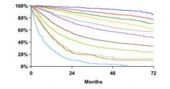
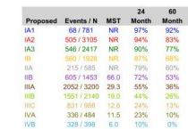
Earlier stage in NSCLC
Stage I Stage II Stage III
Stage IV
“Early stage”, but …
IASLC Staging
Lung Cancer
Program
cases
22%
21%
53%
% of
Risk of recurrence
35,9% 8,9%
63,7%
rate
Survival
5 yrs
https://seer.cancer.gov/statfacts/html/lungb.html; Goldstraw P, etal J ThoracOncol 2016
Dr. Laura Mezquita Content of this presentation is copyright and responsibility of the author. Permission is required for re-use.

Slide 6
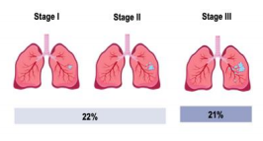
Management of earlier stage NSCLC
Neoadjuvant
Resection
Treatment selection
Stage IB-IIIA
Stage III
Neoadjuvant
Resection
Adjuvant
Resection
Adjuvant
CHEMORADIATION
Consolidation
Dr. Laura Mezquita
Content of this presentation is copyright and responsibility of the author. Permission is required for re-use.

Slide 7
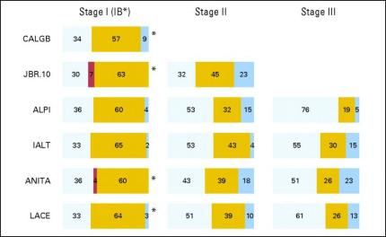
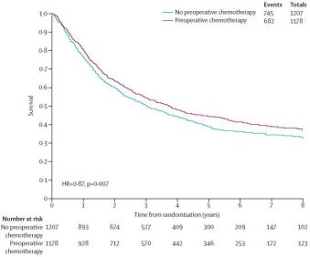
Neo/Adjuvantchemo: “Classical” SoC
NEOADJUVANT chemotherapy
ADJUVANT chemotherapy
Modest impact
Pisters KMW, etal J Clin Oncol 2006; NSCLC Meta-analysis Collaborative Group, Lancet Oncol 20214
Content of this presentation is copyright and responsibility of the author. Permission is required for re-use.
Dr. Laura Mezquita

Slide 8
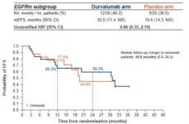
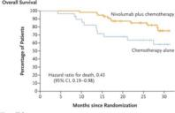
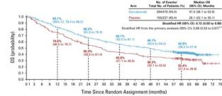
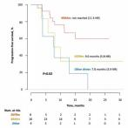
Immunotherapy: New SoC in earlier stage NSCLC
NADIM, perioperative treatment
AEGEAN, perioperative treatment
BUT …
↓ benefit in driver pop
Wild type
PACIFIC, durvalumab consolidation
RWD, durvalumab consolidation
Provencio M, et al NEJM 2023, Spigel D, etalJ Clin Oncol 2022; Riudavets, M etal, Eur J Cancer 2022, HarpoleD, WCLC 2023
Content of this presentation is copyright and responsibility of the author. Permission is required for re-use.
Dr. Laura Mezquita

Slide 9
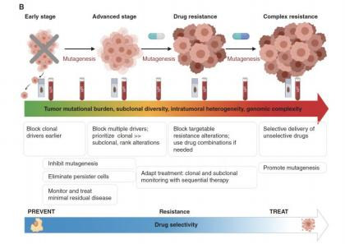
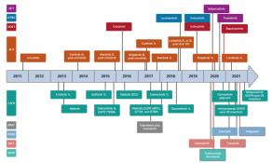
Targeted therapy in earlier stage NSCLC
The sooner the better?
Earlier stage |  | Advanced disease
Targeted therapies in advanced NSCLC
Aldea M, et al, Cancer Discov 2021, Tan, etalJCO 2022
Content of this presentation is copyright and responsibility of the author. Permission is required for re-use.
Dr. Laura Mezquita

Slide 10
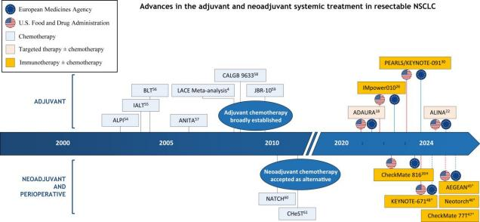
Neo/Adjuvant therapy in earlier stage
Oncogene-addicted NSCLC
EGFR
LAURA
ALK
ADAURA
ALINA
Houda I et al. Lancet Reg Health Eur2024
Content of this presentation is copyright and responsibility of the author. Permission is required for re-use.
Dr. Laura Mezquita

Slide 11
Learning points
1. Current therapeutic strategy in oncogene-addicted earlier stage NSCLC
- Neo/Adjuvant therapy in EGFRm NSCLC
- Neo/Adjuvant therapy in ALK+ NSCLC
- Consolidation in EGFRmin NSCLC
2. Debates & open questions
- Patient/Treatment selection?
- Treatment at PD?
- Clinical development & biomarkers …
Dr. Laura Mezquita
Content of this presentation is copyright and responsibility of the author. Permission is required for re-use.

Slide 12
ADJUVANT Therapy in EGFRm NSCLC
1st gen. EGFR-TKI – DFS improvement – not in OS
Phase III - EGFR -TKI
Date | Study | Stage | Drug | DFS |  | OS
2015 | RADIANT | IB-IIIA | Erlotinib vs. placebo | HR 0.94 (95% CI 0.78-1.14) | P=0.56 | HR 1.12 (95% CI 0.9–1.4) | NS
2020 | ADJUVANT/ CTONG1104 | II-IIIA | Gefitinib vs. chemo | HR 0.56 (95% CI 0.40-0.79) | P=0.001 | HR 0.92 (95% CI 0.62-1.36) | NS
2021 | IMPACT | II-III | Gefitinib vs. chemo | HR 0.92 (95% CI 0.67-1.28) | P=0.63 | HR 1.03 (95% CI 0.65-1.65) | NS
2021 | EVIDENCE | II-IIIA | Icotinib vs. chemo | HR 0.36 (95% CI 0.24-0.35) | P<0.0001 | HR 0.91 (95% CI 0.42-1.94) | NS
O’Brien, ASCO 2015, Zhong, Lancet Oncol 2018, Zhong JCO 2020, Wu NEJM 2020, Tada, JCO 2021, He j, Lancet Res Med 2021
Content of this presentation is copyright and responsibility of the author. Permission is required for re-use.
Dr. Laura Mezquita

Slide 13
ADJUVANT Therapy in EGFRm NSCLC
Osimertinibadjuvant
Herbstetal, ASCO 2023; Tsuboietal, NEJM 2023
Content of this presentation is copyright and responsibility of the author. Permission is required for re-use.
Dr. Laura Mezquita

Slide 14
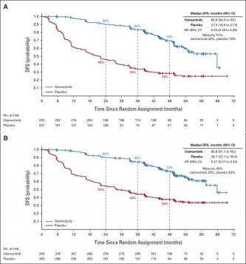
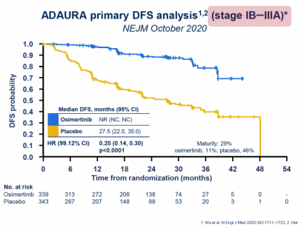
ADJUVANT Therapy in EGFRm NSCLC
Primary endpoint - Improved DFS
Stage II - IIIA
Updated analysis
Stage IB - IIIA
Herbstetal, ASCO 2023; Tsuboietal, NEJM 2023
Content of this presentation is copyright and responsibility of the author. Permission is required for re-use.
Dr. Laura Mezquita

Slide 15
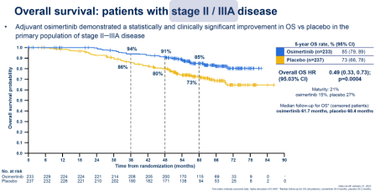
ADJUVANT Therapy in EGFRm NSCLC
Secondary endpoint - Improved OS
Herbstetal, ASCO 2023; Tsuboietal, NEJM 2023
Content of this presentation is copyright and responsibility of the author. Permission is required for re-use.
Dr. Laura Mezquita

Slide 16
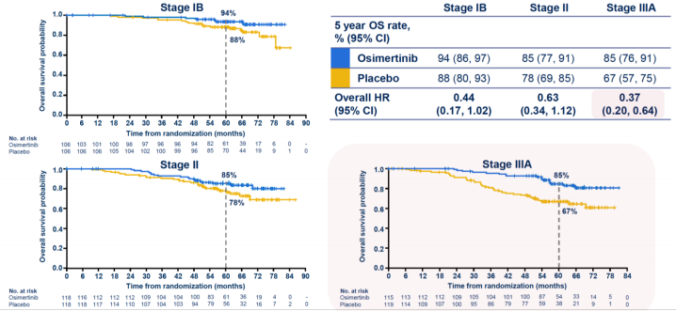
ADJUVANT Therapy in EGFRm NSCLC
OS benefit by stage
Herbstetal, ASCO 2023; Tsuboietal, NEJM 2023
Content of this presentation is copyright and responsibility of the author. Permission is required for re-use.
Dr. Laura Mezquita

Slide 17
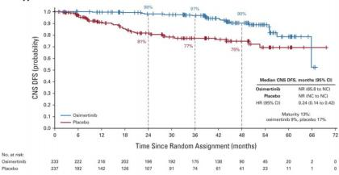
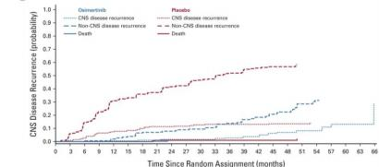
ADJUVANT Therapy in EGFRm NSCLC
Secondary endpoint – Improved CNS outcomes
Intracranial PD KEY ENDPOINT
CNS - DFS CNS - Recurrence
↓ CNS PD
Herbstetal,JCO 2023
Content of this presentation is copyright and responsibility of the author. Permission is required for re-use.
Dr. Laura Mezquita

Slide 18
ADJUVANT Therapy in EGFRm NSCLC
Adjuvant chemotherapy?
Adjuvantchemo (60%)
NO adjuvantchemo (40%)
DFS
Herbstetal, ASCO 2023; HerbstJCO 2023; Tsuboietal, NEJM 2023
Content of this presentation is copyright and responsibility of the author. Permission is required for re-use.
Dr. Laura Mezquita

Slide 19
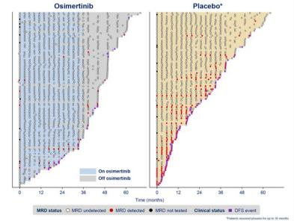
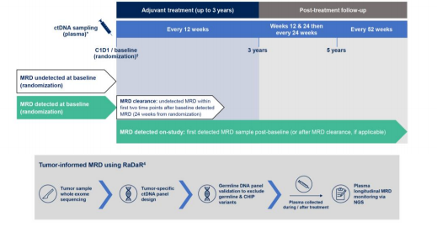
ADJUVANT Therapy in EGFRm NSCLC
MRD - Molecular residual disease
Exploratory endpoint – Feasibility of MRD – during/after adjuvantT
91% of patients
33 variants per panel
13% MRD+
49%
MRD+
John T, ASCO 2024
Content of this presentation is copyright and responsibility of the author. Permission is required for re-use.
Dr. Laura Mezquita

Slide 20
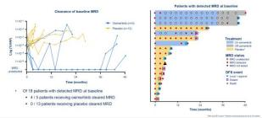
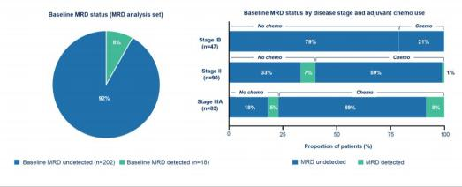
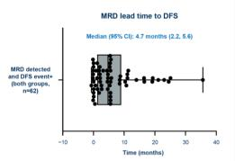
ADJUVANT Therapy in EGFRm NSCLC
MRD - Molecular residual disease
8%
detected
MRD
John T, ASCO 2024
Content of this presentation is copyright and responsibility of the author. Permission is required for re-use.
Dr. Laura Mezquita

Slide 21
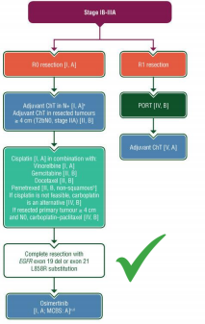
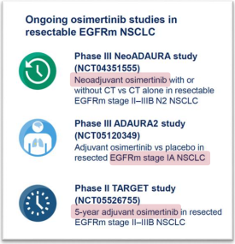
ADJUVANT Therapy in EGFRm NSCLC
Osimertinib x 3 years
Current SoC for patients with
NSCLC stage IB-IIIA after resection,
regardless of prior adjuvant
chemotherapy use
Benefit of adjuvantchemo – to be considered
Herbstetal, ASCO 2023; HerbstJCO 2023; Tsuboietal, NEJM 2023
Content of this presentation is copyright and responsibility of the author. Permission is required for re-use.
Dr. Laura Mezquita

Slide 22
NEOADJUVANT Therapy in EGFRm NSCLC
Osimertinib
N= 88 screened
71,1% ORR
- 11% MPR
- 4% pCR
LyuC, ELCC 2023
Content of this presentation is copyright and responsibility of the author. Permission is required for re-use.
Dr. Laura Mezquita

Slide 23
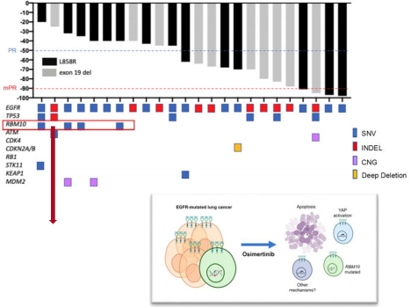
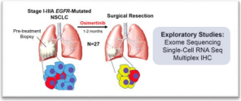
NEOADJUVANT Therapy in EGFRm NSCLC
Osimertinib
Median DFS = 32,4 mo (95% CI 25.9-NR)
N=27 Osimertinib 1-2 mo. | Primary endpoint: MPR (≈ 50%) Secondary: safety, ORR, PCR, DFS
48% ORR 0% pCR
Median time = 56 days
MPR = 15%
N= 24 completed surgery (R0)
N= 3 converted to CT-RT (1 PD)
RBM10 Loss-of-function mut.
identified in non-responders
AredoJV, ASCO 2023
Dr. Laura Mezquita
Content of this presentation is copyright and responsibility of the author. Permission is required for re-use.

Slide 24
Learning points
1. Current therapeutic strategy in oncogene-addicted earlier stage NSCLC
- Neo/Adjuvant therapy in EGFRm NSCLC
- Neo/Adjuvant therapy in ALK+ NSCLC
- Consolidation in EGFRmin NSCLC
2. Debates & open questions
- Patient/Treatment selection?
- Treatment at PD?
- Clinical development & biomarkers …
Dr. Laura Mezquita
Content of this presentation is copyright and responsibility of the author. Permission is required for re-use.

Slide 25
ADJUVANT Therapy in ALK+ NSCLC
Alectinib
Solomon BJ, ESMO 2023
Content of this presentation is copyright and responsibility of the author. Permission is required for re-use.
Dr. Laura Mezquita

Slide 26
ADJUVANT Therapy in ALK+ NSCLC
Alectinib – DFS primary endpoint
Solomon BJ, ESMO 2023
Content of this presentation is copyright and responsibility of the author. Permission is required for re-use.
Dr. Laura Mezquita

Slide 27
ADJUVANT Therapy in ALK+ NSCLC
Alectinib – DFS primary endpoint
Solomon BJ, ESMO 2023
Content of this presentation is copyright and responsibility of the author. Permission is required for re-use.
Dr. Laura Mezquita

Slide 28
ADJUVANT Therapy in ALK+ NSCLC
Alectinib – CNS disease
Intracranial PD KEY ENDPOINT
CNS protection?
Solomon BJ, ESMO 2023
Content of this presentation is copyright and responsibility of the author. Permission is required for re-use.
Dr. Laura Mezquita

Slide 29
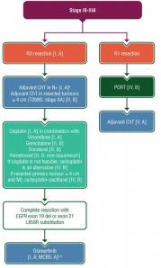
ADJUVANT Therapy in ALK+ NSCLC
Alectinibx 3 years
ALK+
ALECTINIB
Survival data not mature (!)
Improved DFS for patients
with NSCLC stage IB-IIIA
after resection, with no
prior adjuvantchemo
Perioperative?
Consolidation?
Herbstetal, ASCO 2023; HerbstJCO 2023; Tsuboietal, NEJM 2023
Content of this presentation is copyright and responsibility of the author. Permission is required for re-use.
Dr. Laura Mezquita

Slide 30
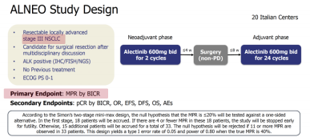
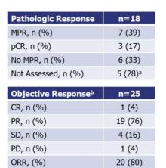
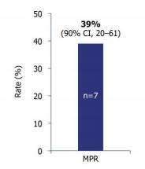
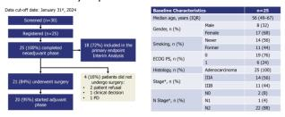
NEO/ADJUVANT Therapy in ALK+ NSCLC
Alectinib
N= 18 (86%) completed surgery (R0)
N= 4 no radical surgery
N= 20 received adjuvantalectinib
Leonetti A, WCLC 2024
Content of this presentation is copyright and responsibility of the author. Permission is required for re-use.
Dr. Laura Mezquita

Slide 31
NEO/ADJUVANT Therapy in NSCLC
Other driver alterations
^{LCMC} ^{Leader} ^{study,} ^{neoadjuvant} NAUTIKA study, perioperative
Lee JM, et al,JTO 2023
Content of this presentation is copyright and responsibility of the author. Permission is required for re-use.
Dr. Laura Mezquita

Slide 32
Learning points
1. Current therapeutic strategy in oncogene-addicted earlier stage NSCLC
- Neo/Adjuvant therapy in EGFRm NSCLC
- Neo/Adjuvant therapy in ALK+ NSCLC
- Consolidation in EGFRmin NSCLC
2. Debates & open questions
- Patient/Treatment selection?
- Treatment at PD?
- Clinical development & biomarkers …
Dr. Laura Mezquita
Content of this presentation is copyright and responsibility of the author. Permission is required for re-use.

Slide 33
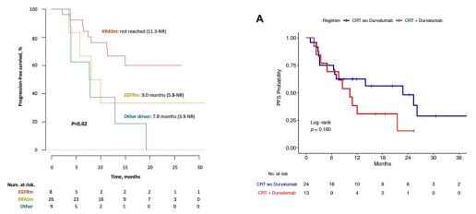
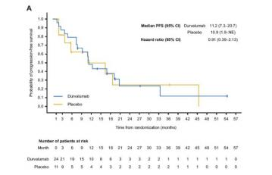
CONSOLIDATION Therapy in EGFRm NSCLC
PACIFIC mPFS = HR, 0.55; 95% CI, 0.45 to 0.68; median, 16.9 v 5.6 mo.)
Durvalumab after chemoradiation
CONSOLIDATION: NO benefit of durvalumab, with high frequency of irAEsin EGFRm population
Retrospective cohort, n=8 EGFRm
Retrospective cohort, n=37 EGFRm
PACIFIC Post Hoc analysis, n=35 EGFRm
durvalumab
durvalumab
durvalumab
mPFS = 9 mo.
mPFS = 10.3 mo.
mPFS = 11.2 mo.
Riudavets M, EJC 2022, AredoJV, JTO 2021 Naidoo, JTO 2023
Content of this presentation is copyright and responsibility of the author. Permission is required for re-use.
Dr. Laura Mezquita

Slide 34
CONSOLIDATION Therapy in EGFRm NSCLC
Osimertinib after chemoradiation
Ramalingam, ASCO 2024; LuS, NEJM 2024
Content of this presentation is copyright and responsibility of the author. Permission is required for re-use.
Dr. Laura Mezquita

Slide 35
CONSOLIDATION Therapy in EGFRm NSCLC
Osimertinib after chemoradiation
Ramalingam, ASCO 2024; LuS, NEJM 2024
Content of this presentation is copyright and responsibility of the author. Permission is required for re-use.
Dr. Laura Mezquita

Slide 36
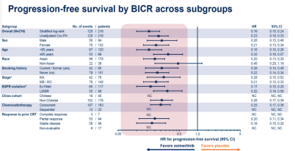
CONSOLIDATION Therapy in EGFRm NSCLC
Primary endpoint – PFS
Osimertinib – 38,9 mo
Placebo - 7,3 mo
Ramalingam, ASCO 2024; LuS, NEJM 2024
Content of this presentation is copyright and responsibility of the author. Permission is required for re-use.
Dr. Laura Mezquita

Slide 37
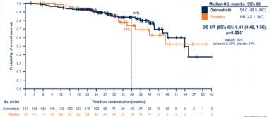
CONSOLIDATION Therapy in EGFRm NSCLC
Secondary endpoints – Response & OS
RESPONSE by BICR
OS not mature
ORR - 57% ORR - 33%
Placebo arm - 81% crossover to osimertinib Osimertinib arm - 28% osimertinib postPD
Ramalingam, ASCO 2024; LuS, NEJM 2024
Content of this presentation is copyright and responsibility of the author. Permission is required for re-use.
Dr. Laura Mezquita

Slide 38
CONSOLIDATION Therapy in EGFRm NSCLC
Recurrence
Intracranial PD
KEY FACTOR
Ramalingam, ASCO 2024; LuS, NEJM 2024
Content of this presentation is copyright and responsibility of the author. Permission is required for re-use.
Dr. Laura Mezquita

Slide 39
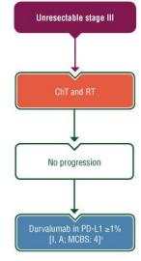
CONSOLIDATION Therapy in EGFRm NSCLC
Osimertinib after chemoradiation
Improved PFS in unresectable
stage III EGFRm NSCLC after
definitive chemoradiation
EGFRm
OSIMERTINIB
?
Survival data not mature (!)
Optimal treatment duration?
Ramalingam, ASCO 2024; LuS, NEJM 2024 Hendriks L et al, AnnOncol 2023
Content of this presentation is copyright and responsibility of the author. Permission is required for re-use.
Dr. Laura Mezquita

Slide 40
CONSOLIDATION Therapy in other populations
ALK, ROS1, RET and beyond
HORIZON 01 study design
Assessments
& tissue/blood
biomarkers
Paz-Ares , ELCC 2023
Content of this presentation is copyright and responsibility of the author. Permission is required for re-use.
Dr. Laura Mezquita

Slide 41
Learning points
1. Current therapeutic strategy in oncogene-addicted earlier stage NSCLC
- Neo/Adjuvant therapy in EGFRm NSCLC
- Neo/Adjuvant therapy in ALK+ NSCLC
- Consolidation in EGFRmin NSCLC
2. Debates & open questions
- Patient/Treatment selection?
- Treatment at PD?
- Clinical development & biomarkers …
Dr. Laura Mezquita
Content of this presentation is copyright and responsibility of the author. Permission is required for re-use.

Slide 42
OPEN QUESTIONS
Optimal treatment?
Treatment at PD?
Early stage
Neoadjuvant
Resection
?
Neoadjuvant
Resection
Adjuvant
Patient selection
Resection
Adjuvant
Therapeutic strategy?
EGFRm
ALK+
Other pop
CHEMORADIATION
Consolidation
Duration?
Long-term benefit?
Biomarkers?
Dr. Laura Mezquita
Content of this presentation is copyright and responsibility of the author. Permission is required for re-use.

Slide 43
Learning points
1. Current therapeutic strategy in oncogene-addicted earlier stage NSCLC
- Neo/Adjuvant therapy in EGFRm NSCLC
- Neo/Adjuvant therapy in ALK+ NSCLC
- Consolidation therapy in EGFRmin NSCLC
2. Debates & open questions
- Patient/Treatment selection?
- Treatment at PD?
- Clinical development & biomarkers …
Dr. Laura Mezquita
Content of this presentation is copyright and responsibility of the author. Permission is required for re-use.

Slide 44
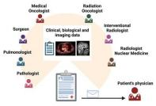
Patientselection in earlier stages
MULTIDISCIPLINARY Thoracic Tumor Board
TREATMENT STRATEGY
Medically operable?
Neoadjuvant
Resection
Adjuvant
Potentially resectable?
Biomarkers*
Staging (PET-CT, brain imaging)
Comorbidities PS
Chemoradiation
Consolidation
* PD-L1 & EGFR/ALK; other drivers also recommended – access to clinical trials
Modified from: https://www.ilcn.org/multidisciplinary-tumor-boards-six-eyes-see-more-than-two/
Content of this presentation is copyright and responsibility of the author. Permission is required for re-use.
Dr. Laura Mezquita

Slide 45
In resectable NSCLC: Optimal strategy?
Resection
TKI
NEOS
NEOADAURA?
Classical SoC
TKI
Chemo
Chemo
Adjuvant
Chemo?
TKI
Neoadjuvant
ADAURA
TKI
ALINA
Perioperatory
TKI
TKI
ALNEO
Dr. Laura Mezquita
Content of this presentation is copyright and responsibility of the author. Permission is required for re-use.

Slide 46
Optimal treatment strategy?
^{To} ^{date} … NEOADJUVANT ADJUVANT
Advantages
- ↑ Compliance
- ↑ ORR
- Safety profile favorable
Advantages
- Phase III evidence
- Significant DFS improvement
- OS benefit (ADAURA)
- No delay for curative surgery
Disadvantages
- Phase II evidence
- 16% - no surgery
- MPR lower than expected
- Required biopsy before surgery
Disadvantages
- Potentially less compliance?
- Magnitude of benefit depends onstage
- Prolonged exposure to TKI
- Lack of defined treatment period
Modified (adapted for ALK/EGFR po) from : MountziosG, et al, Nat Rev Clin Oncol 2023
Content of this presentation is copyright and responsibility of the author. Permission is required for re-use.
Dr. Laura Mezquita

Slide 47
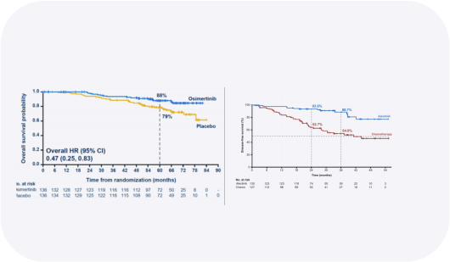
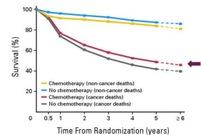
Is chemostill relevant in adjuvantsetting?
ADJUVANT SETTING
ADAURA, osimertinib ^{ALINA,alectinib}
Benefit regardless
adjuvantchemo
No adjuvantchemo (40%)
^{Adjuvant}?^{chemotherapy}
NEOADJUVANT SETTING
NEOADAURA,
Osimertinib
(ongoing)
No adjuvantchemo
Herbstetal, ASCO 2023; Tsuboietal, NEJM 2023, Solomon, ESMO 2023
Content of this presentation is copyright and responsibility of the author. Permission is required for re-use.
Dr. Laura Mezquita

Slide 48
Safety & tolerance?
Osimertinib
AURA, Adjuvant Osimertinib LAURA, Osimertinib consolidation
Herbstetal, ASCO 2023; Tsuboietal, NEJM 2023, Solomon, ESMO 2023; Ramalingam, ASCO 2024
Content of this presentation is copyright and responsibility of the author. Permission is required for re-use.
Dr. Laura Mezquita

Slide 49
Safety & tolerance?
Alectinib
ALINA, Adjuvantalectinib
2 years 4 months
Health QoL
Clinical improvements from baseline for
ALECTINIB vs. chemo across all health
domains except physical functioning
Solomon BJ, ESMO 2023; Nishio M, WCLC 2024
Content of this presentation is copyright and responsibility of the author. Permission is required for re-use.
Dr. Laura Mezquita

Slide 50
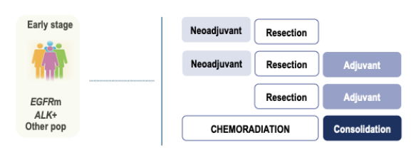
Optimal duration?
ALINA, 2 yrs
ADAURA, 3 yrs
5 yrs?
1-2 months
Long-term benefit?
Cost
CNS protection?
Toxicity
Improved DFS/PFS
Cons
Pros
Until PD????
Dr. Laura Mezquita
Content of this presentation is copyright and responsibility of the author. Permission is required for re-use.

Slide 51
Learning points
1. Current therapeutic strategy in oncogene-addicted earlier stage NSCLC
- Neo/Adjuvant therapy in EGFRm NSCLC
- Neo/Adjuvant therapy in ALK+ NSCLC
- Consolidation in EGFRmin NSCLC
2. Debates & open questions
- Patient/Treatment selection?
- Treatment at PD?
- Clinical development & biomarkers …
Dr. Laura Mezquita
Content of this presentation is copyright and responsibility of the author. Permission is required for re-use.

Slide 52
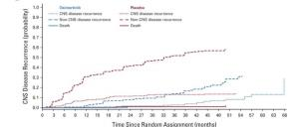
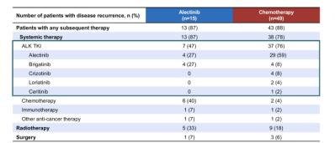
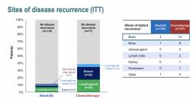
Subsequent treatment at PD?
Preliminary data
ADAURA, osimertinib
Sequential TKI
CNS - Recurrence
Mainly local
76%
↓ CNS PD
ALINA,alectinib
47%
Herbstetal, JCO 2023; Solomon BJ, ESMO 2023
Content of this presentation is copyright and responsibility of the author. Permission is required for re-use.
Dr. Laura Mezquita

Slide 53
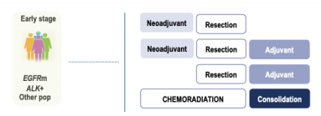
Subsequent treatment at PD?
Criteria for treatment
selection?
Advanced stage - UPFRONT
Rechallenge
RECURRENCE
Pattern of PD
Previous TKI
Disease free interval
Molecular resistance
TKI
TKI + chemotherapy
Other drugs
DFS PFS1 OS
More FU & long-term BENEFIT data
Content of this presentation is copyright and responsibility of the author. Permission is required for re-use.
Dr. Laura Mezquita

Slide 54
Learning points
1. Current therapeutic strategy in oncogene-addicted earlier stage NSCLC
- Neo/Adjuvant therapy in EGFRm NSCLC
- Neo/Adjuvant therapy in ALK+ NSCLC
- Consolidation in EGFRmin NSCLC
2. Debates & open questions
- Patient/Treatment selection?
- Treatment at PD?
- Clinical development & biomarkers …
Dr. Laura Mezquita
Content of this presentation is copyright and responsibility of the author. Permission is required for re-use.

Slide 55
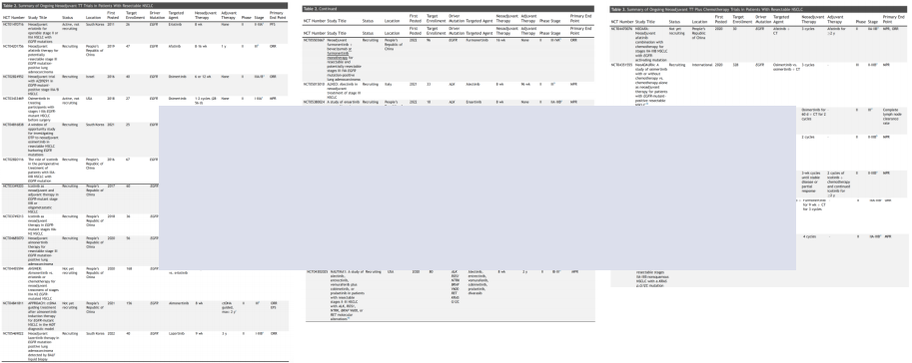
Clinical development: “Classical” approach
Targeted therapies Targeted therapies + chemo
Phase 2 single arm design:
- Small sample sizes
- Heterogeneous design (i.e., primary endpoint, N, stage, treatments, duration, etc.)
KEY CLINICAL QUESTIONS:
- Phase 3 studies for all these small pop?
- Approval will be based on which one?
Neo/Adjuvantstudies (ongoing)
Lee JM etal,JTO 2023
Content of this presentation is copyright and responsibility of the author. Permission is required for re-use.
Dr. Laura Mezquita

Slide 56
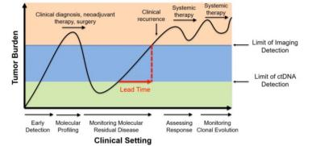
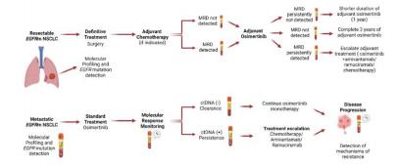
Biomarkers can guide decisions?
POTENTIAL APPLICATIONS:
Risk stratification
Response monitoring (detection of early PD)
Treatment decisions (adjuvant & consolidation)
- Escalation strategies
- De-escalation strategies
-
-
-
-
Molecular biomarkers:
TP53 mutation
Other co-occurring alt.
Blood-based biomarkers:
MRD detection
ctDNA detection & clearance
Vellanki PJ, et al. J Immuno Cancer 2023; Desai A et al, Cancer 2024; Marinello A, Cancer Treat Rev 2024
Content of this presentation is copyright and responsibility of the author. Permission is required for re-use.
Dr. Laura Mezquita

Slide 57
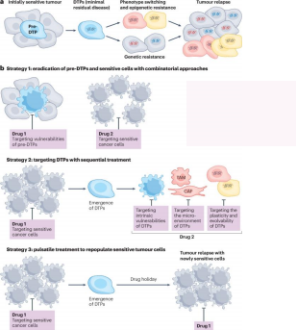
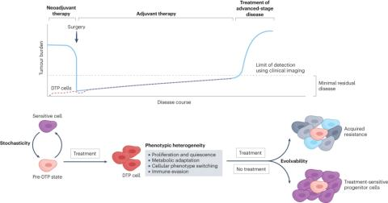
Understanding the resistance – for clinical development
Drug-Tolerant Persistent Cells (DTP)
Therapeutic
strategies for
DTPs
persistent cancer cell
Clinical trials ongoing – molecular mechanisms of DTP
Russo M, et al, Nat Rev Cancer 2024; PuY, Nat Rev Clin Oncol 2023
Content of this presentation is copyright and responsibility of the author. Permission is required for re-use.
Dr. Laura Mezquita

Slide 58
TAKE-HOME MESSAGES
Oncogene-driven earlier stage NSCLC
EGFRm: Osimertinib
- Adjuvant therapy after resection in stage IB-IIIA – OS/DFS benefit (SoC)
- Consolidation after definitive chemoradiation – DFS benefit
ALK+: Alectinib
- Adjuvant therapy after resection with no prior adjuvantchemo – DFS benefit
Neo/Adjuvant therapy: data emerging, ph 2/3 ongoing
Beyond EGFRm/ALK+: under investigation
Open questions: patientselection, optimal treatment?, duration (!), treatment at PD?
Future: Clinical trials - new designs, involving biomarkers (i.e., MRD, ctDNA, DTP...) & their applications
Dr. Laura Mezquita
Content of this presentation is copyright and responsibility of the author. Permission is required for re-use.

Slide 59
¡MUCHAS GRACIAS!
lmezquita@clinic.cat
@LauraMezquitaMD
European Society for Medical Oncology (ESMO)
Via Ginevra 4, CH-6900 Lugano
T. +41 (0)91 973 19 00
esmo@esmo.org
esmo.org

