Slide 1
Operation notes - immune checkpoint
inhibitors and perioperative treatment of gastroesophageal adenocarcinoma
LBA 73 (MATTERHORN) & LBA 74 (KEYNOTE 585)
Elizabeth C Smyth MD FRCP
Oxford, United Kingdom
October 19th 2023

Slide 2
DECLARATION OF INTERESTS
Elizabeth Smyth MD
Personal financial interests since 2017 (lecture honoraria, advisory boards, travel support)
Amal Therapeutics, Aptitude Health, Amgen, Astellas, Astra Zeneca, Beigene, BMS, Celgene, Daiichi Sankyo, Elsevier, Everest Clinical Research, First Word Group, Five Prime Therapeutics, Gritstone Oncology, Imedex, Merck, My Personal Therapeutics, Novartis, Pfizer, Roche, Sai-Med, Servier, Touch Oncology, Turning Point Therapeutics, Viracta, Zymeworks
Leadership Roles
EORTC GI Clinical Trials Group Gastric Task Force co-Lead
ESMO GI Faculty (2017 – current)
UK & Ireland Oesophagogastric Cancer Group Trustee
Elizabeth Smyth MD
Content of this presentation is copyright and responsibility of the author. Permission is required for re-use.

Slide 3
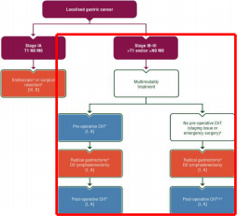
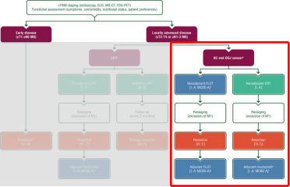
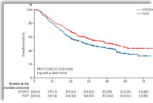
Operable gastroesophageal cancer - European approach
ESMO Guidelines 2022
FLOT-4 trial
mDFS 30 months mOS 50 months
<50% cure rate
Gastric cancer >T2N0
Perioperative chemotherapy
recommended > adjuvant
chemotherapy
Gastroesophageal junction adenocarcinoma (≥T2/N1)
Perioperative chemotherapy or neoadjuvant chemoradiotherapy
Introducing targeted therapy in
the perioperative space has
been a challenge
- no HER2/VEGFR2
Elizabeth Smyth MD
Lordick et al, Annals Oncol 2022 Obermannova et al, Annals Oncol 2022 Al Batran et al, Lancet 2019

Slide 4
Operable gastroesophageal cancer - East Asian approach
Japanese GC guidelines 2021 Korean GC Guidelines 2021
Neoadjuvant chemo only for bulky lymph nodes
Neoadjuvant chemo conditional, consider for cT4
Elizabeth Smyth MD JGCA, Gastric Cancer, 2022
Kim et al, J Gastric Cancer 2022

Slide 5
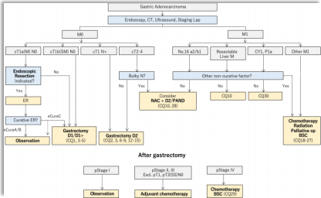
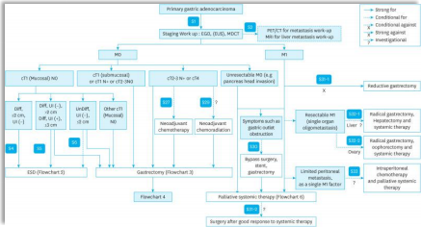
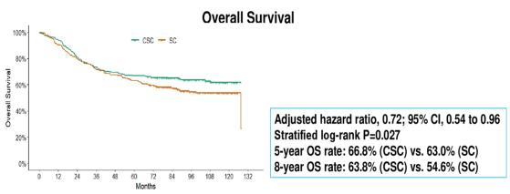
Operable gastroesophageal cancer - East Asian approach
Japanese GC guidelines 2021 Korean GC Guidelines 2021
PRODIGY trial
Neoaduvant D-Ox-S1
Excellent OS high risk Asian patients
(T3N2+/T4)
Neoadjuvant chemo only for bulky lymph nodes
Neoadjuvant chemo conditional, consider for cT4
Elizabeth Smyth MD
Kang et al, ASCO 2023

Slide 6
ICI for advanced gastroesophageal adenocarcinoma
Global practice defining clinical trials in 1L advanced GEA
 | CHECKMATE-649 | RATIONALE-305 | KEYNOTE 859
Anti-PD-1 | Nivolumab | Tislelizumab | Pembrolizumab
Chemotherapy | Oxaliplatin + 5FU | Oxaliplatin + 5FU | Oxali or cis + 5FU
Gastric:GEJ | 70:30 | 81:19 | 78:22
PD-L1 endpoints | CPS ≥5 28.8 | TAP ≥5 SP263 | CPS ≥ 1 & ≥10 223C
% PD-L1 CPS ≥5 or 10 | 60% | ~55% | 35% (*gastric)
OS | All HR 0.80 CPS ≥ 1 HR 0.77 CPS ≥ 5 HR 0.71 CPS ≥ 10 HR 0.66 | TAP ≥ 5 HR 0.74 | All HR 0.78 CPS ≥ 1 HR 0.73 CPS ≥ 10 HR 0.64
Consistent benefit anti-PD-1 plus chemotherapy at higher levels of PD-L1 expression
Janjigian et al, Lancet. 2021 Sun et al, Lancet. 2021 Moehler et al, ASCO GI 2023 Rha et al, ASCO 2023
Elizabeth Smyth MD

Slide 7
Perioperative treatment inoperable GEA
Goals of therapy
1. Shrink the tumour – (downstaging for R0 resection, measured by pathological response)
2. Ensure surgery is not compromised by treatment toxicity (surgery is the definitive treatment)
3. Eliminate micrometastases (long term survival dependent on this, measured by EFS/OS)

Slide 8
KEYNOTE 585 & MATTERHORN
Study design
 | KEYNOTE 585 | MATTERHORN
Trial design Sample size | Global Phase III RCT Placebo controlled n= 1007 | Global Phase III RCT Placebo controlled N=948
Chemotherapy | Cisplatin/5FU or cape (80%) FLOT (20%) | FLOT 100%
Immune checkpoint inhibitor | Pembrolizumab (anti-PD- 1) with chemo +33 weeks adjuvant | Durvalumab (anti-PD-L1) with chemo + 10 months adjuvant
Region | Global 38% Asian entire cohort | Global 19% Asian
Primary endpoint | pathCR rate per BICR (Mandard), EFS per investigator, OS (main cohort), safety (FLOT) Complex statistical approach | EFS Key secondary endpoint pCR (modified Ryan) Simple statistical approach
Majority of patients in KEYNOTE 585 not treated with triplet Different methodologies for pCR & statistical approaches

Slide 9
Neoadjuvantchemoimmunotherapy and surgery rates
Surgery is the definitive treatment for operable gastroesophageal adenocarcinoma
 |  | KEYNOTE 585 |  | MATTERHORN
 |  | All chemo | All chemo- pembro | FLOT | FLOT-durva
Curative intent surgery (%) | 83% |  | 85% | 85% | 87%
Reasons for not attempting curative intent surgery
KEYNOTE 585 – progression 4 % (↓ with FLOT), unresectable at surgery 3.3%, remainder AE/other MATTERHORN – progression 3-5% unresectable at surgery 4-5%, remainder AE/other
Elizabeth Smyth MD
Content of this presentation is copyright and responsibility of the author. Permission is required for re-use.

Slide 10
Neoadjuvantchemoimmunotherapy and surgery rates
Surgery is the definitive treatment for operable gastroesophageal adenocarcinoma
 | KEYNOTE 585 |  | MATTERHORN |  | FLOT4 | DANTE
Curative intent surgery (%) | All chemo 83% | All chemo- pembro 85% | FLOT 85% | FLOT- durva 87% | FLOT 94% | FLOT 96% | FLOT- atezo 97%
R0 resection
ITT | 75% 80% |  | 76% 77% |  | 85% | 91% 93%
Curatively operated patients | 91% 93% |  | 90% 89% |  | 90% | 96% 96%
→Adding PD-(L)1 to neoadjuvant chemotherapy does not impact on ability to have surgery
… bu ….rates of curative intent surgery lower in both control and experimental arms than in previous studies
…..↓ sample size in which to show a benefit (operated patients with R0 resection), ↓ power ↑false negative rate
For operated patients, R0 surgery was comparable to historical control
Elizabeth Smyth MD
Al Batran et al, Lancet 2019

Slide 11
KEYNOTE 585 and MATTERHORN
Impact of pre-treatment stage on outcomes
 | KEYNOTE 585 | MATTERHORN
Stage | Stage III/Iva 79% At least T3N2 or T4any | 24% T4 70% N+ve
Laparoscopy Not mandated |  | Not mandated

Slide 12
KEYNOTE 585 and MATTERHORN
Impact of pre-treatment stage
 | KEYNOTE 585 | MATTERHORN | FLOT-4 | DANTE
Stage | Stage III/Iva 79% | 24% T4 | 9% T4 | 8% T4
 | At least T3N2 or T4any | 70% N+ve | 80% N+ve | 78% N+ve
Laparoscopy Not mandated |  | Not mandated | Recommended (done in 39%) | Mandated T3/4 or diffuse
KEYNOTE 585 and MATTERHORN enrolled patients with very locally advanced cancers
More difficult to downstage to attempt surgical resection
More difficult to achieve a pCR in a bulky tumour with chemotherapy
Larger, more advanced tumours are more immune evasive
Al Batran et al, Lancet 2019 Manji et al, AACR 2022 Pietrantonnio et al, ASCO GI 2023

Slide 13
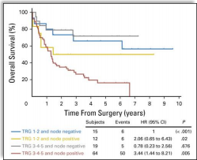
The relationship between pCR and long-term survival
Pathological response in primary tumour and lymph nodes
pCR in primary tumour following neoadjuvant chemotherapy is associated with better OS
Even in primary pCR, if nodes remain positive, OS is worse than a non-responding primary with negative nodes
Elizabeth Smyth MD
Smyth, Valeri et al, J Clin Oncol 2016

Slide 14
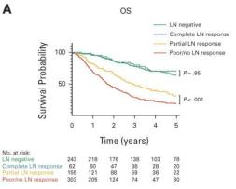
pCR – it’s not just the primary that matters
Degree of response in lymph nodes differentiates survival
Also within lymph nodes, degree of response to chemotherapy is predictive
Negative nodes post chemotherapy = survival to non-involved nodes Partial response in lymph nodes > survival than no response
Elizabeth Smyth MD Smyth, Valerietal, J Clin Oncol 2016
Liu et al, JCRCO 2023

Slide 15
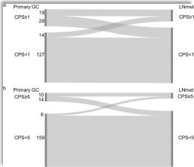
pCR – it’s not just the primary that matters
Degree of response in lymph nodes differentiates survival
Also within lymph nodes, degree of response to chemotherapy is predictive
Negative nodes post chemotherapy = survival to non-involved nodes Partial response in lymph nodes > survival than no response
Lymph nodes can be discordant with
primary in biomarkerstatus
~27% discordant in PD-L1 expression …
Elizabeth Smyth MD
Smyth, Valeri et al, J Clin Oncol 2016 Liu et al, JCRCO 2023

Slide 16
KEYNOTE 585 & MATTERHORN
Does addition of immune checkpoint inhibitors improve downstaging and pCR?
 | KEYNOTE 585 |  | MATTERHORN
pCR | FP or FLOT chemo 2.4% | Chemo-pembro 13.0% |  | FLOT FLOT-durva 7 % 19%
 | Δ10.6% (7.4- 14.0) |  |  | ∆12% OR : 3.08 (2.03–4.67) p<0.00001
Downstaging | Not reported |  | T0 (%) | 23% 45%
 |  |  | N (%) | 36% 52%
Mandard et al, Cancer, 1994 Ryan et al, Histopathology 2005

Slide 17
KEYNOTE 585 & MATTERHORN
Does addition of immune checkpoint inhibitors improve pCR?
 | KEYNOTE 585 |  | MATTERHORN
pCR | FP or FLOT chemo 2.4% | Chemo-pembro 13.0% | FLOT 7 % | FLOT-durva 19%
 | Δ10.6% (7.4- 14.0) |  | OR : 3.08 | ∆12% (2.03–4.67) p<0.00001
Mandard TRG
1. Complete regression
2. Fibrosis with scattered tumour cells
3. Fibrosis and tumour cells, more fibrosis 4. Fibrosis and tumour, more tumor cells 5. No regression
Modified Ryan criteria
0. No viable cancer cells (complete response)
1. Single cells or rare small groups of cancer cells 2. Residual cancer with evident tumour regression 3. Extensive residual cancer poor or no response
Mandard et al, Cancer, 1994 Ryan et al, Histopathology 2005

Slide 18
KEYNOTE 585 & MATTERHORN
Does addition of immune checkpoint inhibitors improve pCR?
 | KEYNOTE 585 |  | MATTERHORN
pCR | FP or FLOT chemo 2.4% | Chemo-pembro 13.0% | FLOT 7 % | FLOT-durva 19%
 | Δ10.6% (7.4- 14.0) |  | OR : 3.08 | ∆12% (2.03–4.67) p<0.00001
Mandard et al, Cancer, 1994 Ryan et al, Histopathology 2005

Slide 19
KEYNOTE 585 & MATTERHORN
Control arm pCR rate less than historical clinical trials
Platinum-5FU taxane (FLOT) AIO trials
MATTERHORN
FLOT-4 FLOT
DANTE FLOT
RAMSES FLOT
pCR 7% 15% 15% 15%
Platinum-5FU |  |  |  | Platinum-5FU (+epirubicin)
 | KN585 | RESOLVE | Yuan et al | ST03 | FLOT-4
 | Cis-FU | S1-Ox | S1- Ox/CapeOx | ECX | ECX
pCR | 2% | 5.5% | 7% | 8% | 7%
Al Batran et al, Lancet, 2019
Goetze et al, IntJ Cancer, 2023 Lorenzen et al, J Clin Oncol, in press Zhang et al, Lancet Oncol, 2021 Yuan et al, ASCO 2023
Cunningham et al, Lancet Oncol 2017 Al Batran et al, Lancet, 2019

Slide 20
MATTERHORN
How do these chemotherapy pCR rates compare to historical trials?
 | Platinum-5FU taxane (FLOT) AIO trials |  |  |  | Platinum-5FU taxane Outside Germany
MATTERHORN | FLOT-4 FLOT | DANTE FLOT | RAMSES FLOT | UK cohort FLOT | International Anastomosis Audit FLOT | Italian collaborative FLOT | PRODIGY D-Ox-S1
pCR 7% | 15% | 15% | 15% | 9.5% | 10% | 7.3% | 10.4%
Al Batran et al, Lancet, 2019
Goetze et al, IntJ Cancer, 2023 Lorenzen et al, J Clin Oncol, in press Moore et al, EJC, 2022
Kamarajah et al, Annal Surg, 2022 Giomonni et al, BMC Cancer, 2021 Zhang et al, Lancet Oncol, 2021

Slide 21
MATTERHORN
Do Germans do FLOT better?
 | Platinum-5FU taxane (FLOT) AIO trials |  |  |  | Platinum-5FU taxane Outside Germany
MATTERHORN | FLOT-4 FLOT | DANTE FLOT | RAMSES FLOT | UK cohort FLOT | International Anastomosis Audit FLOT | PRODIGY D-Ox-S1 | Italian collaborative FLOT
pCR 7% | 15% | 15% | 15% | 9.5% | 10% | 10.4% | 7.3%
AIO vs ROW
Pre-operative staging Stages included
Dose intensity

Slide 22
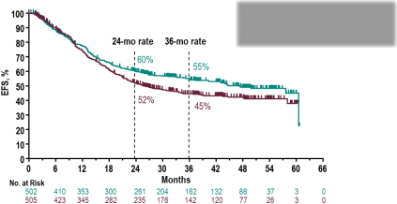
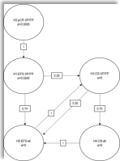
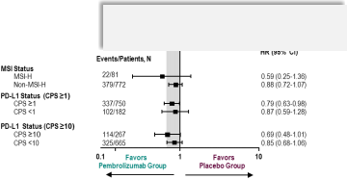
KEYNOTE 585 event free survival
Improved pCR fails to translate into better EFS for most patients
Statistical failure
α loss & multiplicity
Median
45.8m vs HR 0.81 (95%
EFS
.7m
0.68-0.97)
25 CI,
Chemo+PD- 1 ↑↑EFS in PD-L1 CPS
≥ 10 patients
20 month ↑ in EFS could be clinically meaningful
But … .
1) Comparing to inferior baseline than standard of care 2) Driven by PD-L1 positive/high subgroup
3) Has a “head-start” because of 9 months extra adjuvant treatment
Elizabeth Smyth MD
Content of this presentation is copyright and responsibility of the author. Permission is required for re-use.

Slide 23
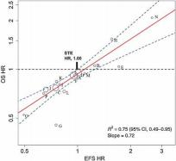
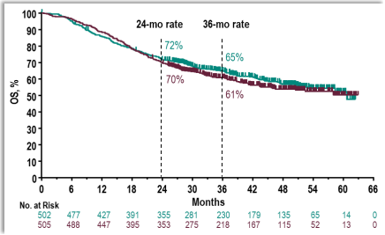
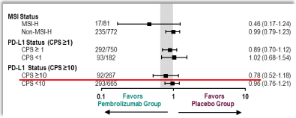
KEYNOTE 585 overall survival
No overall survival benefit for adding pembrolizumab to perioperative chemotherapy
Usually, fair agreement
EFS vs OS in 16 UGI RCTs
r²=0.76
These were chemo trials
Unlikely any benefit in MSS, CPS <10
No increase in cure for most patients
Elizabeth Smyth MD Wainbergetal, CCR, 2023

Slide 24
The relationship between pCR and long term survival
Chemotherapy vschemo-immunotherapy
Last practice changing perioperative trial FLOT-4 : FLOT vs ECX
↑ pCR 2.5x (6 vs 15%)
↑ DFS 25%
↑ OS 23%
KEYNOTE 585 al- comers (vs CPS ≥10)
↑ pCR 5x (CPS ≥10 not reported)
↑ EFS 19% (CPS ≥10 31%)
↑ OS 7% (CPS ≥10 22%)
Cytoxics
↑pCR = ↑ % of cancer cells killed ↓micrometastatic disease ↑ cure
Immune checkpoint inhibitors
↑ % of cancer cells killed
and vaccinates against the tumour
mostly in patients with immunologically hot tumours
Disparity in pCR vs EFS/OS may be due to organ specific immune responses and increasing immune evasion with tumour progression
Elizabeth Smyth MD
Content of this presentation is copyright and responsibility of the author. Permission is required for re-use.

Slide 25
A final comment on adjuvant chemotherapy
All chemotherapy is important
 | KEYNOTE 585 | MATTERHORN
Started adjuvant chemo | 75% | 73%
Completed adjuvant chemo 48% |  | 63%
Elizabeth Smyth MD
Content of this presentation is copyright and responsibility of the author. Permission is required for re-use.

Slide 26
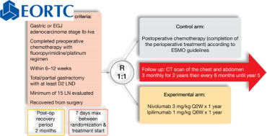
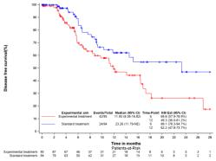
A final comment on adjuvant chemotherapy
Total dose intensity matters
 | KEYNOTE 585 | MATTERHORN
Started adjuvant chemo | 75% | 73%
Completed adjuvant chemo 48% |  | 63%
Chemotherapy
23.26
(11.79 - NE)
Nivo/Ipi
11.93
(8.36- 16.82)
Median
DFS(m) (95% CI)
Post operative chemotherapy
made a meaningful difference
even in poor responding patients
VESTIGE TRIAL
Elizabeth Smyth MD
Smyth et al, World GI 2023

Slide 27
Perioperative chemo-immunotherapy inoperable GEA
Do KEYNOTE 585 and MATTERHORN meet the goal for successful neoadjuvant therapy?
1. Shrink the tumour (downstaging for R0 resection)
YES, unequivocal improvements in pCR rate for both trials
Control arm pCR underperformed in both studies (advanced tumours)
2. Ensure surgery is not compromised to treatment toxicity
YES, equal rates of resection in control and experimental arms
but…toxicity is not trivial (KN 585 11% Grade 3-4 AEs experimental arm)
3. Eliminate micrometastases & develop/re-invigorate T-cell response against tumour MAYBE, but probably only for immunologically hot tumours

Slide 28
Neoadjuvantchemoimmunotherapy in GEA
What’snext?
. No changes to current clinical practice.
. Is there hope for a positive result for MATTERHORN?
. Statistically sounder, less wasted α
. Better chemotherapy partner (oxali vs cisplatin)
. More adjuvant chemotherapy
. If MATTERHORN is negative, next steps are biomarker selected trials & total neoadjuvant therapy
. Keep bringing promising drugs early into perioperative therapy to cure more patients
Elizabeth Smyth MD Content of this presentation is copyright and responsibility of the author. Permission is required for re-use.

Slide 29
Thank you all for your attention.
Join us at ESMO GI in Munich June 26 -29 2024!
elizabeth.smyth2@nhs.net
@lizzysmyth1
European Society for Medical Oncology (ESMO)
Via Ginevra 4, CH-6900 Lugano
T. +41 (0)91 973 19 00
esmo@esmo.org
esmo.org

