Slide 1
Colorectal Cancer
Optimal sequencing of therapeutic strategies in molecularly-driven CRC
ESMO Congress 2024
Barcelona, 13th Sep 2024
Lukas Weiss, MD PhD
IIIrd Medical Department
Paracelsus Medical University Salzburg, Austria
CCCIT
L工MCR
R S a c h
S七 i七 七
K 乙 E T

Slide 2
Declaration of Interests
Lukas Weiss
Employment:
University Hospital Salzburg, Austria.
Leadership:
Head of Colorectal Cancer Branch, Austrian Breast and Colorectal Cancer Study Group (ABCSG)
Honoraria:
Amgen, Astellas, AstraZeneca, BMS, Daiichi-Sankyo, Merck, MSD, Novocure, Pierre Fabre, Servier, Takeda
Consulting or Advisory Role:
Amgen, Astellas, BMS, GSK, Incyte, Lilly, Merck, MSD, Novocure, Pharmamar, Pierre Fabre, Roche
Speakers' Bureau:
none
Research Funding:
Novocure, Roche, Servier
Patents, Royalties, Other Intellectual Property:
none
Travel, Accommodations, Expenses:
AstraZeneca, Daiichi-Sankyo, Janssen, Merck, Pierre Fabre, Roche, Servier
*time period: Sep 2021 bis Sep 2024
RICCCIT I LI MCR

Slide 3
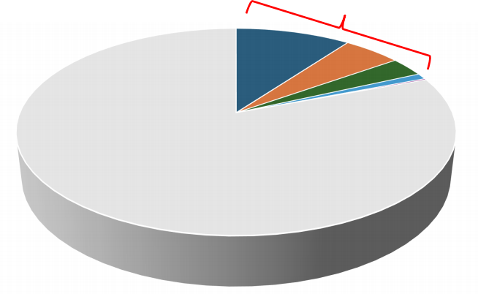
Overview
20%
10% BRAF V600E mutation¹
3-5% HER 2 overexpression/amplification²
2-3% KRAS G12C mutation³
0.9% NTRK Fusion⁴
0.2% RET Fusion⁵
1. De Roock W et al. Lancet Oncol. 2010 Aug;11(8):753-62.
2. BertottiA, et al. Cancer Discov. 2011 Nov;1(6):508-23.
3. Chida K et al. Oncologist. 2021 Oct;26(10):845-853.
4. Okamura R et al. JCO Precis Oncol. 2018:2018:PO.18.00183.
5. Le RolleAF et al. Oncotarget. 2015 Oct 6;6(30):28929-37.
RICCCIT I LI MCR

Slide 4
BRAF^{V600E}mt mCRC
RICCCIT I LI MCR

Slide 5
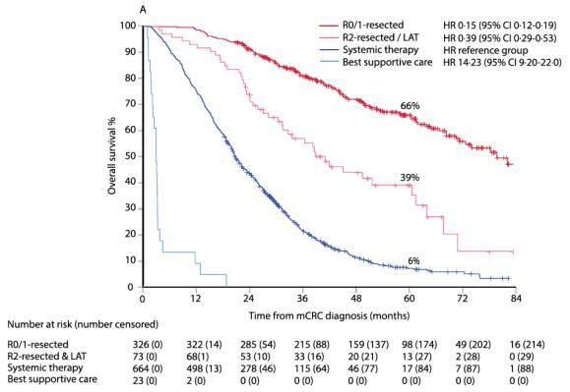
Resectability & Outcome
RAXO - prospective Finnish nationwide study N=1,086
Resectability?
- upfront
- 2x during 1L
resection and/or Local Ablative Therapy (LAT) (including RFA & SBRT)
Total Resectability Rate: 41%
Overall Survival
Osterlund P et al., Lancet Reg Health Eur. 2021 Jan 29;3:100049.
RICCCIT I LI MCR

Slide 6
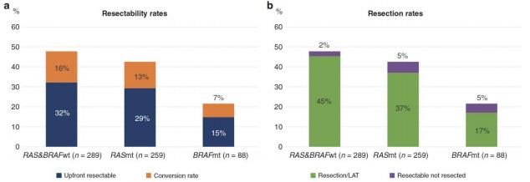
Pattern of Metastasization
RAXO registry
by RAS & BRAF mutational status
Uutela A et al., Br J Cancer 2022 Sep;127(4):686-694.
RICCCIT I LI MCR

Slide 7
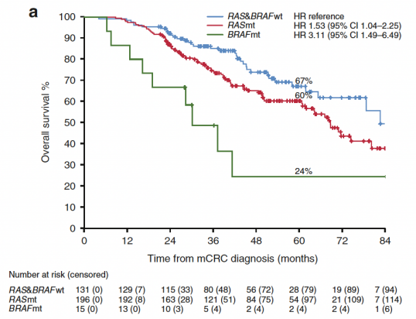
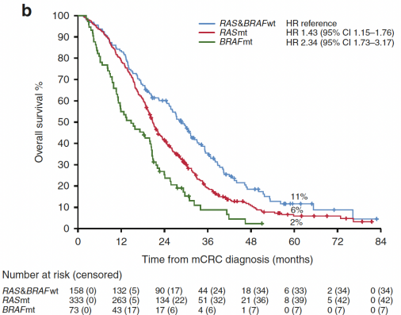
Resectability & Outcome by Subtype
OS with local therapy OS without local therapy
 | BRAFmt median OS: 15 months 5-year OS: 2%
BRAFmt median OS: 30 months 5-year OS: 24%
Uutela A et al., Br J Cancer 2022 Sep;127(4):686-694.
RICCCIT I LI MCR

Slide 8
CAIRO5 Trial - Design
Phase 3 RCT
1 ° endpoint: Progression Free Survival
2 ° endpoints: Overall survival Overall response rate R0/R1 resection rate Postoperative morbidity
Colorectal Cancer, stage IV
Liver Limited Disease
initially unresectable (defined by panel evaluation)
RAS mutant or BRAF mutant
and/or right-sided primary tumor
N=294
Chemotherapy Triplet (FOLFOXIRI)
& Bevacizumab
Chemotherapy Doublet (FOLFOX or FOLFIR) & Bevacizumab
_{R} ^{1:1}
NCT02162563
RICCCIT I LI MCR

Slide 9
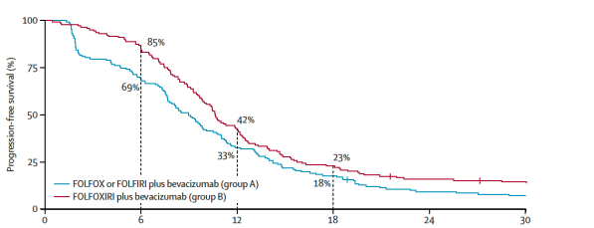
CAIRO5 Trial - Outcome
HR 0.76 (95% CI 0.60-0.98), p=0.032
median PFS: 9.0 vs 10.6 months
BRAF^{V600E} mutated: 7-8%
*All liver metastases treated with an R0–1 resection or ablation, or both.
Bond MJG et al. Lancet Oncol. 2023 Jul;24(7):757-771.
RICCCIT I LI MCR

Slide 10
1L mCRC - Triplet vs Doublet
Individual Patient Data Meta-Analysis
Experimental | Triplet | FOLFOXIRI & Bevacizumab
Control | Doublet | FOLFOX or FOLFIRI & Bevacizumab
Cremolini C et al. J Clin Oncol. 2020 Aug 20;JCO2001225
RICCCIT I LI MCR

Slide 11
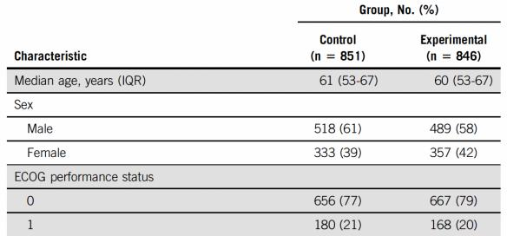
1L mCRC - Triplet vs Doublet
Triplet FOLFOXIRI & Bevacizumab
Doublet FOLFOX or FOLFIRI & Bevacizumab
Cremolini C et al. J Clin Oncol. 2020 Aug 20;JCO2001225
RICCCIT I LI MCR

Slide 12
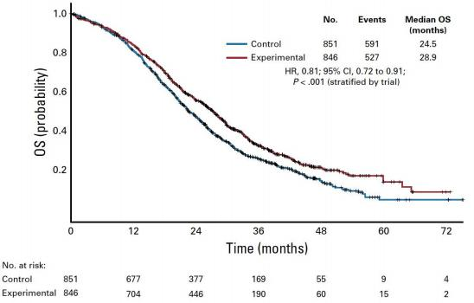
1L mCRC - Triplet vs Doublet
ITT
FOLFOXIRI & Bevacizumab
FOLFOX or FOLFIRI & Bevacizumab
No added benefit for Triplet in BRAFmt mCRC
Cremolini C et al. J Clin Oncol. 2020 Aug 20;JCO2001225
RICCCIT I LI MCR

Slide 13
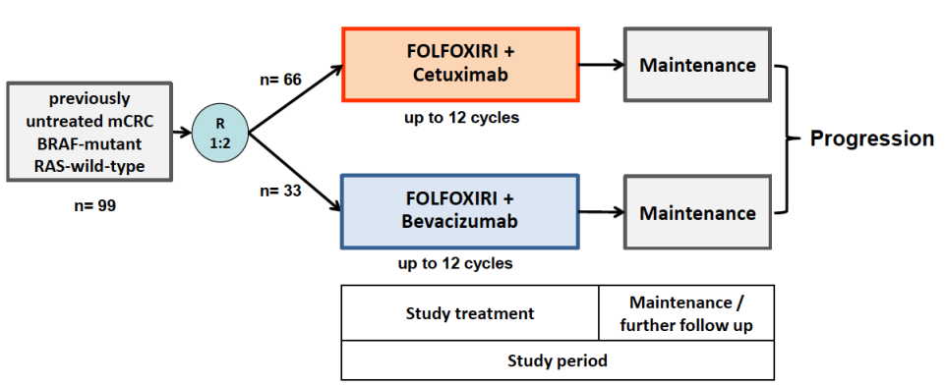
FIRE 4.5 – Study Design
Randomized Phase 2 Trial
1L mCRC BRAF^{V600E} mutant
Stintzing S et al., ASCO 2021 and J Clin Oncol 2023
RICCCIT I LI MCR

Slide 14
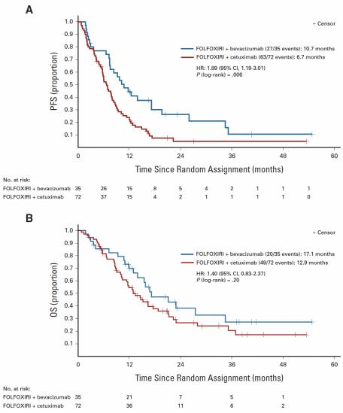
FIRE 4.5 - Outcome
 | Cetuximab Arm N=72 | Bevacizumab Arm N=35
ORR (per BICR) | 41.7% | 57.1%
CR | 4.2% | 5.7%
PR | 37.5% | 51.4%
SD | 26.4% | 20.0%
DCR | 68.1% | 77.1%
median PFS | 6.7 months | 10.7 months
median OS | 12.9 months | 17.1 months
Stintzing S et al. J Clin Oncol. 2023 Sep 1;41(25):4143-4153.
RICCCIT I LI MCR

Slide 15
BEACON– Study Design
Phase 3 RCT
mCRC, BRAF V600E mutated ≥1L prior lines of therapy
1。end point
- OS & ORR (per BICR)
Encorafenib
Binimetinib
Cetuximab
Encorafenib
Cetuximab
FOLFIRI OR Irinotecan
Cetuximab
1:1:1
R
Kopetz S et al. N Engl J Med. 2019 Oct 24;381(17):1632-1643.
RICCCIT I LI MCR

Slide 16
BEACON– Outcome
OS
 | Enco/Bini/Cetux N=224 | Enco/Cetux N=220 | Chemo N=221
ORR (per BICR) | 27% | 20% | 2%
CR | 4% | 3% | 0%
PR | 23% | 16% | 2%
SD | 48% | 56% | 29%
median PFS | 4.5 months | 4.3 months | 1.5 months
median OS | 9.3 months | 9.3 months | 5.9 months
Tabernero J et al.,J Clin Oncol 2021; 39:273-84
RICCCIT I LI MCR

Slide 17
BREAKWATER – Study Design
Phase 3 RCT
mCRC, BRAF V600E mutated Treatment Naïve
1。end point
- PFS (per BICR)
Encorafenib
Cetuximab
Encorafenib
Cetuximab
mFOLFOX6
mFOLFOX6 OR FOLFOXIRI OR CAPOX +/- Bevacizumab
1:1:1
R
Tabernero J et al. ESMO 2022
RICCCIT I LI MCR

Slide 18
BREAKWATER – Safety Lead In
mCRC, BRAF V600E mutated 1L or 2L setting
1。end point
- Safety
2。end points
- PK
- Antitumor Activity
Cohort 1 N=30 | Encorafenib Cetuximab FOLFIRI
Cohort 2 N=27
Encorafenib
Cetuximab mFOLFOX6
• Safety: generally tolerable
• PK: encorafenib decreased irinotecan by 25%
• Encorafenib/Cetuximab/mFOLFOX6 chosen for Phase 3
Tabernero J et al. ESMO 2022
RICCCIT I LI MCR

Slide 19
Take Home Messages – BRAF^{V600E}mt mCRC
• aggressive subtype, frequent peritoneal metastases (nevertheless: assess resectability)
• 1L SoC:
• Doublet Chemotherapy & Bevacizumab
• (Triplet Chemotherapy & Bevacizumab with goal of 2nd ary resectability)
• 2L SoC: Encorafenib & Cetuximab (EMA approval)
• MSI & BRAF^{V600E}mt: Immunotherapy before BRAFinhibition or Chemotherapy
RICCCIT I LI MCR

Slide 20
HER2+ mCRC
RICCCIT I LI MCR

Slide 21
MOUNTAINEER - Study Design
Open Label, Phase 2
CRC stage IV
HER2+ AND RAS wildtype Chemotherapy refractory
No prior anti-HER2 therapy
Trastuzumab – anti-HER2 antibody Tucatinib – HER2 inhibitor (TKI)
1。end point
- ORR (BICR)
Cohort A
^{N=45} Tucatinib PO 300mg BID Cohort B
& Trastuzumab IV Q3W N=41
Expansion
R
Cohort C N=31
Tucatinib PO 300mg BID & Trastuzumab IV Q3W
Tucatinib PO 300mg BID
Strickler JH et al. Lancet Oncol. 2023 May;24(5):496-508. PMID: 37142372
RICCCIT I LI MCR

Slide 22
MOUNTAINEER - Study Design
Open Label, Phase 2
CRC stage IV
HER2+ AND RAS wildtype Chemotherapy refractory
No prior anti-HER2 therapy
Trastuzumab – anti-HER2 antibody
Tucatinib – HER2 inhibitor (TKI)
1。end point
- ORR (BICR)
Cohort A N=45 | Tucatinib PO 300mg BID & Trastuzumab IV Q3W
Cohort B
N=41 | Tucatinib PO 300mg BID & Trastuzumab IV Q3W
Expansion
R
Cohort C N=31
Tucatinib PO 300mg BID
Strickler JH et al. Lancet Oncol. 2023 May;24(5):496-508. PMID: 37142372
RICCCIT I LI MCR

Slide 23
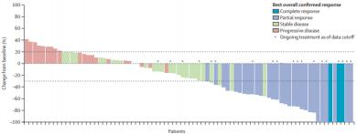
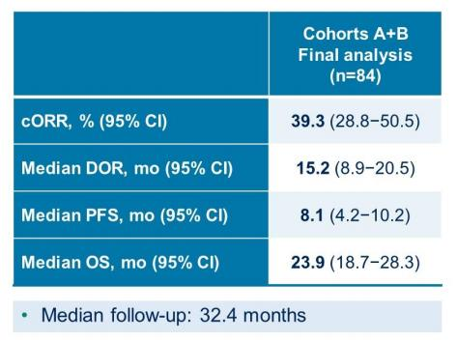
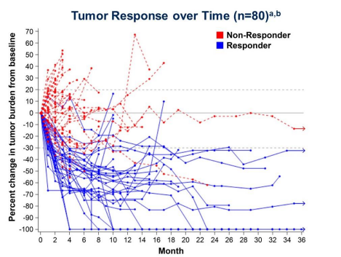
MOUNTAINEER - Efficacy
Cohorts A & B (Trastuzumab & Tucatinib)
Strickler JH et al. Lancet Oncol. 2023 May;24(5):496-508. PMID: 37142372
Strickler JH et al. ASCO 2024
RICCCIT I LI MCR

Slide 24
MOUNTAINEER-03 – Study Design
Phase 3 RCT
mCRC, 1L (or end of adj CTx >6 months ago)
- HER2+ (IHC3+ or IHC2+/ISH+)
- RAS wildtype
1。end point
- PFS (per BICR)
N=400 planned
stratified by:
- sidedness
- Liver mets (yes/no)
mFOLFOX6
Trastuzumab IV 8mg/kg LD, then 6mg/kg Q3W Tucatinib PO 300 mg BID
mFOLFOX6
+/- Bevacizumab or Cetuximab
R
1:1
NCT05253651
RICCCIT I LI MCR

Slide 25
DESTINY-CRC01 – Study Design
Phase 2
mCRC, HER2+ (≥IHC1+)
- RAS wildtype ONLY
- BRAF wildtype ≥2 prior therapies
Cohort A: IHC3+ or IHC2+/ISH+
Cohort B: IHC2+/ISH-
Cohort C: IHC1+
T-DXd = Trastuzumab Deruxtecan
1。end point
- ORR (Cohort A)
T-DXd IV 6.4mg/kg Q3W
N=53
N=15 N=18
Yoshino T et alASCO 2021
RICCCIT I LI MCR

Slide 26
DESTINY-CRC01 – Response
Yoshino T et alASCO 2021
RICCCIT I LI MCR

Slide 27
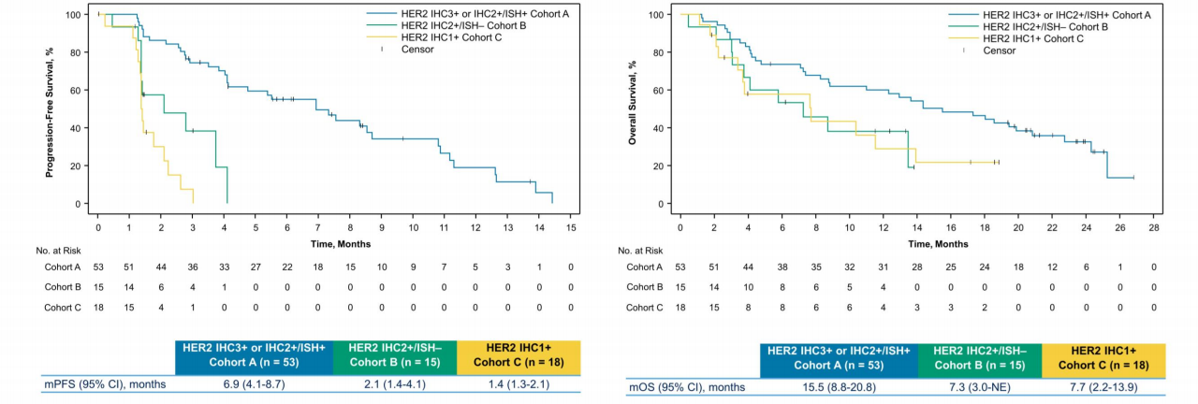
DESTINY-CRC01 – Survival
PFS OS
mPFS 6.9 months
mOS 15.5 months
Yoshino T et alASCO 2021
RICCCIT I LI MCR

Slide 28
T-DXd – AE of special interest
Interstitial Lung Disease (ILD)
Yoshino T et alASCO 2021
RICCCIT I LI MCR

Slide 29
DESTINY-CRC02 – Study Design
Phase 2
stage 1: blinded RCT
stage 2: non-randomized
mCRC, HER2+ (IHC3+ or IHC2+/ISH+)
- RAS wildtype AND mutant
- BRAF wildtype
Prior anti-HER2 therapy allowed
N=40
T-DXd = Trastuzumab Deruxtecan
stage 1 stage 2
T-DXd IV 5.4mg/kg Q3W T-DXd IV 6.4mg/kg Q3W | N=42 T-DXd IV 5.4mg/kg Q3W 1。end point - cORR per BICR
R
1:1
N=40
Raghav K et alASCO 2023 # 3501
RICCCIT I LI MCR

Slide 30
DESTINY-CRC02 – Response
T-DXd T-DXd
5.4 mg/kg Q3W 6.4 mg/kg Q3W
 | Stage 1 n = 40 | Stage 2 n = 42 | Total N = 82 | Stage 1 N = 40
cORR, n (%) [95% CI] | 18 (45.0) [29.3-61.5] | 13 (31.0) [17.6-47.1] | 31 (37.8) [27.3-49.2] | 11 (27.5) [14.6-43.9]
CR | 0 | 0 | 0 | 0
PR | 18 (45.0) | 13 (31.0) | 31 (37.8) | 11 (27.5)
SD | 20 (50.0) | 20 (47.6) | 40 (48.8) | 23 (57.5)
PD | 2 (5.0) | 6 (14.3) | 8 (9.8) | 4 (10.0)
NE | 0 | 3 (7.1) | 3 (3.7) | 2 (5.0)
Confirmed DCR, n (%) [95% CI] | 38 (95.0) [83.1-99.4] | 33 (78.6) [63.2-89.7] | 71 (86.6) [77.3-93.1] | 34 (85.0) [70.2-94.3]
Median DoR, mo (95% CI) | 8.1 (4.2-NE) | 4.6 (4.1-7.0) | 5.5 (4.2-8.1) | 5.5 (3.7-NE)
Median follow-up, mo (range) | 10.6 (2.9-17.1) | 7.7 (0.5-10.3) | 8.9 (0.5-17.1) | 10.3 (0.7-16.4)
Median treatment duration, mo (range) | 5.5 (1.4-13.2) | 4.8 (0.7-10.8) | 5.5 (0.7-13.2) | 4.9 (0.7-13.8)
Median total dose, mg/kg (range) | 39.6 (10.5-96.8) | 37.4 (5.4-81.3) | 37.8 (5.4-96.8) | 40.8 (6.4-128.4)
Median number of cycles initiated (range) | 8.0 (2-19) | 7.0 (1-15) | 7.0 (1-19) | 7.0 (1-20)
Raghav K et alASCO 2023 # 3501
RICCCIT I LI MCR

Slide 31
DESTINY-CRC02 – Response
ORR, % (n/N) 95% CIª
All patients (5.4 mg/kg) | N = 82 |  |  | 37.8 (31/82) | 27.3-49.2
HER2 status | IHC 3+ IHC 2+/ISH+ |  |  | 46.9 (30/64) 5.6 (1/18) | 34.3-59.8 0.1-27.3
RAS status | Wild-type Mutant^{b} |  |  | 39.7 (27/68) 28.6 (4/14) | 28.0-52.3 8.4-58.1
ECOG PS | 0 1 |  |  | 39.1 (18/46) 36.1 (13/36) | 25.1-54.6 20.8-53.8
Primary tumor site | Left colon^{c} Right colon^{d} |  |  | 39.3 (24/61) 33.3 (7/21) | 27.1-52.7 14.6-57.0
Prior anti-HER2 treatment | No Yes |  |  | 36.9 (24/65) 41.2 (7/17) | 25.3-49.8 18.4-67.1
0 10 20 30 40 50 60 70 80
Objective Response Rate, %
Raghav K et alASCO 2023 # 3501
RICCCIT I LI MCR

Slide 32
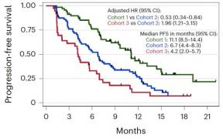
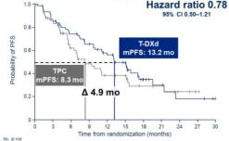
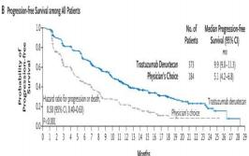
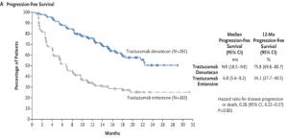
Metastatic Breast Cancer
Trastuzumab Deruxtecan
Progression Free Survival
HER2 neg
IHC 0
Cohort 3: HER2 Non-Expressing
HER2-ultralow
IHC >0 <1+, ≤ 10%
HER2-low
IHC1+, IHC2+ SISH neg
HER2+
IHC3+, IHC2+ SISH pos
HR 0.78
HR 0.50
HR 0.28
DAISY¹ DESTINY-Breast 06² DESTINY-Breast 04³ DESTINY-Breast 03⁴
1 Dièras V et al. PD8-02, SABCS 2021; Mosele F et al. Nature Medicine 2023 3 Modi S et al. NEJM 2022
2 Curigliano G et al. ASCO 2024 4 Cortés J et al. NEJM 2022
RICCCIT I LI MCR

Slide 33
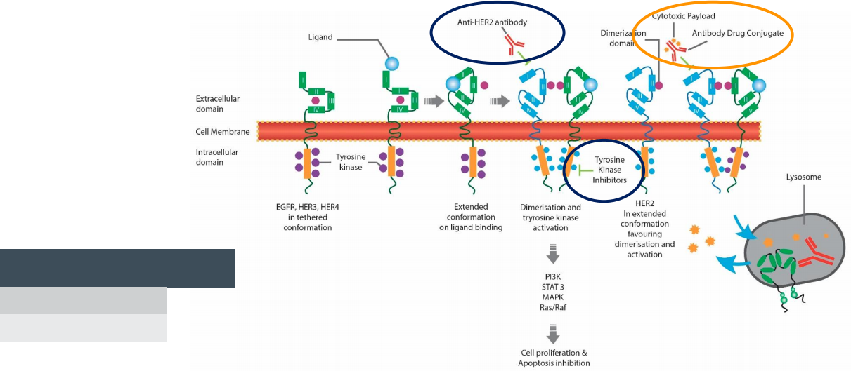
Mode of Action
Clinical Efficacy
 | RAS WT | RASmt | IHC 2+ SISH+ | IHC 3+
Tucatinib/Trastuzumab | + | - | + | +
Trastuzumab-Deruxtecan | + | + | - | +
Ferrario C et al Curr Oncol 2022 Apr 13;29(4):2720-2734
RICCCIT I LI MCR

Slide 34
Take Home Messages - HER2+ mCRC
• High Clinical Efficacy of anti-HER2 regimens
• HER2 testing recommended in all patients
• Different Options
(Trastuzumab/Pertuzumab, Trastuzumab/Lapatinib, Trastuzumab /Tucatinib, T-DXd)
• Choice of Regimen dependent on
… previous therapies
…RAS mutational status
…HER2 expression levels (IHC2+ vs IHC3+)
…availability / approval status
RICCCIT I LI MCR

Slide 35
KRAS ^{G12C}mt mCRC
RICCCIT I LI MCR

Slide 36
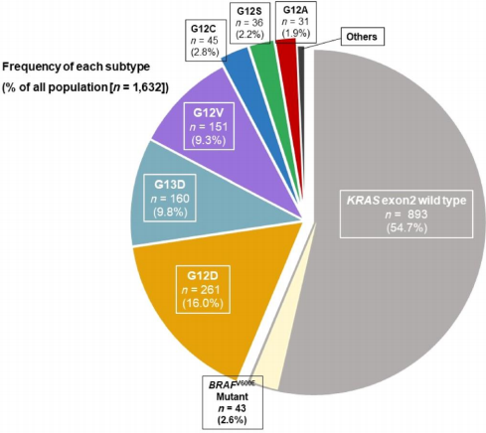
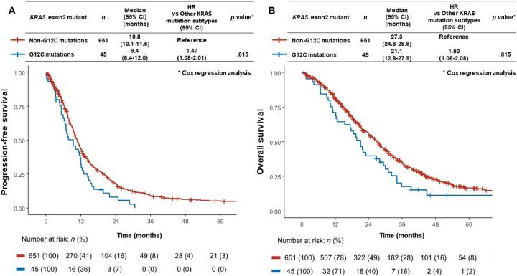
KRAS G12C mutation in CRC
CRC: 2-3% KRAS G12C: poor prognosis
(NSCLC: 13%)
Chida K et al. Oncologist. 2021 Oct;26(10):845-853.
RICCCIT I LI MCR

Slide 37
KRYSTAL-1 - Study Design
Open Label, Phase 1b/2
mCRC with KRAS G12C mutation no available SoC treatment
Phase 2
Phase 1b
N=44
1。end point
- ORR
1。end point
- safety
Adagrasib PO 600mg BID
Adagrasib PO 600mg BID
& Cetuximab IV 500mg Q2W
N=32
Yaeger R et al. N Engl J Med. 2023 Jan 5;388(1):44-54. PMID: 36546659
RICCCIT I LI MCR

Slide 38
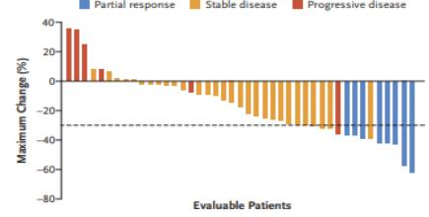
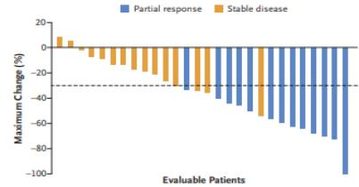
KRYSTAL-1 - Response
Adagrasib
 | Adagrasib N=43 | Adagrasib & Cetuximab N=28
ORR (per BICR) | 23% | 46%
CR | 0% | 0%
PR | 19% | 46%
SD | 14% | 54%
median DoR | 4.3 months | 7.6 months
median PFS | 5.6 months | 6.9 months
median OS | 19.8 months | 13.4 months
No previous Tx | 3 (1-9) | 3 (1-8)
Adagrasib & Cetuximab
Yaeger R et al. N Engl J Med. 2023 Jan 5;388(1):44-54. PMID: 36546659
RICCCIT I LI MCR

Slide 39
KRYSTAL-10 – Study Design
Phase 3 RCT
mCRC, KRAS G12C mutated
2L setting (progression on 1L FOLFOX or FOLFIRI) N=461
1。end point
- PFS, OS
Adagrasib PO 600 mg BID
Cetuximab IV
FOLFIRI or
mFOLFOX6
(+/- Bevacizumab)
R
1:1
NCT04793958
RICCCIT I LI MCR

Slide 40
CodeBreaK 300 – Study Design
Phase 3 RCT
mCRC, KRAS G12C mutated
≥1L (progressed on or after 5-FU, Irinotecan & Oxaliplatin) ECOG ≤2
1。end point
- PFS (per BICR)
Sotorasib PO 960 mg QD
Panitumumab IV 6mg/kg Q2W
Sotorasib PO 240 mg QD
Panitumumab IV 6mg/kg Q2W
Investigator‘s Choice:
Trifluridine/Tipiracil OR
Regorafenib
1:1:1
R
stratified by:
- prior antiangiogenic therapy
- Time from diagnosis of mCRC (≥18mo/<18mo)
- ECOG PS (0-1/2)
Pietrantonio F et al ESMO 2023
RICCCIT I LI MCR

Slide 41
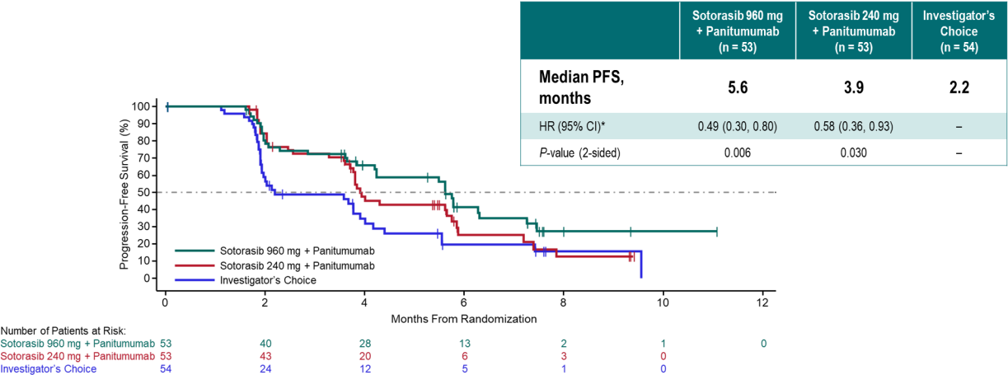
CodeBreaK 300 – PFS ^{ITT}
Pietrantonio F et al ESMO 2023
RICCCIT I LI MCR

Slide 42
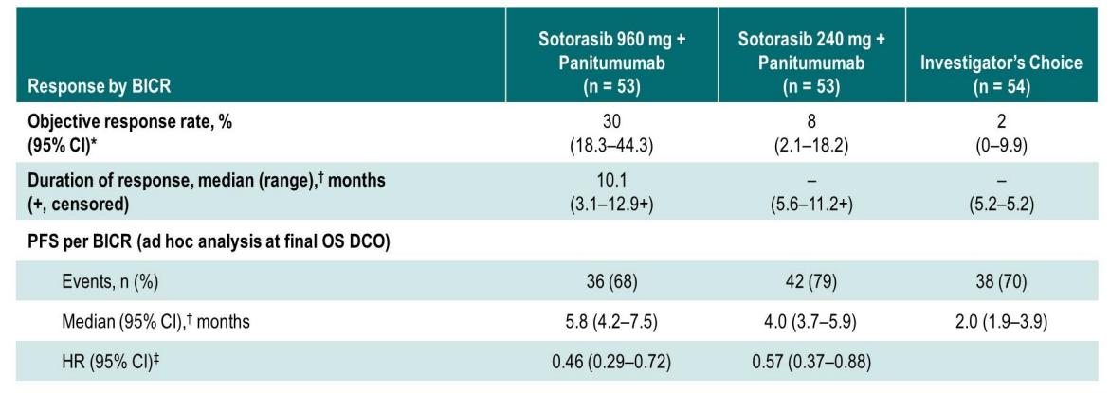
CodeBreaK 300 – ORR & PFS
Fakih MG et alASCO 2024
RICCCIT I LI MCR

Slide 43
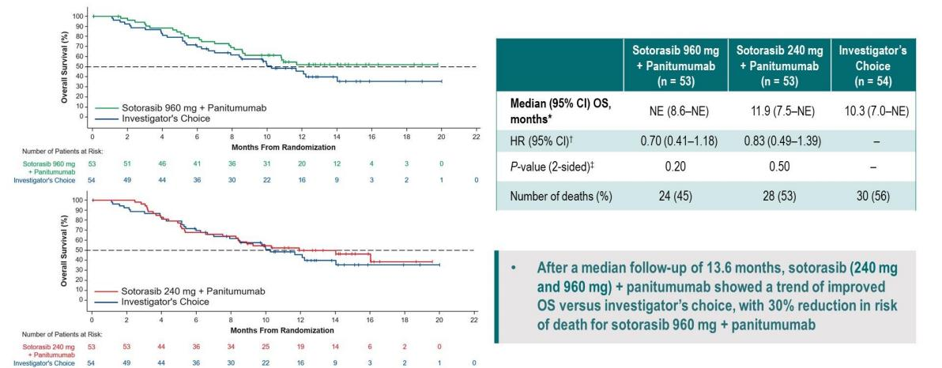
CodeBreaK 300 – OS
Fakih MG et alASCO 2024
RICCCIT I LI MCR

Slide 44
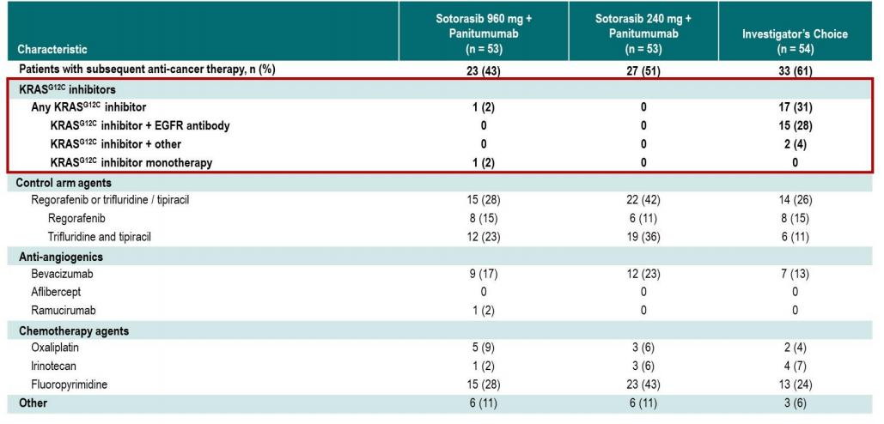
CodeBreaK 300 – Subsequent Therapies
Fakih MG et alASCO 2024
RICCCIT I LI MCR

Slide 45
CodeBreak101 – Subprotocol H - Study Design
mCRC, KRAS G12C mutated ≥1L prior treatment
Phase 1b, open label
1。end point
- safety & tolerability
Part 1: Cohort B dose exploration N=6
Part 2: Cohort G dose expansion N=40
No DLTs
Level 1 = RP2D
FOLFIRI
Sotorasib PO 960 mg QD
Panitumumab IV 6mg/kg Q2W
FOLFIRI
Sotorasib PO 960 mg QD
Panitumumab IV 6mg/kg Q2W
Hong DS et al. ASCO 2023
RICCCIT I LI MCR

Slide 46
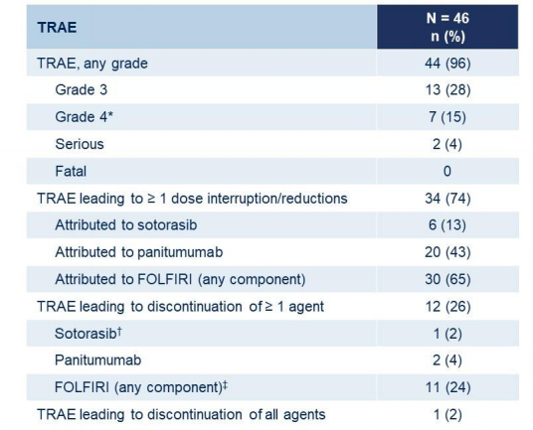
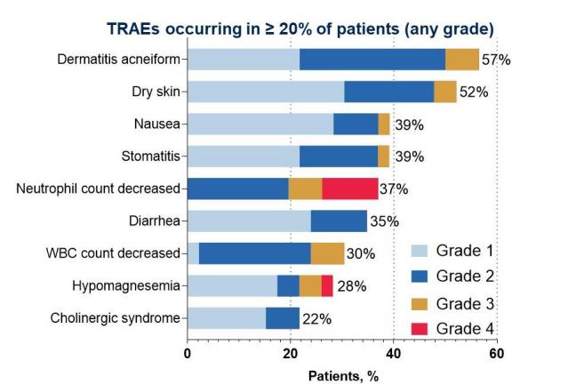
CodeBreaK 101 SP-H – Safety
Hong DS et al. ASCO 2023
CCCIT I LI MCR
Content of this presentation is the property of the author, licensed by ASCO. Permission required for reuse.

Slide 47
CodeBreaK 101 SP-H – Response
Hong DS et al. ASCO 2023
CCCIT I LI MCR
Content of this presentation is the property of the author, licensed by ASCO. Permission required for reuse.

Slide 48
CodeBreaK 301 – Study Design
Phase 3 RCT
mCRC, KRAS G12C mutated 1L setting (treatment naïve)
N=450 planned
1。end point
- PFS
FOLFIRI
Sotorasib PO 960 mg QD
Panitumumab IV 6mg/kg Q2W
FOLFIRI
+/- Bevacizumab
R
1:1
NCT06252649
RICCCIT I LI MCR

Slide 49
Take Home Messages – KRAS ^{G12C}mt mCRC
• Combination confers increased Efficacy:
KRAS^{G12C} inhibitors
& anti-EGFR antibodies
& chemotherapy
• New agents on the horizon
(KRASG12C: Divarasib,…; KRAS G12D; pan-RAS)
• Future Employment in earlier lines?
(2L KRYSTAL-10; 1L CodeBreak-301)
• Current Availability? (no EMA approval)
RICCCIT I LI MCR

Slide 50
Rare Alterations
RICCCIT I LI MCR

Slide 51
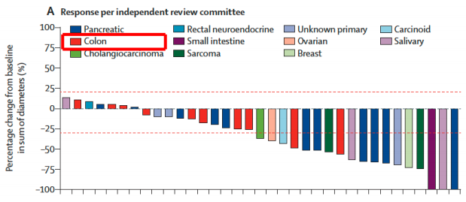
RET fusion - Selpercatinib
LIBRETTO-001
Phase 1/2, open label, basket trial RET fusion-positive solid tumours other than lung or thyroid tumours
Subbiah V et al. Lancet Oncol. 2022 Oct;23(10):1261-1273.
RICCCIT I LI MCR

Slide 52
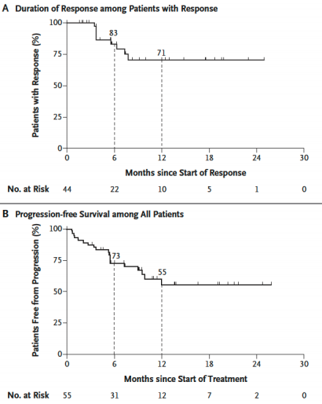
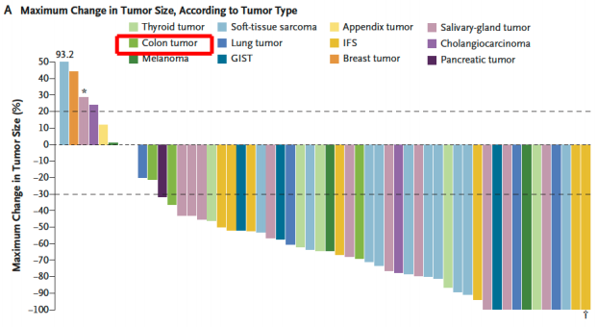
NTRK fusion - Larotrectinib
Phase 1/2, open label, basket trial NTRK fusion-positive solid tumours Total: N=51; CRC: N=4
DrilonA et al. N Engl J Med. 2018 Feb 22;378(8):731-739.
RICCCIT I LI MCR

Slide 53
Summary
RICCCIT I LI MCR

Slide 54
Summary
• Moleculary-driven mCRC = relevant subgroup
• Targeted Therapies with high clinical efficacy
• Increasing Number of Therapeutic Options
(on the horizon: KRAS^{G12D} & pan-RAS inhibitors, new combinations, etc)
• Testing is Key
• Future developments will facilitate Testing
(e.g. liquid biopsy in 1L; WES/WGS of tumor informed ctDNA tests,…)
RICCCIT I LI MCR

Slide 55
Thank you for your attention!
Lukas Weiss, MD, PhD
Associate Professor of Medical Oncology
IIIrd Medical Department
Paracelsus Medical University
Salzburg, Austria
Salzburg Cancer Research Institute (SCRI)
Laboratory for Immunological and Molecular Cancer Research (LIMCR) Center for Clinical Cancer and Immunology Trials (CCCIT)
mail to: lu.weiss@salk.at
· AGMT
工。
●
Austrian Group o Medical o Tunnor Therapy
CCCIT
L工MCR
R S a c h
S七 i七 七
K 乙 E T

