Slide 1
For: Do Adjuvant Therapies Have a Role in the Management of Hepatocellular Carcinoma?
Content of this presentation is the property of the author, licensed by ASCO. Permission required for reuse.

Slide 2
The Facts
Content of this presentation is the property of the author, licensed by ASCO. Permission required for reuse.

Slide 3
Adjuvant therapy
Content of this presentation is the property of the author, licensed by ASCO. Permission required for reuse.

Slide 4
Slide 4
Content of this presentation is the property of the author, licensed by ASCO. Permission required for reuse.

Slide 5
Slide 5
Content of this presentation is the property of the author, licensed by ASCO. Permission required for reuse.

Slide 6
Slide 6
Content of this presentation is the property of the author, licensed by ASCO. Permission required for reuse.

Slide 7
Slide 7
Content of this presentation is the property of the author, licensed by ASCO. Permission required for reuse.

Slide 8
Ongoing Phase 3 Trials of Adjuvant Immunotherapy1-4
Content of this presentation is the property of the author, licensed by ASCO. Permission required for reuse.

Slide 9
IMbrave050 study design
Content of this presentation is the property of the author, licensed by ASCO. Permission required for reuse.

Slide 10
High-risk criteria by curative treatment
Content of this presentation is the property of the author, licensed by ASCO. Permission required for reuse.

Slide 11
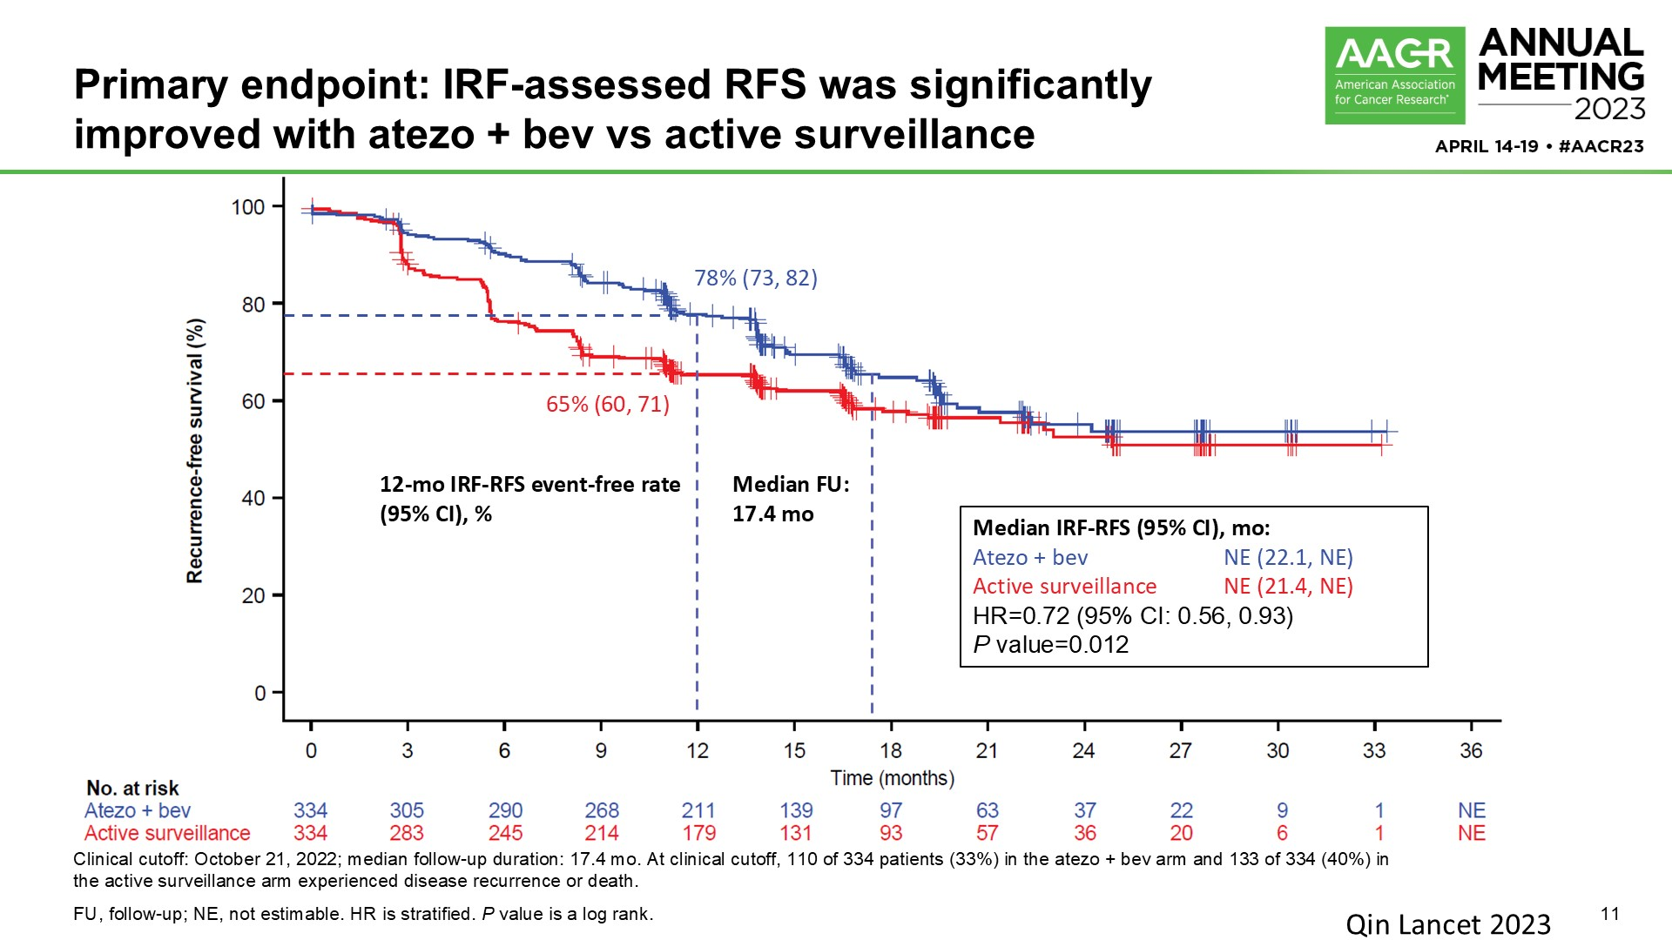
Primary endpoint: IRF-assessed RFS was significantly improved with atezo + bev vs active surveillance
Content of this presentation is the property of the author, licensed by ASCO. Permission required for reuse.

Slide 12
Early RFS benefit was not maintained with <br />longer follow-up
Content of this presentation is the property of the author, licensed by ASCO. Permission required for reuse.

Slide 13
RFS among resection patients was numerically better in those who were outside up-to-7 criteria
Content of this presentation is the property of the author, licensed by ASCO. Permission required for reuse.

Slide 14
Overall safety trend was the same as the first IA
Content of this presentation is the property of the author, licensed by ASCO. Permission required for reuse.

Slide 15
Background: Original RCT
Content of this presentation is the property of the author, licensed by ASCO. Permission required for reuse.

Slide 16
Background: Efficacy Endpoints in the Original RCT
Content of this presentation is the property of the author, licensed by ASCO. Permission required for reuse.

Slide 17
Results: Recurrence-Free Survival (Primary Endpoint)
Content of this presentation is the property of the author, licensed by ASCO. Permission required for reuse.

Slide 18
Results: Overall Survival
Content of this presentation is the property of the author, licensed by ASCO. Permission required for reuse.

Slide 19
Slide 19
Content of this presentation is the property of the author, licensed by ASCO. Permission required for reuse.

Slide 20
Slide 20
Content of this presentation is the property of the author, licensed by ASCO. Permission required for reuse.

Slide 21
This patient
Content of this presentation is the property of the author, licensed by ASCO. Permission required for reuse.

Slide 22
This patient
Content of this presentation is the property of the author, licensed by ASCO. Permission required for reuse.

Slide 23
Key Takeaway Points/Conclusions
Content of this presentation is the property of the author, licensed by ASCO. Permission required for reuse.

Slide 24
Acknowledgements:
Content of this presentation is the property of the author, licensed by ASCO. Permission required for reuse.

