Slide 1
Breakout Session: Emerging Therapies for Liver-limited Hepatobiliary Cancers
Content of this presentation is the property of the author, licensed by ASCO. Permission required for reuse.

Slide 2
The Role of IR in HCC
Content of this presentation is the property of the author, licensed by ASCO. Permission required for reuse.

Slide 3
The Evolving Role of IR<br />HCC by Stage: SEER
Content of this presentation is the property of the author, licensed by ASCO. Permission required for reuse.

Slide 4
Slide 4
Content of this presentation is the property of the author, licensed by ASCO. Permission required for reuse.

Slide 5
Slide 5
Content of this presentation is the property of the author, licensed by ASCO. Permission required for reuse.

Slide 6
Locoregional Therapy
Content of this presentation is the property of the author, licensed by ASCO. Permission required for reuse.

Slide 7
Slide 7
Content of this presentation is the property of the author, licensed by ASCO. Permission required for reuse.

Slide 8
Ablation
Content of this presentation is the property of the author, licensed by ASCO. Permission required for reuse.

Slide 9
TACE
Content of this presentation is the property of the author, licensed by ASCO. Permission required for reuse.

Slide 10
TECHNIQUE, PERFECTING EMBOLICS, DRUGS & PREVALENCE<br /><br />
Content of this presentation is the property of the author, licensed by ASCO. Permission required for reuse.

Slide 11
Slide 11
Content of this presentation is the property of the author, licensed by ASCO. Permission required for reuse.

Slide 12
Slide 12
Content of this presentation is the property of the author, licensed by ASCO. Permission required for reuse.

Slide 13
Risk Factors
Content of this presentation is the property of the author, licensed by ASCO. Permission required for reuse.

Slide 14
Slide 14
Content of this presentation is the property of the author, licensed by ASCO. Permission required for reuse.

Slide 15
TARE (Radioembolization)
Content of this presentation is the property of the author, licensed by ASCO. Permission required for reuse.

Slide 16
Macrovascular Invasion
Content of this presentation is the property of the author, licensed by ASCO. Permission required for reuse.

Slide 17
Slide 17
Content of this presentation is the property of the author, licensed by ASCO. Permission required for reuse.

Slide 18
SIRveNIB and SARAH – Y90 vs. Sorafenib RCT
Content of this presentation is the property of the author, licensed by ASCO. Permission required for reuse.

Slide 19
COMBINATION: MODALITIES, DRUGS, VIRUS<br /><br />
Content of this presentation is the property of the author, licensed by ASCO. Permission required for reuse.

Slide 20
TACE Ablate
Content of this presentation is the property of the author, licensed by ASCO. Permission required for reuse.

Slide 21
TACE-Ablate vs. Y-90
Content of this presentation is the property of the author, licensed by ASCO. Permission required for reuse.

Slide 22
FDA-Approved Systemic Therapy for Advanced HCC
Content of this presentation is the property of the author, licensed by ASCO. Permission required for reuse.

Slide 23
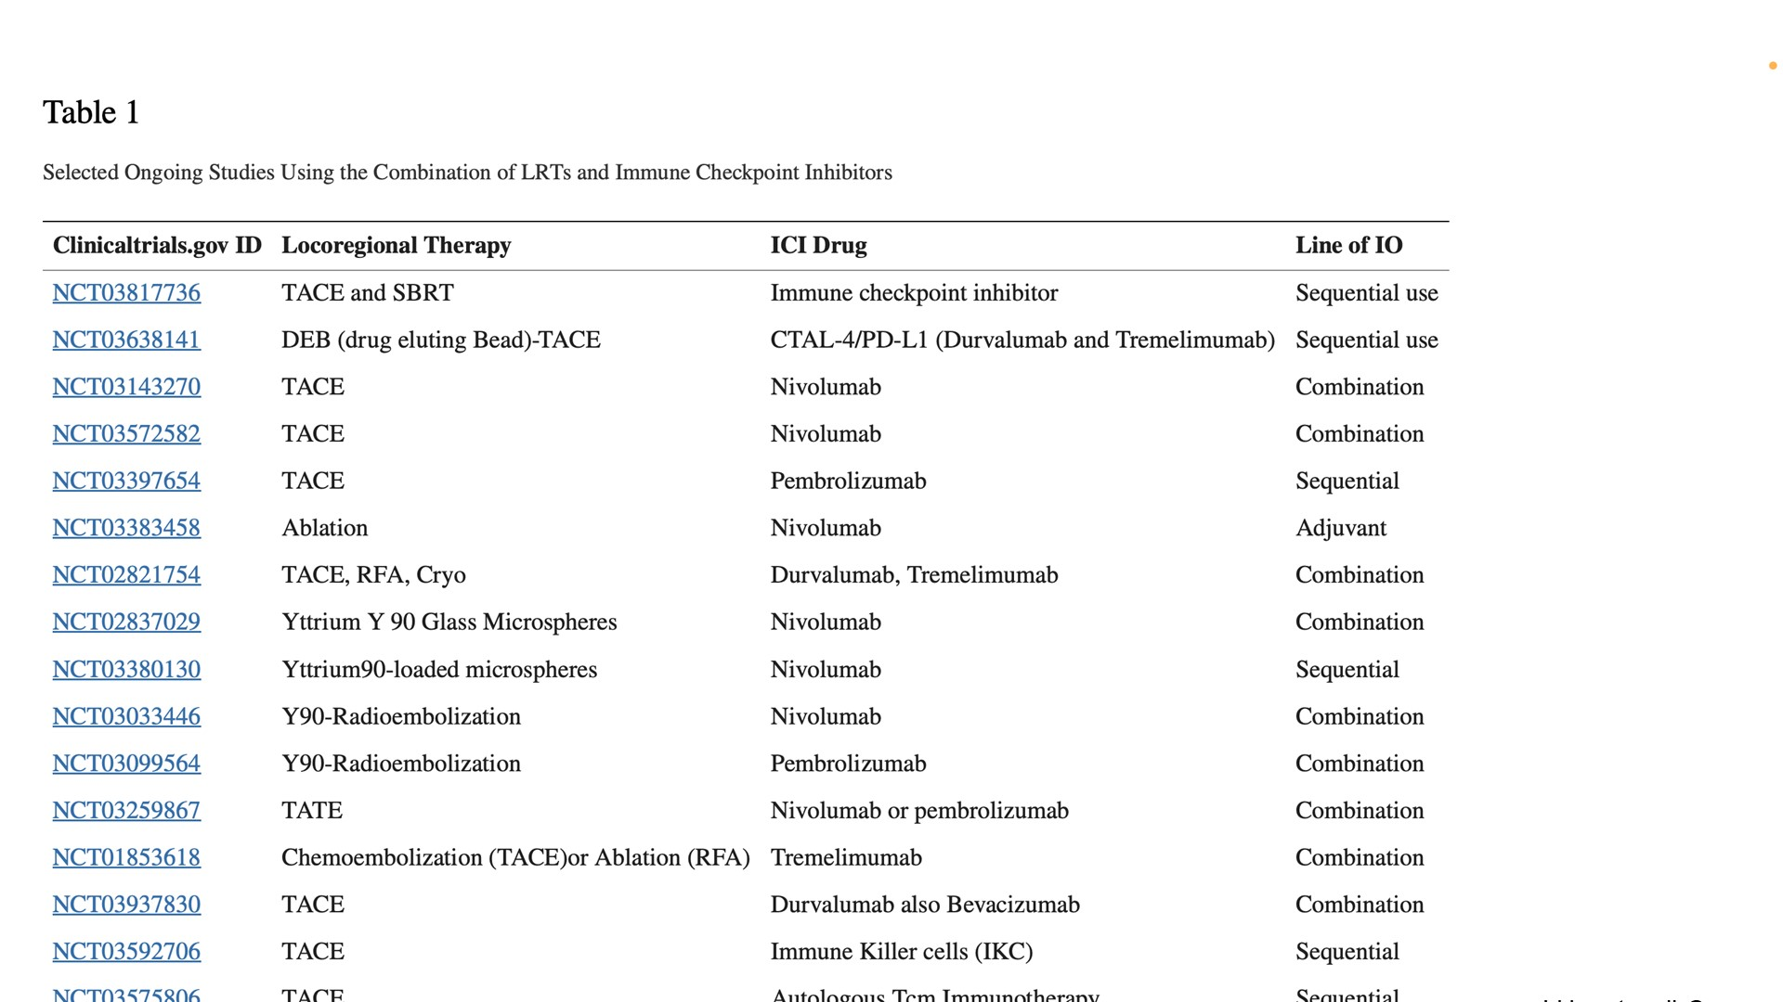
Slide 23
Content of this presentation is the property of the author, licensed by ASCO. Permission required for reuse.

Slide 24
IMbrave150 (Atezolizumab + Bevacizumab vs Sorafenib) as First-line Therapy
Content of this presentation is the property of the author, licensed by ASCO. Permission required for reuse.

Slide 25
Slide 25
Content of this presentation is the property of the author, licensed by ASCO. Permission required for reuse.

Slide 26
Oncolytic Virus
Content of this presentation is the property of the author, licensed by ASCO. Permission required for reuse.

Slide 27
Era of Targeted Therapies
Content of this presentation is the property of the author, licensed by ASCO. Permission required for reuse.

Slide 28
Slide 28
Content of this presentation is the property of the author, licensed by ASCO. Permission required for reuse.

Slide 29
Slide 29
Content of this presentation is the property of the author, licensed by ASCO. Permission required for reuse.

