Slide 1
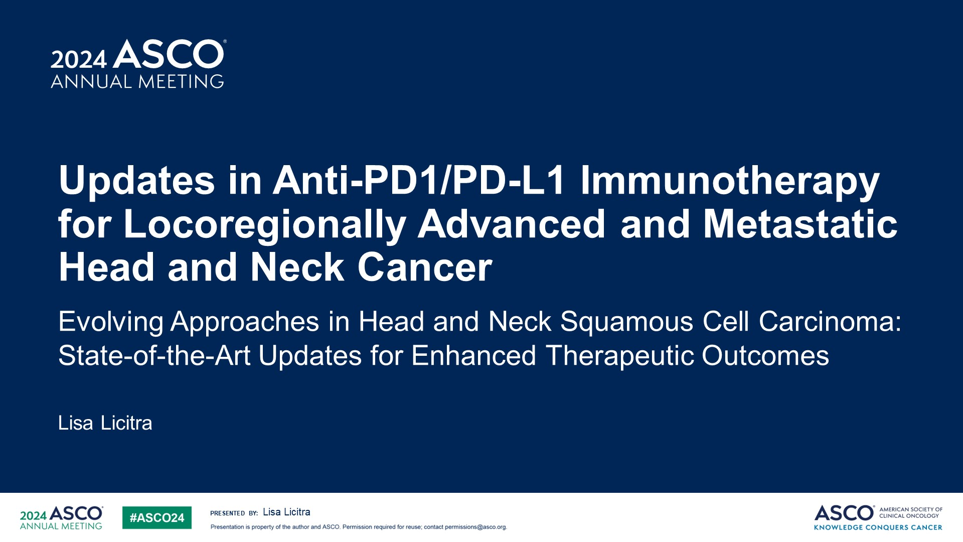
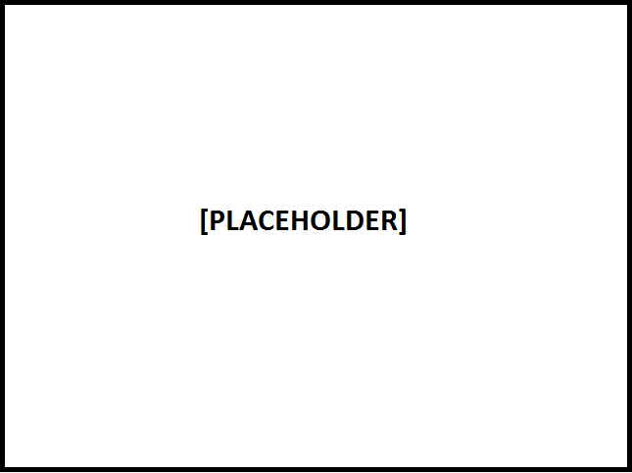
Updates in Anti-PD1/PD-L1 Immunotherapy for Locoregionally Advanced and Metastatic Head and Neck Cancer
Content of this presentation is the property of the author, licensed by ASCO. Permission required for reuse.

Slide 2
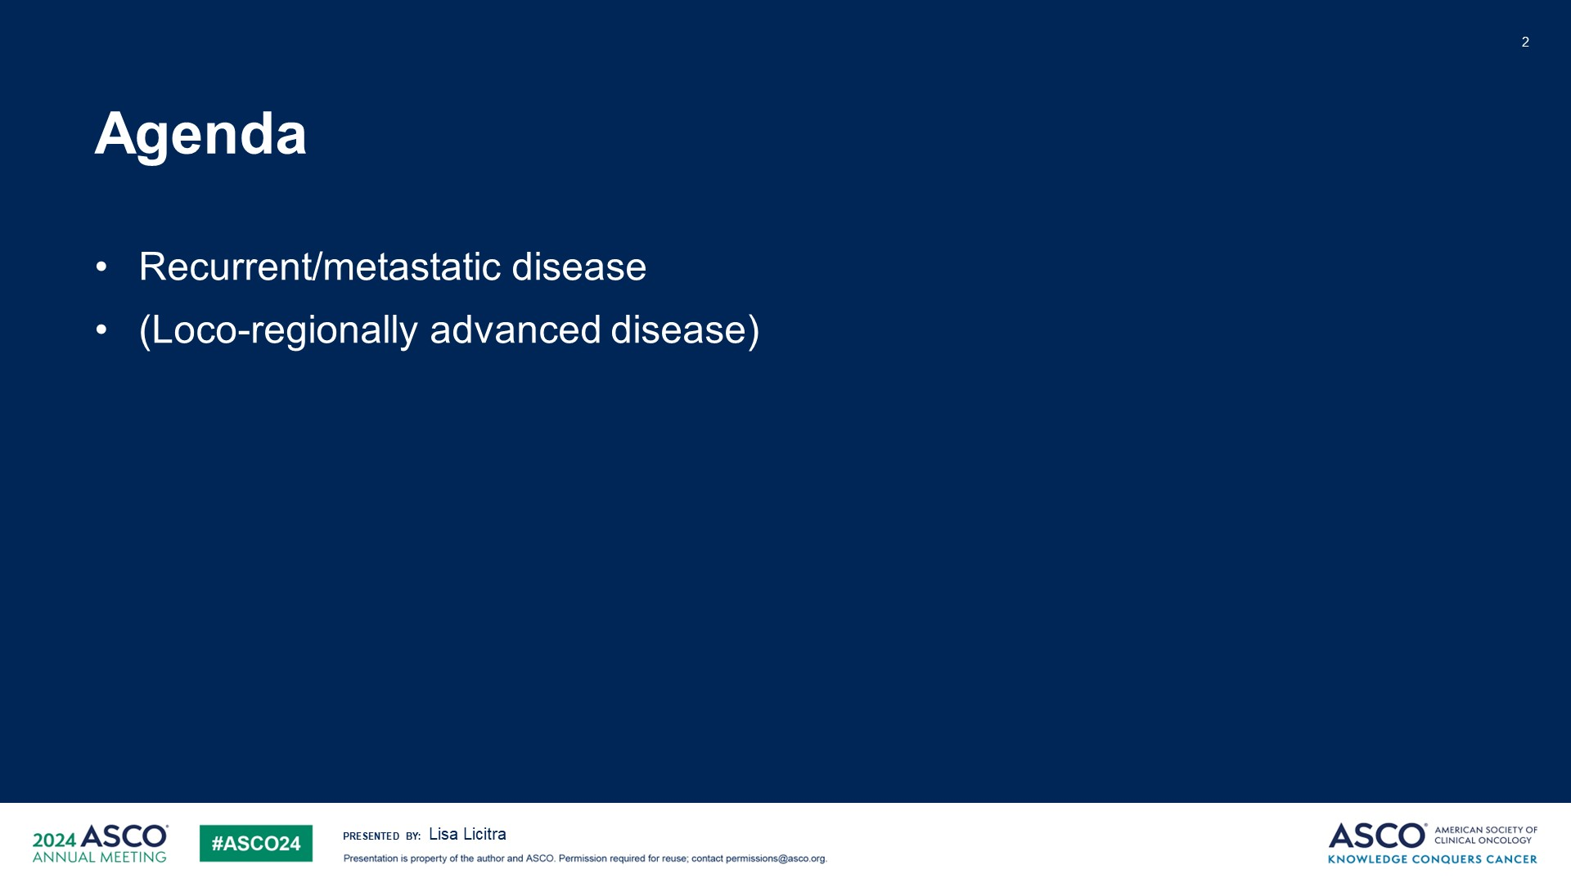
Agenda
Content of this presentation is the property of the author, licensed by ASCO. Permission required for reuse.

Slide 3
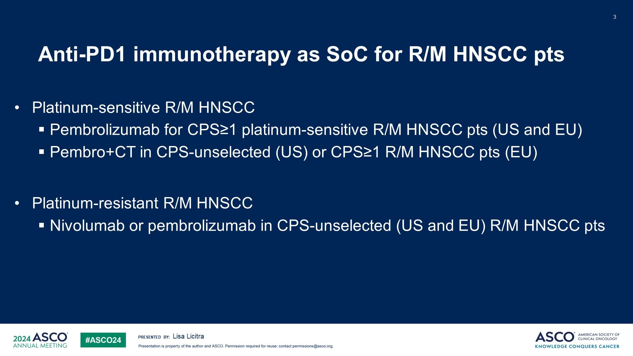
Anti-PD1 immunotherapy as SoC for R/M HNSCC pts
Content of this presentation is the property of the author, licensed by ASCO. Permission required for reuse.

Slide 4
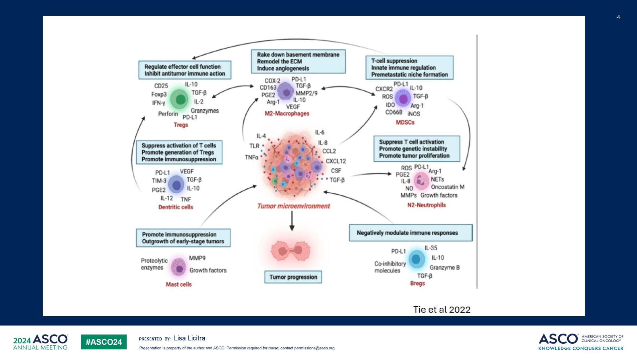
Slide 4
Content of this presentation is the property of the author, licensed by ASCO. Permission required for reuse.

Slide 5
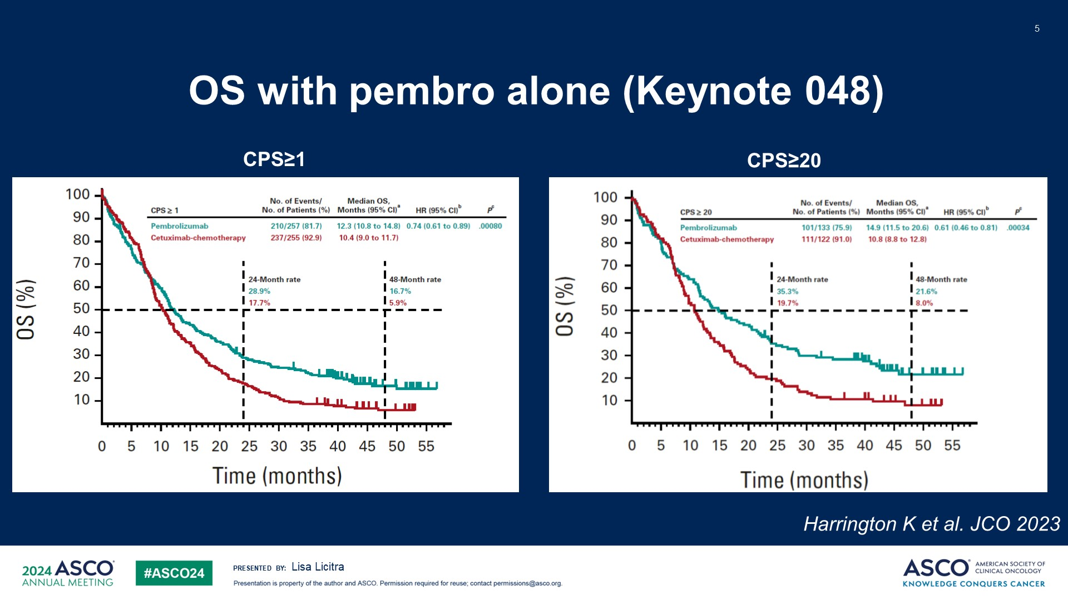
OS with pembro alone (Keynote 048)
Content of this presentation is the property of the author, licensed by ASCO. Permission required for reuse.

Slide 6
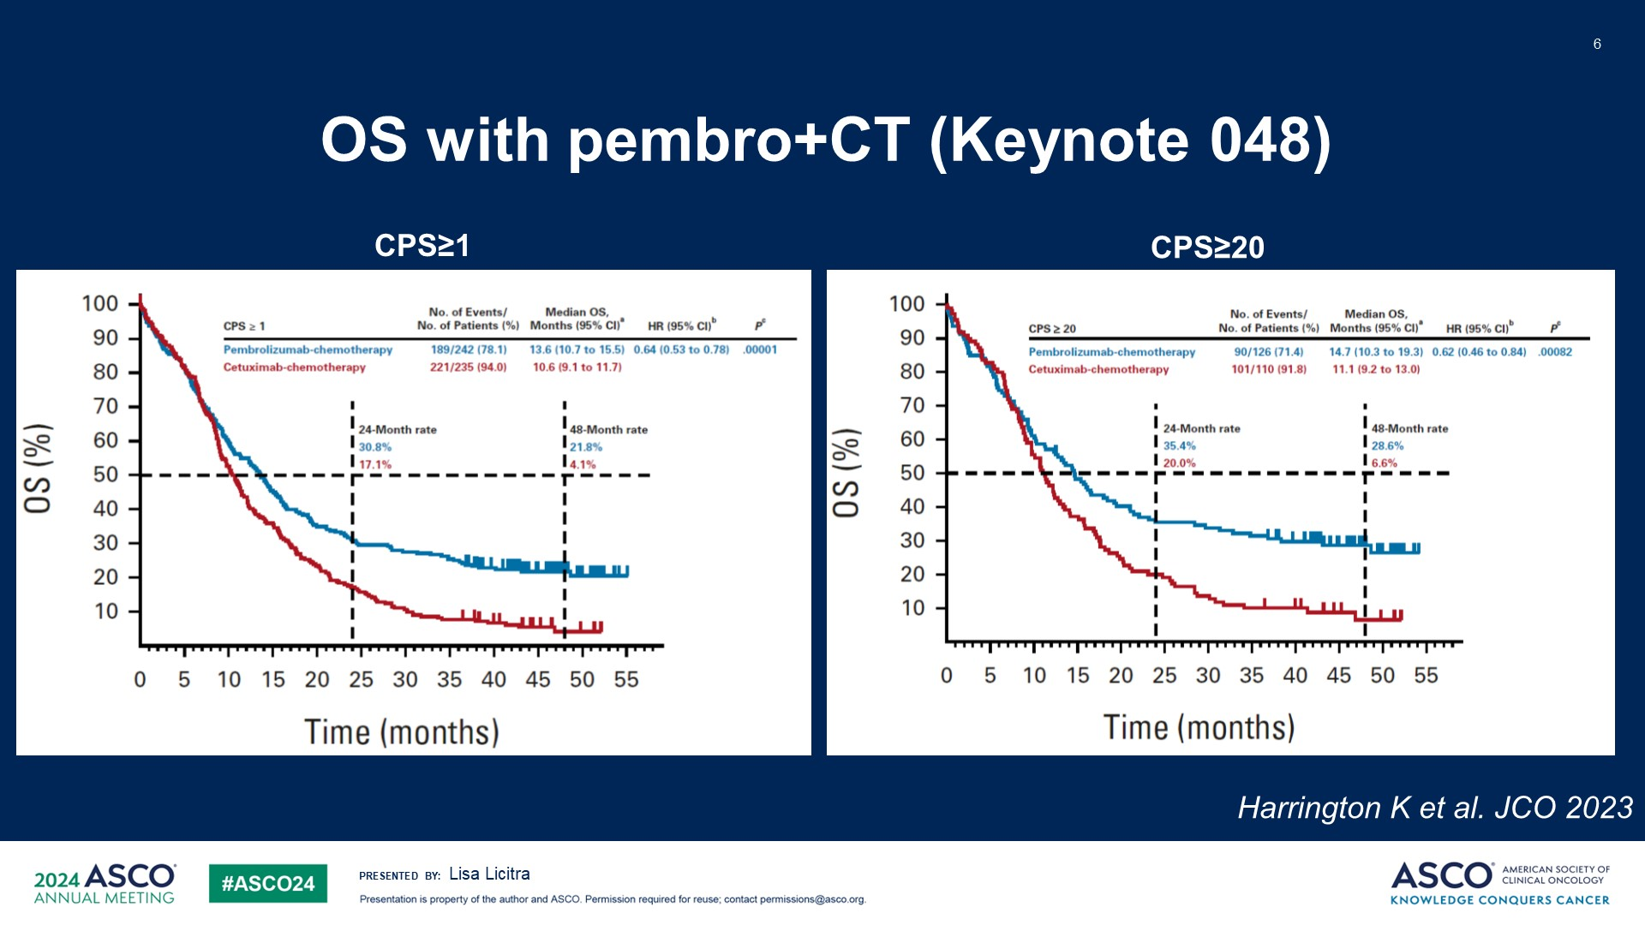
OS with pembro+CT (Keynote 048)
Content of this presentation is the property of the author, licensed by ASCO. Permission required for reuse.

Slide 7
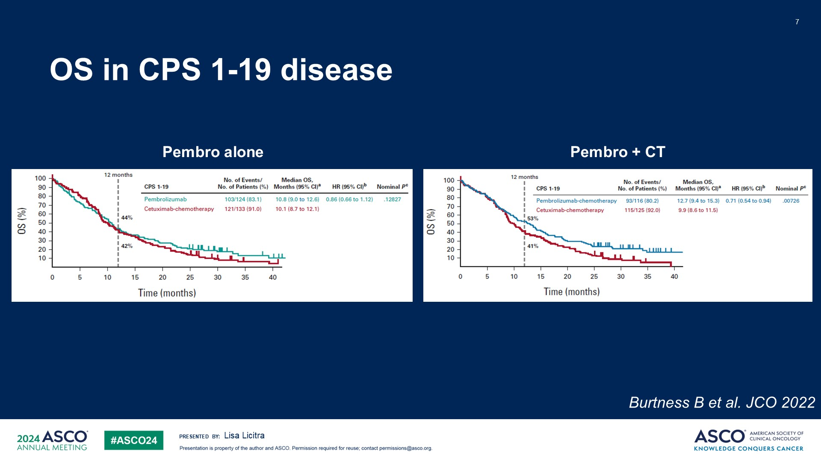
OS in CPS 1-19 disease
Content of this presentation is the property of the author, licensed by ASCO. Permission required for reuse.

Slide 8
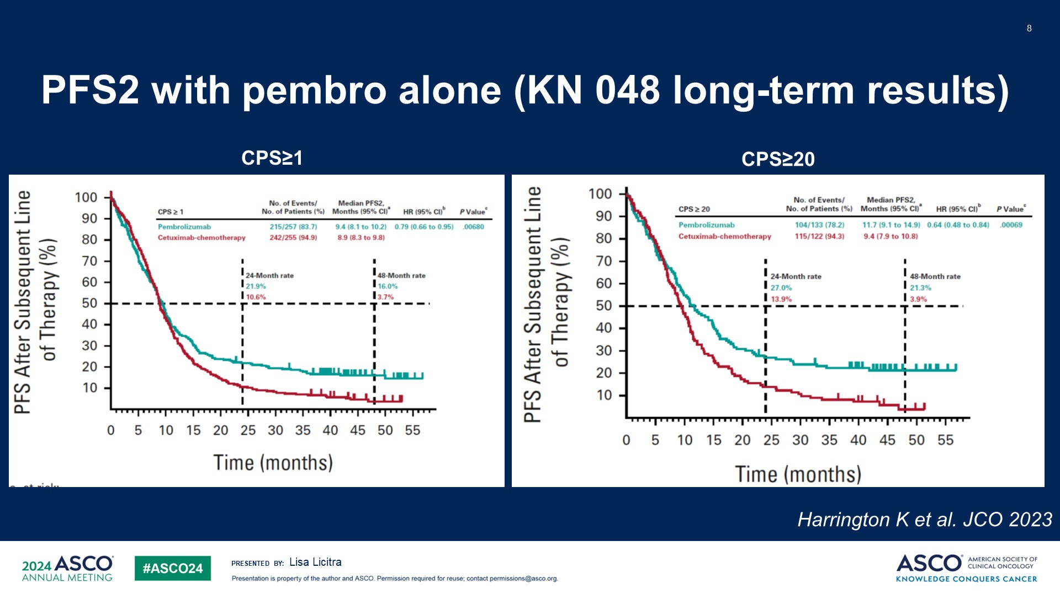
PFS2 with pembro alone (KN 048 long-term results)
Content of this presentation is the property of the author, licensed by ASCO. Permission required for reuse.

Slide 9
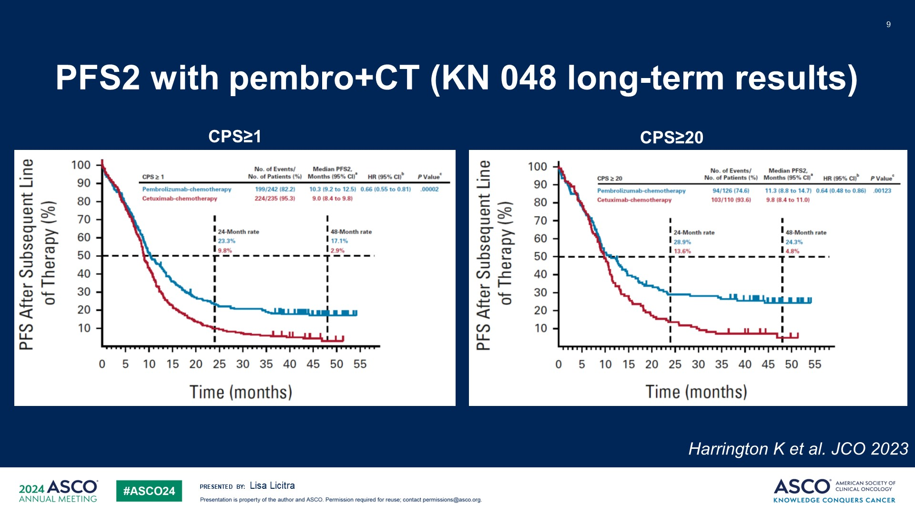
PFS2 with pembro+CT (KN 048 long-term results)
Content of this presentation is the property of the author, licensed by ASCO. Permission required for reuse.

Slide 10
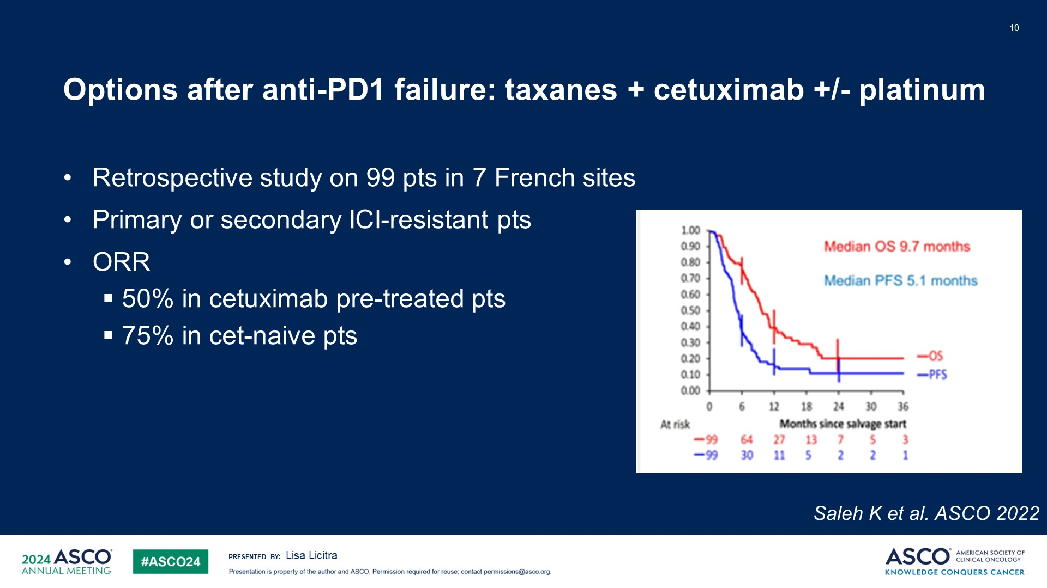
Options after anti-PD1 failure: taxanes + cetuximab +/- platinum
Content of this presentation is the property of the author, licensed by ASCO. Permission required for reuse.

Slide 11
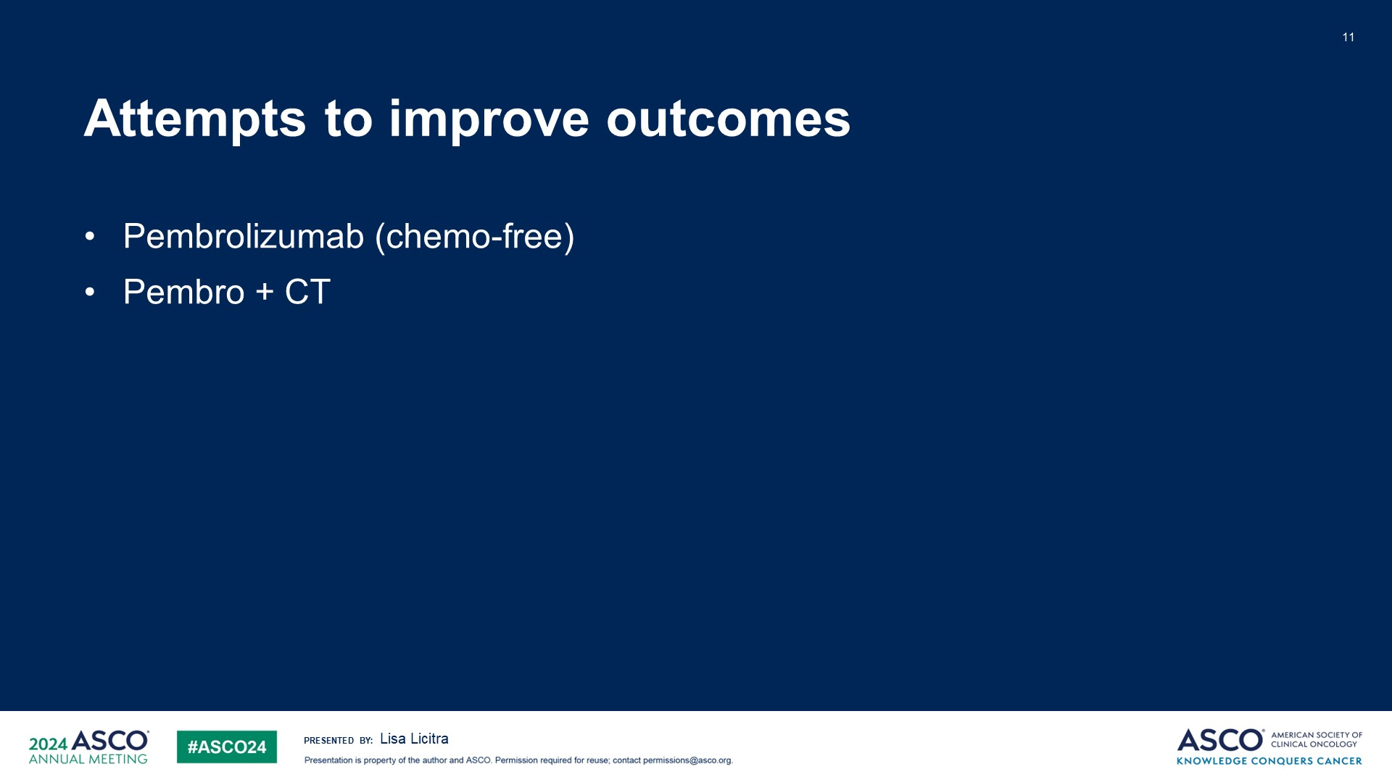
Attempts to improve outcomes
Content of this presentation is the property of the author, licensed by ASCO. Permission required for reuse.

Slide 12
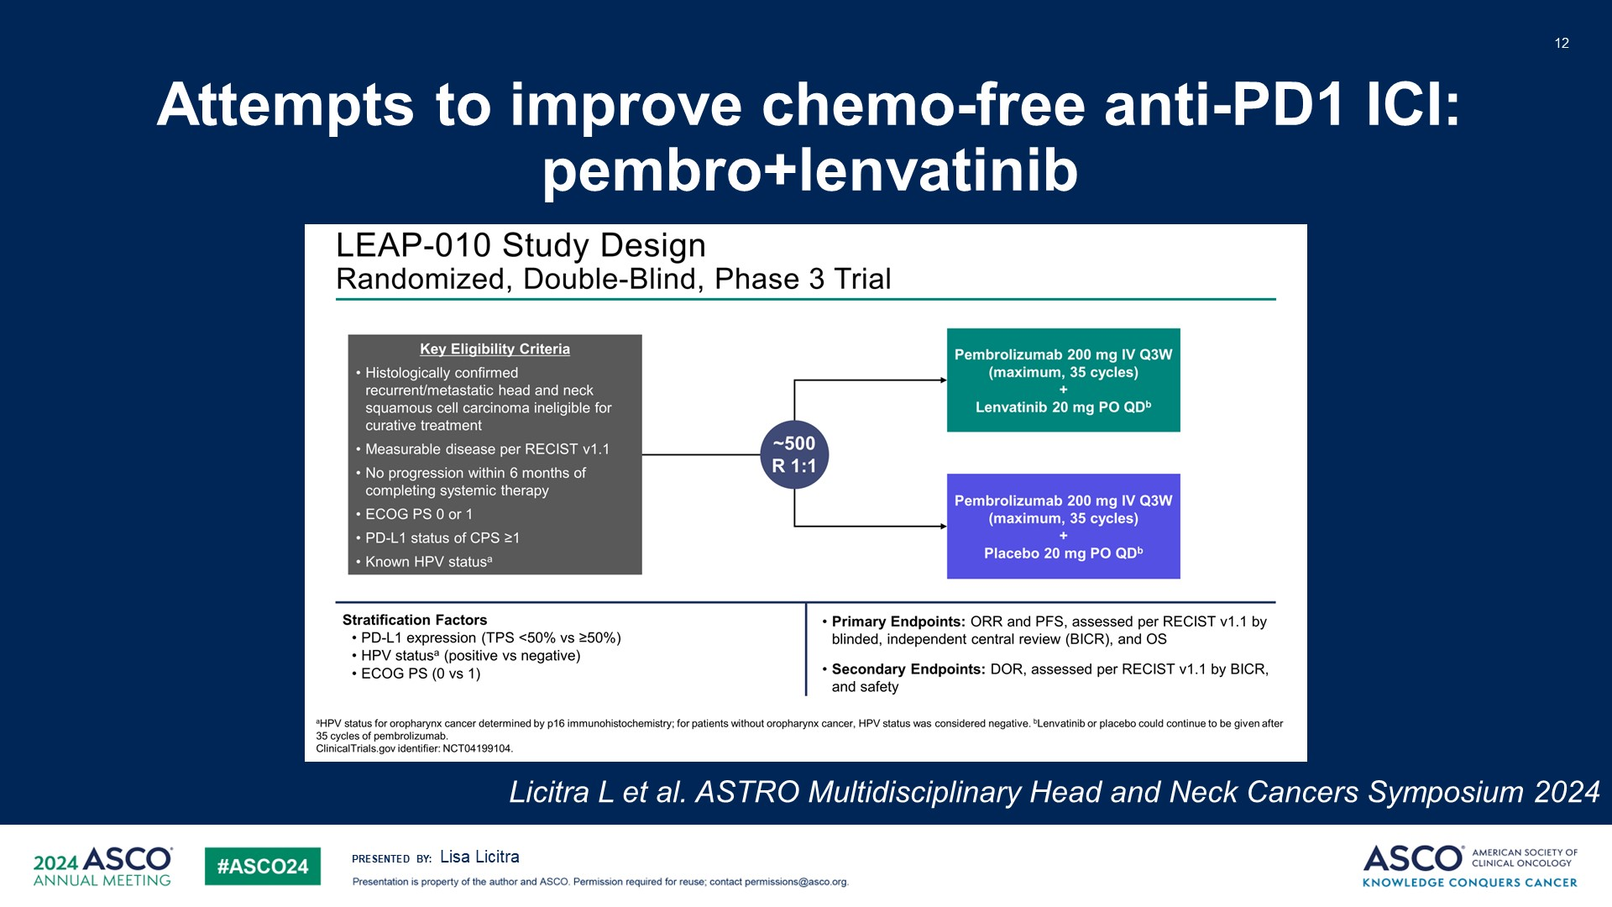
Attempts to improve chemo-free anti-PD1 ICI: <br />pembro+lenvatinib
Content of this presentation is the property of the author, licensed by ASCO. Permission required for reuse.

Slide 13
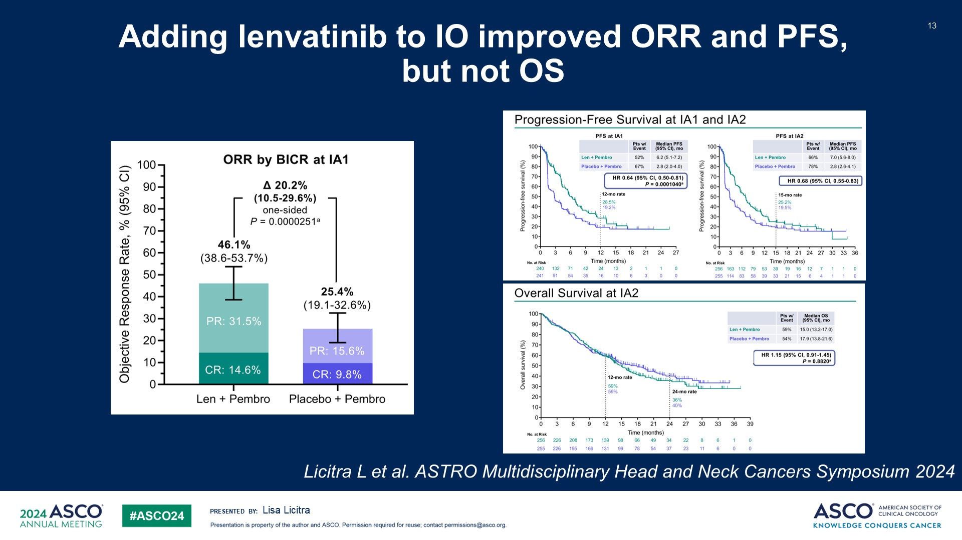
Adding lenvatinib to IO improved ORR and PFS, <br />but not OS
Content of this presentation is the property of the author, licensed by ASCO. Permission required for reuse.

Slide 14
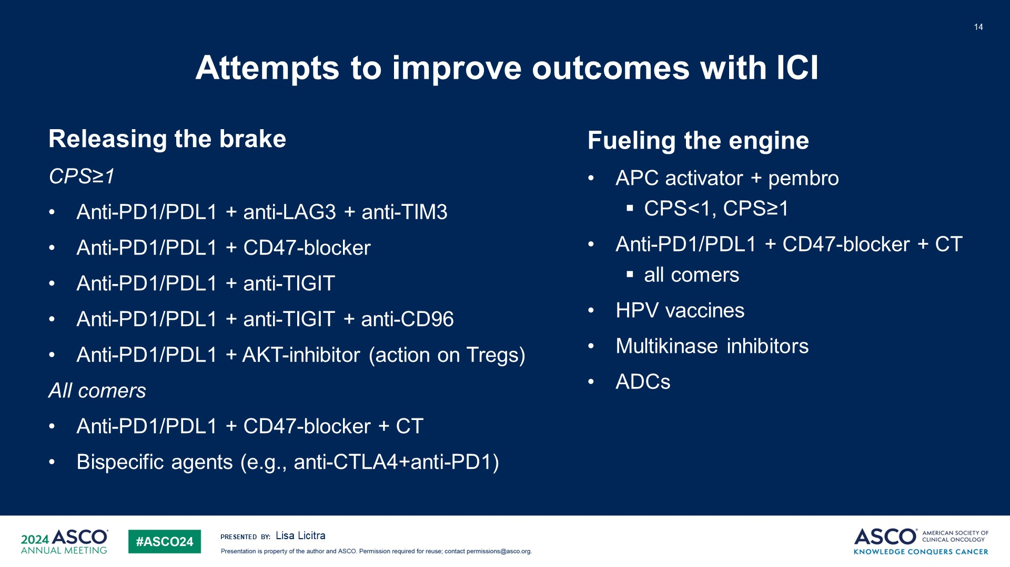
Attempts to improve outcomes with ICI
Content of this presentation is the property of the author, licensed by ASCO. Permission required for reuse.

Slide 15
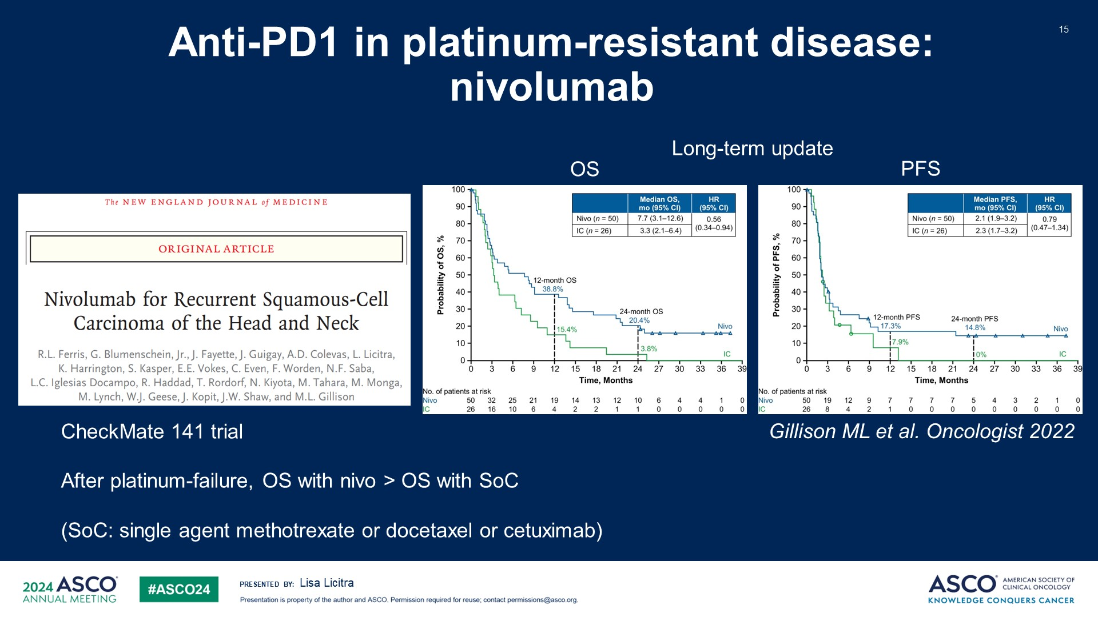
Anti-PD1 in platinum-resistant disease: nivolumab
Content of this presentation is the property of the author, licensed by ASCO. Permission required for reuse.

Slide 16
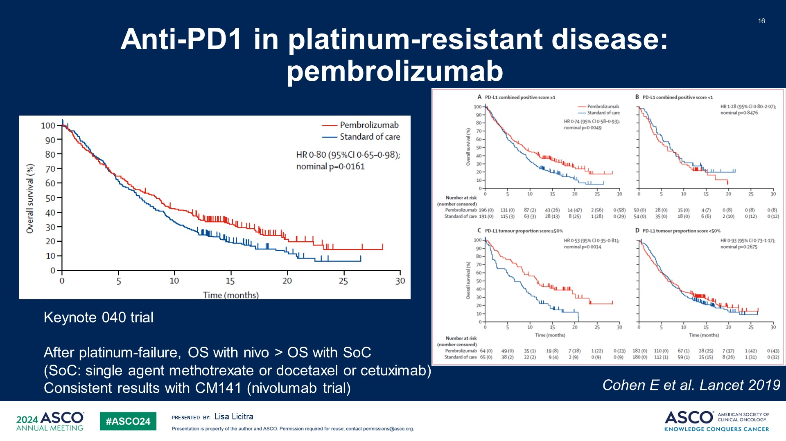
Anti-PD1 in platinum-resistant disease: pembrolizumab
Content of this presentation is the property of the author, licensed by ASCO. Permission required for reuse.

Slide 17
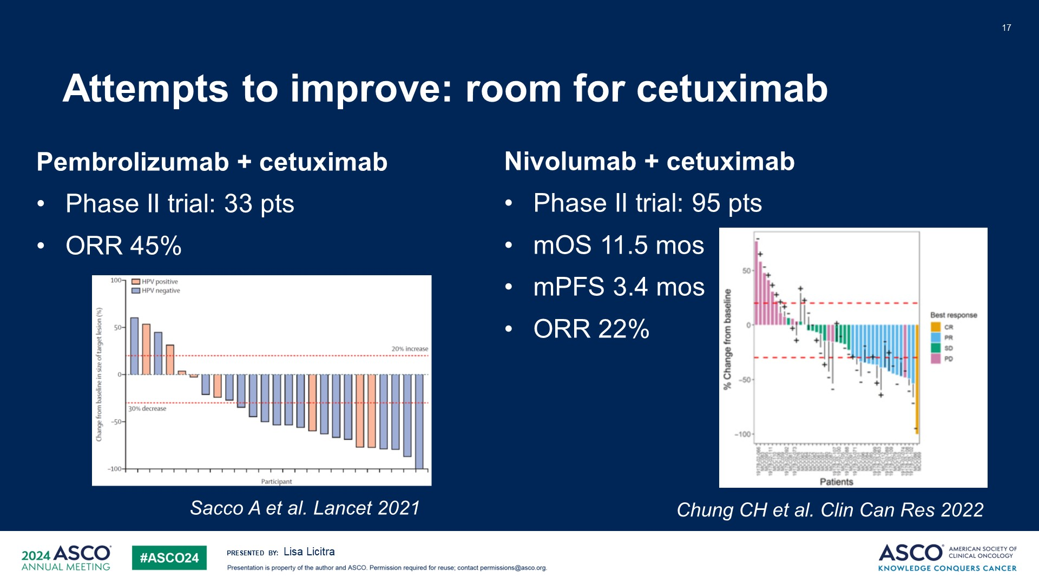
Attempts to improve: room for cetuximab
Content of this presentation is the property of the author, licensed by ASCO. Permission required for reuse.

Slide 18
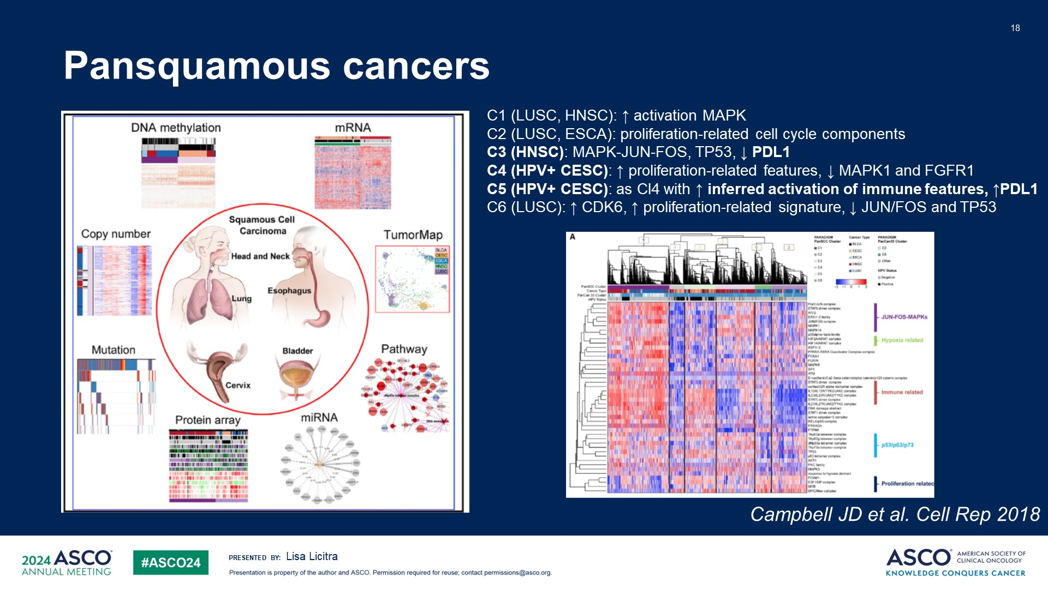
Pansquamous cancers
Content of this presentation is the property of the author, licensed by ASCO. Permission required for reuse.

Slide 19
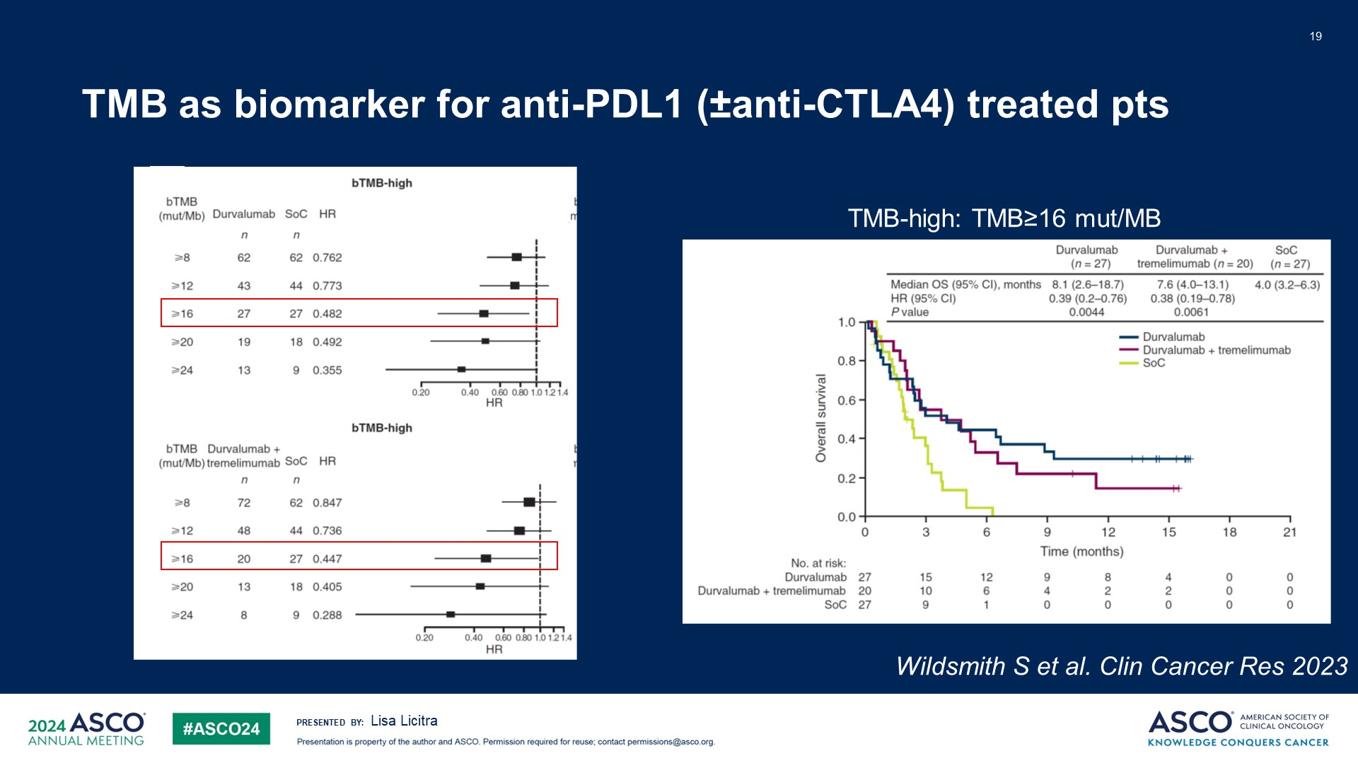
TMB as biomarker for anti-PDL1 (±anti-CTLA4) treated pts
Content of this presentation is the property of the author, licensed by ASCO. Permission required for reuse.

Slide 20
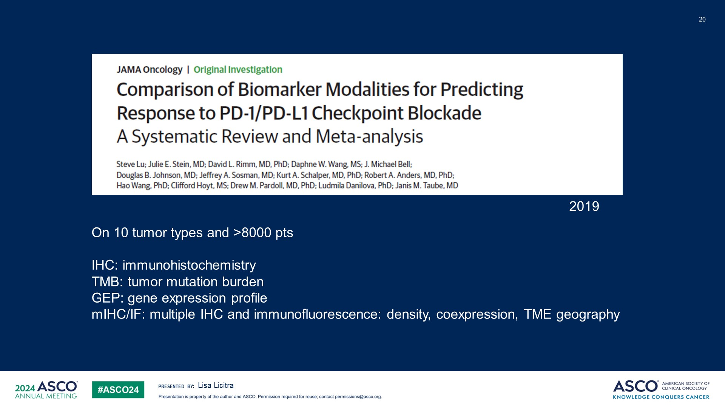
Slide 20
Content of this presentation is the property of the author, licensed by ASCO. Permission required for reuse.

Slide 21
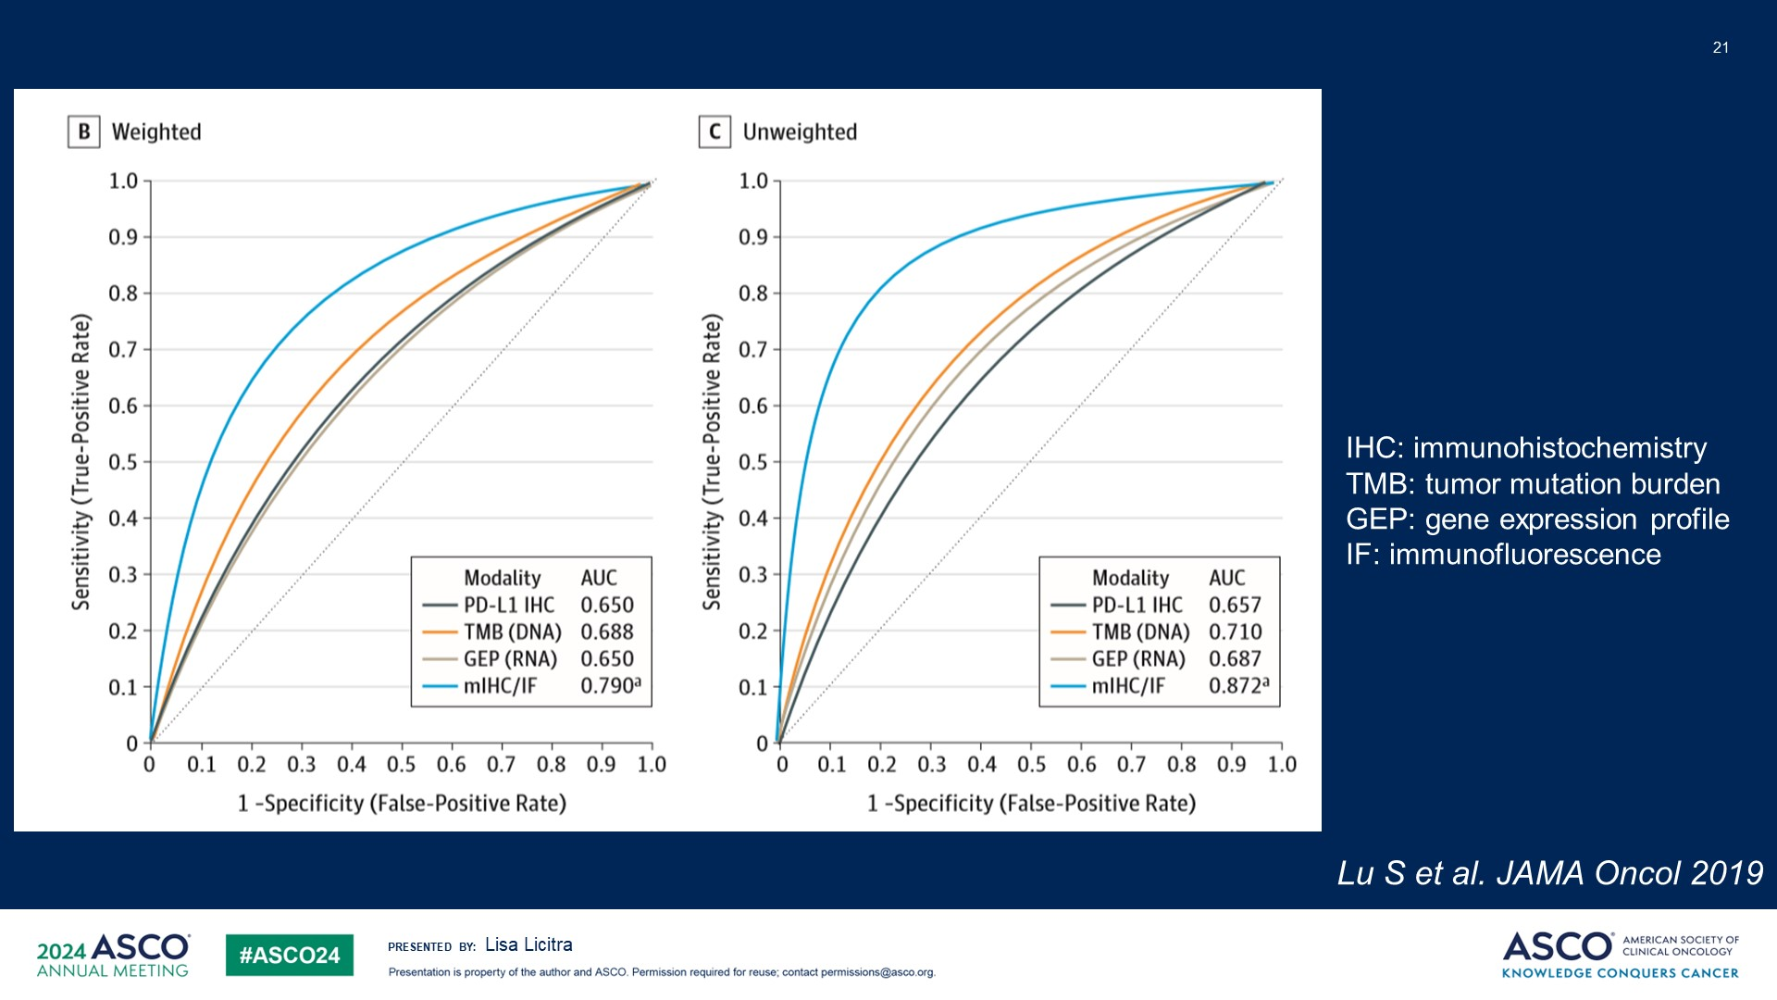
Slide 21
Content of this presentation is the property of the author, licensed by ASCO. Permission required for reuse.

Slide 22
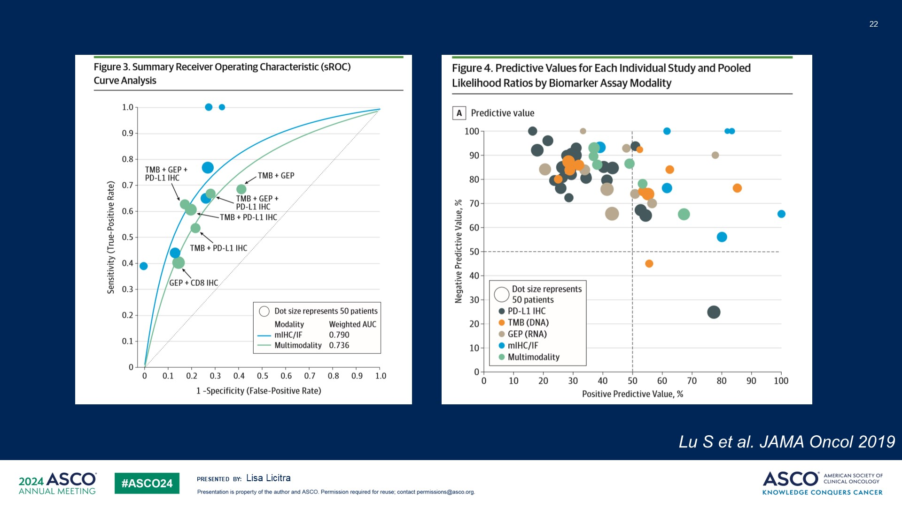
Slide 22
Content of this presentation is the property of the author, licensed by ASCO. Permission required for reuse.

Slide 23
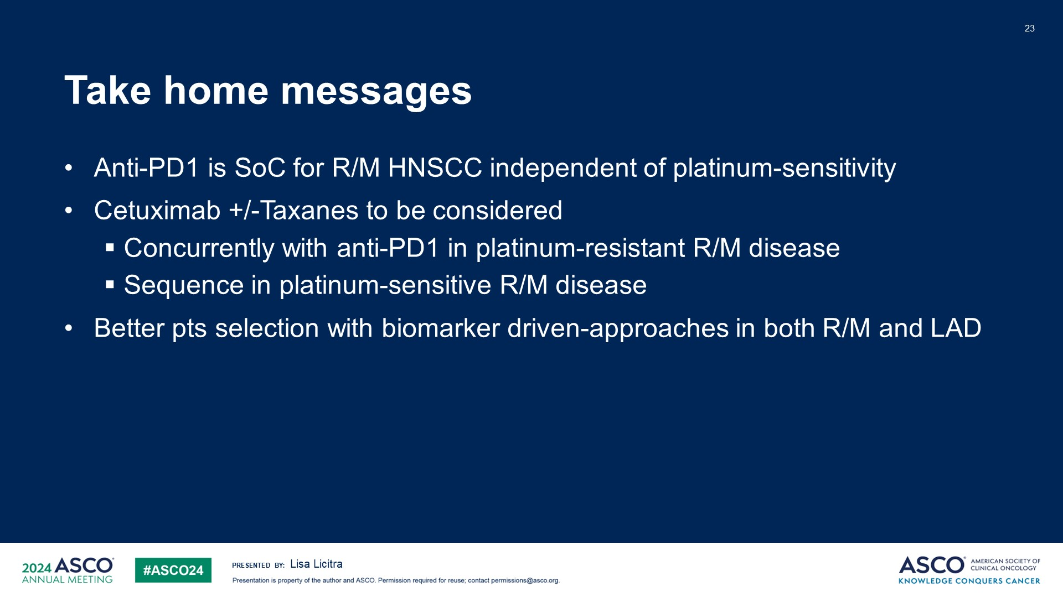
Take home messages
Content of this presentation is the property of the author, licensed by ASCO. Permission required for reuse.

