Slide 1
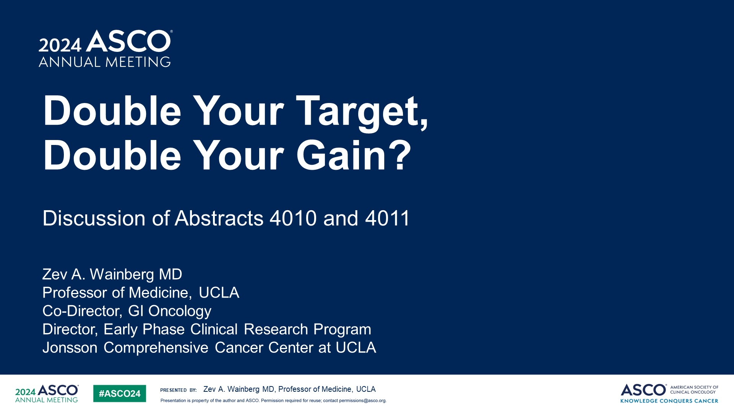
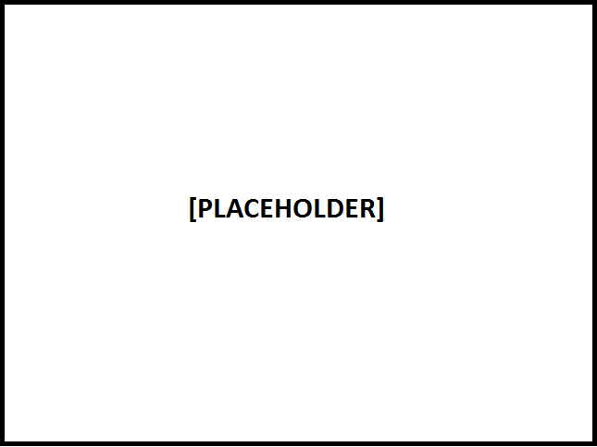
Double Your Target,<br />Double Your Gain?
Content of this presentation is the property of the author, licensed by ASCO. Permission required for reuse.

Slide 2
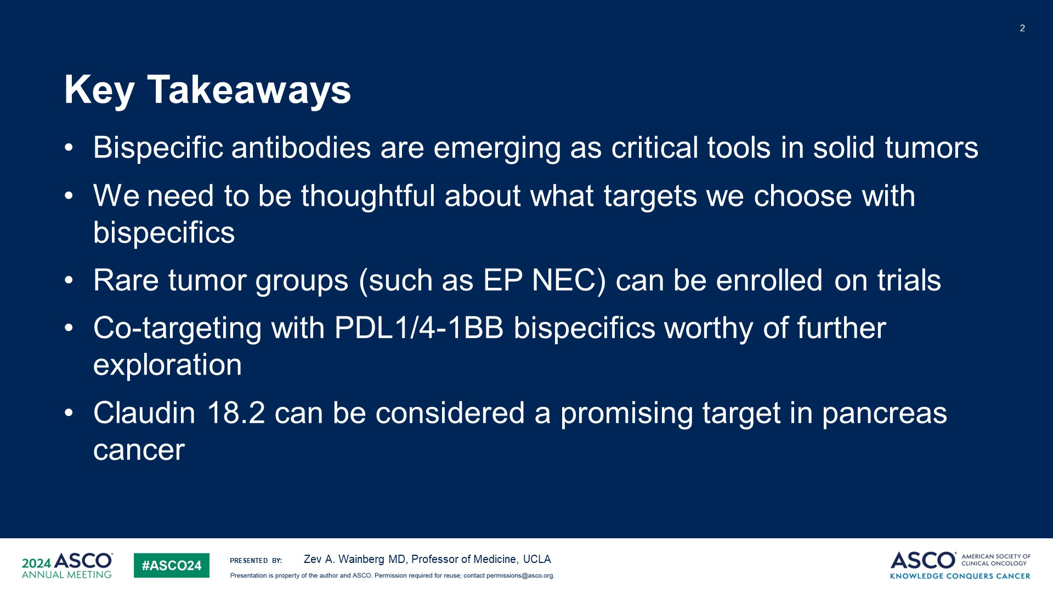
Key Takeaways
Content of this presentation is the property of the author, licensed by ASCO. Permission required for reuse.

Slide 3
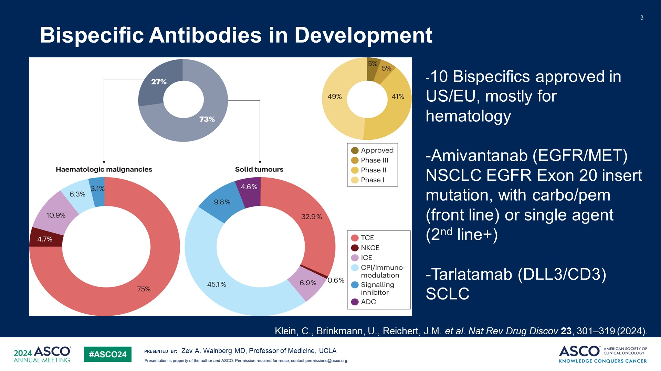
Bispecific Antibodies in Development
Content of this presentation is the property of the author, licensed by ASCO. Permission required for reuse.

Slide 4
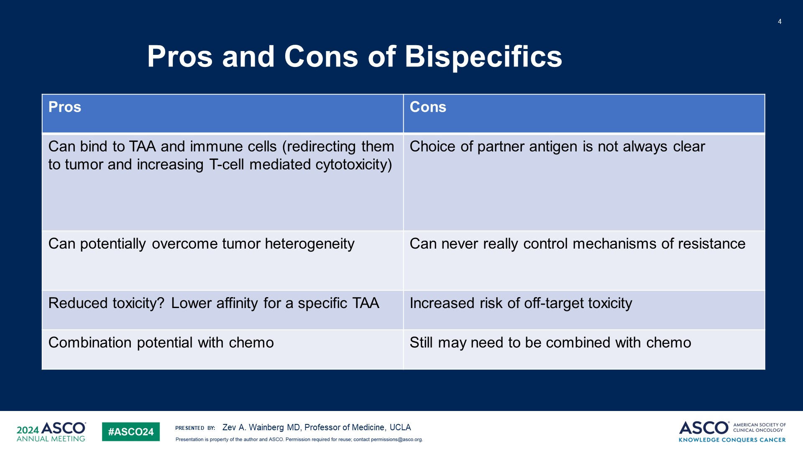
Pros and Cons of Bispecifics
Content of this presentation is the property of the author, licensed by ASCO. Permission required for reuse.

Slide 5
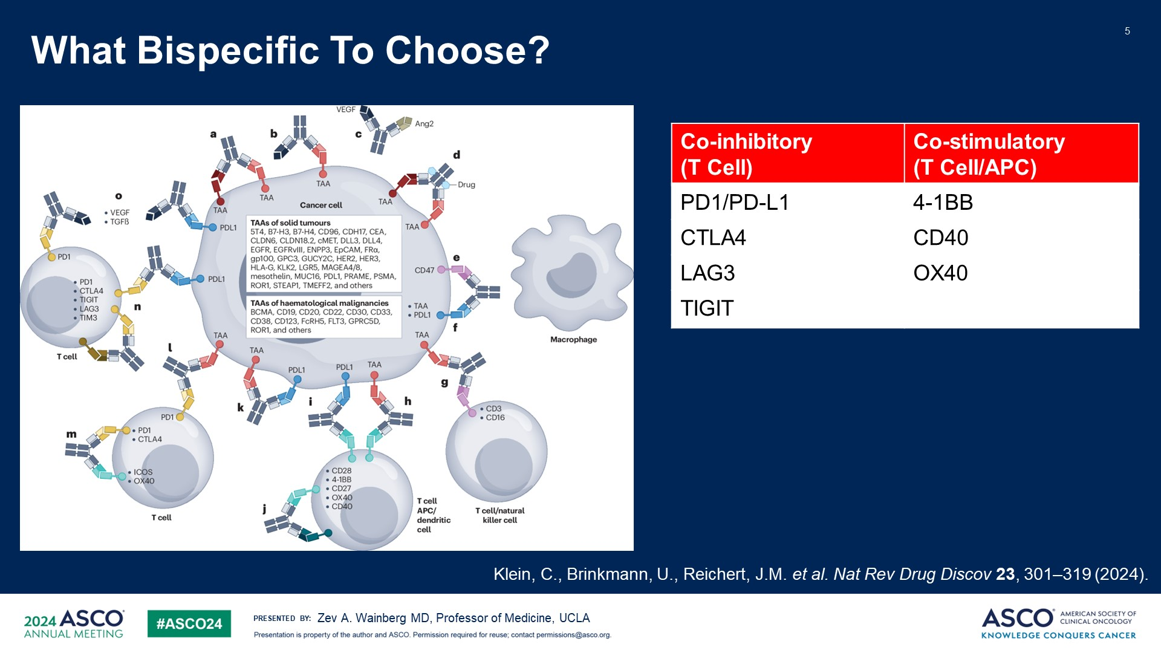
What Bispecific To Choose?
Content of this presentation is the property of the author, licensed by ASCO. Permission required for reuse.

Slide 6
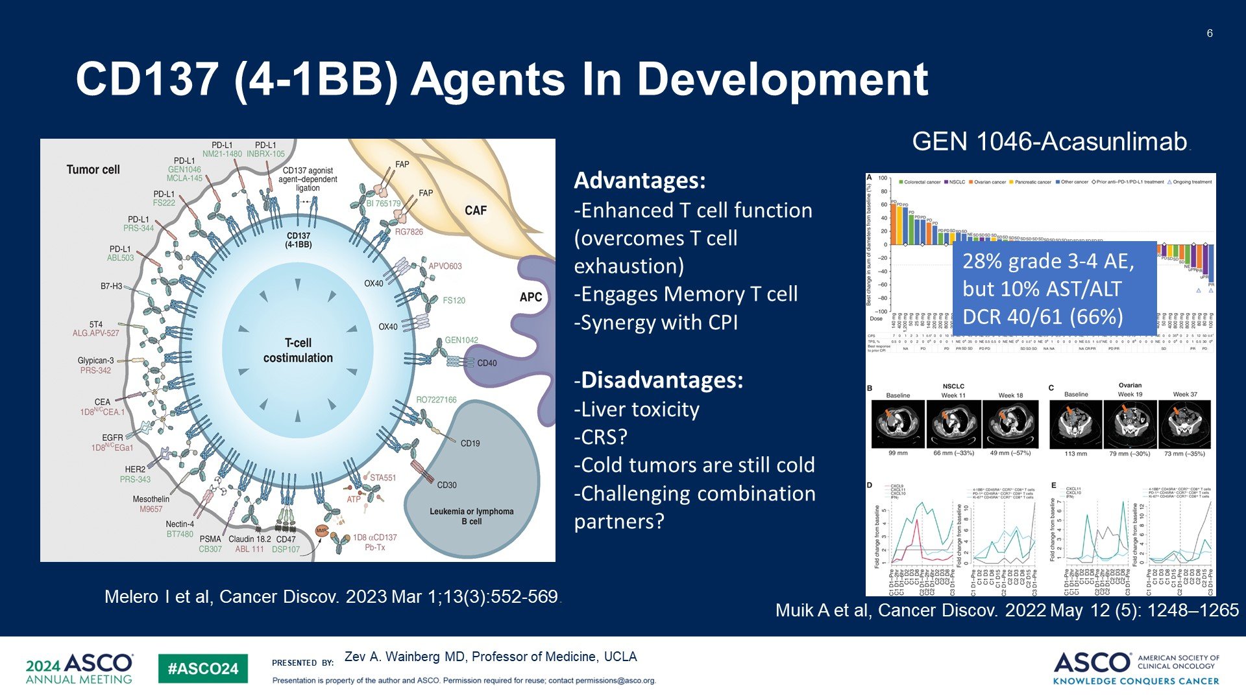
CD137 (4-1BB) Agents In Development
Content of this presentation is the property of the author, licensed by ASCO. Permission required for reuse.

Slide 7
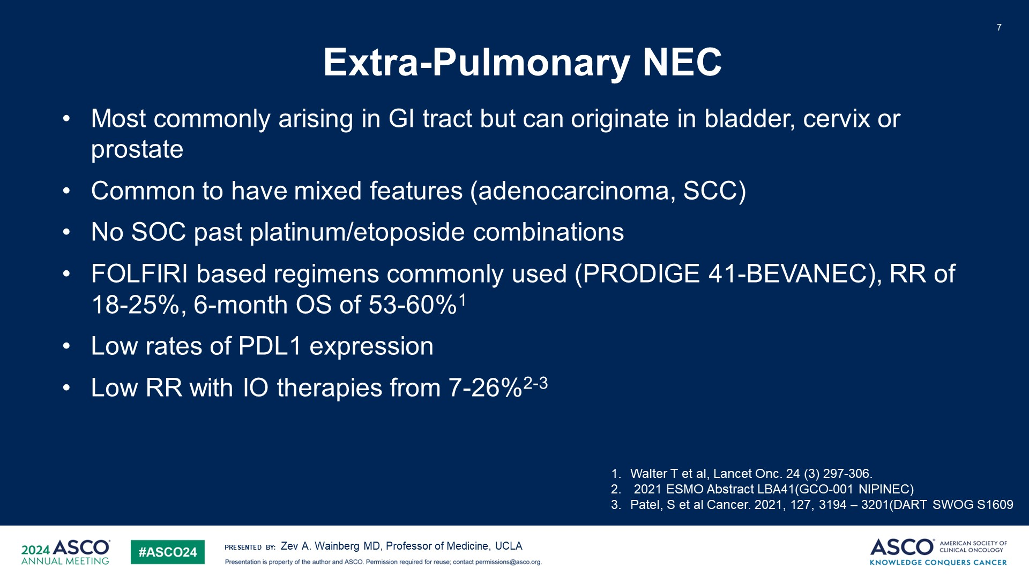
Extra-Pulmonary NEC
Content of this presentation is the property of the author, licensed by ASCO. Permission required for reuse.

Slide 8
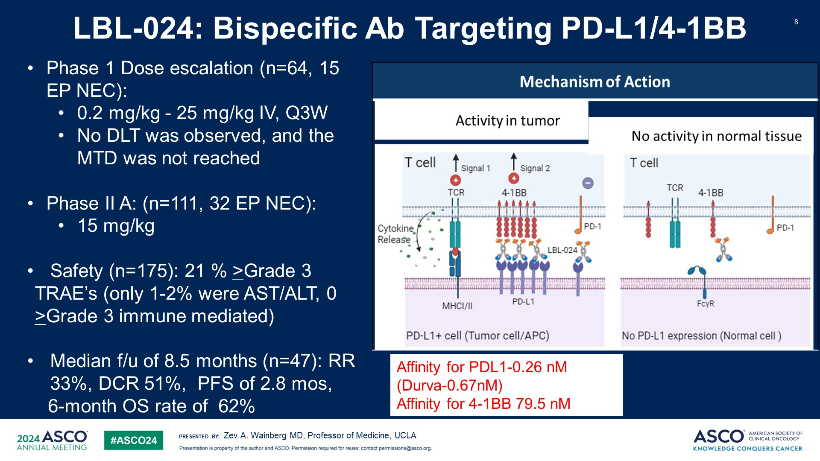
LBL-024: Bispecific Ab Targeting PD-L1/4-1BB
Content of this presentation is the property of the author, licensed by ASCO. Permission required for reuse.

Slide 9
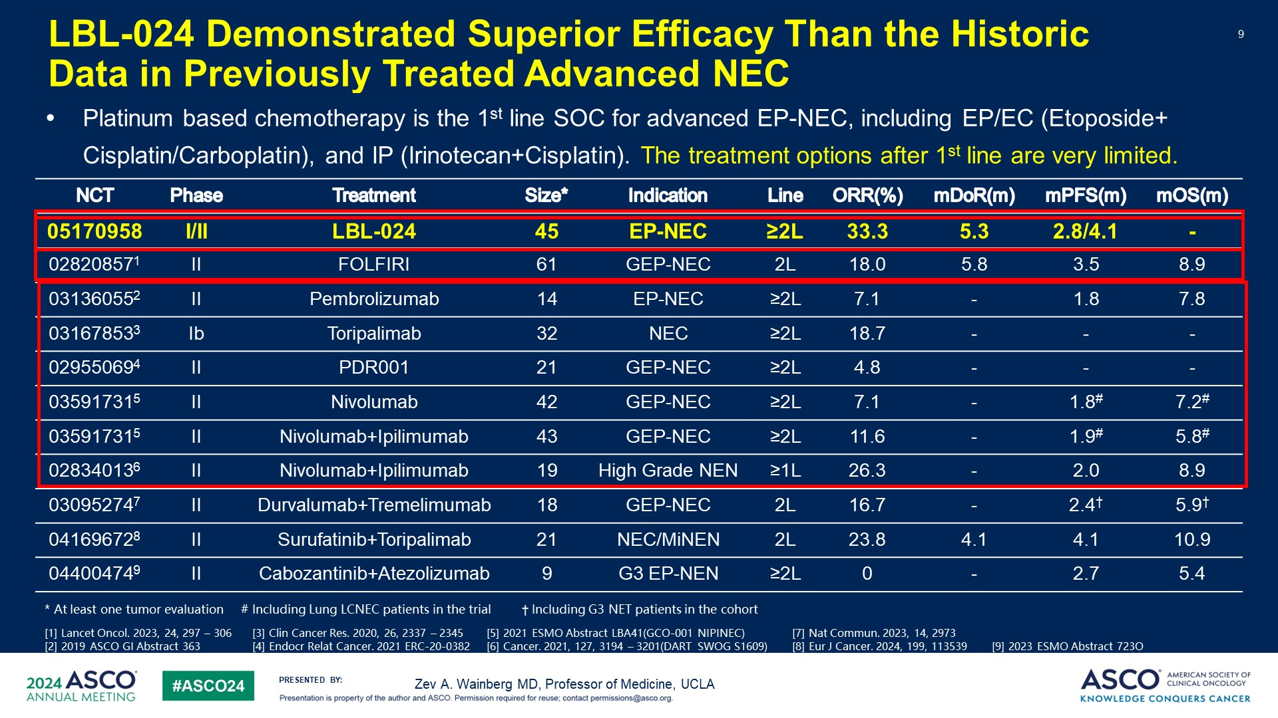
LBL-024 Demonstrated Superior Efficacy Than the Historic Data in Previously Treated Advanced NEC
Content of this presentation is the property of the author, licensed by ASCO. Permission required for reuse.

Slide 10
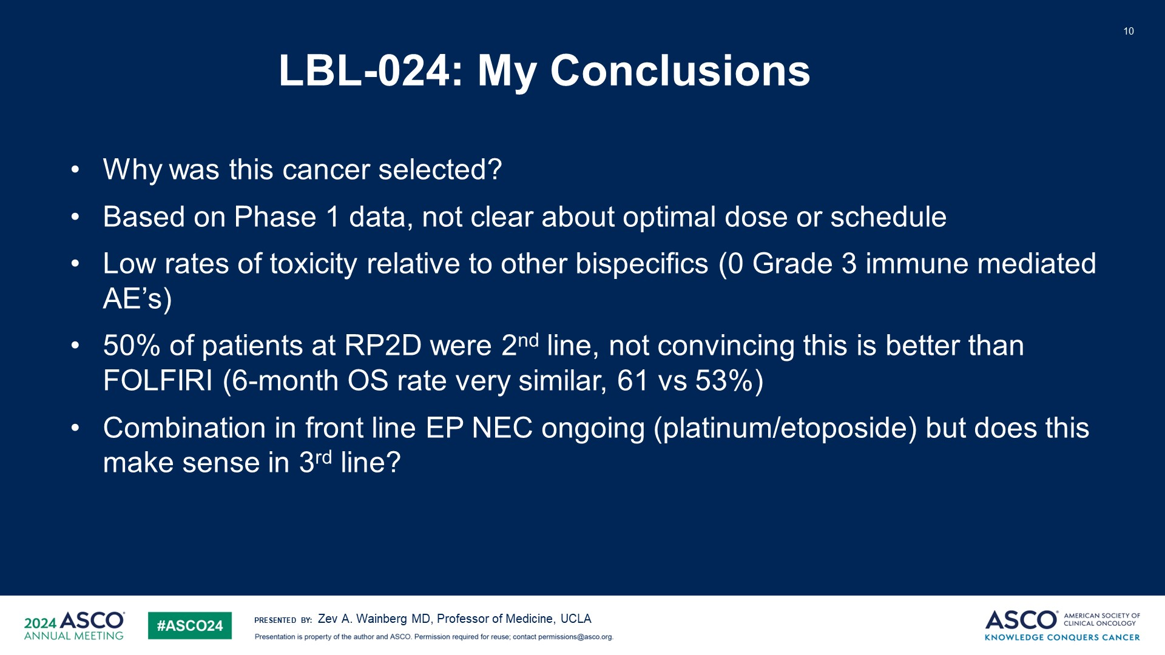
LBL-024: My Conclusions
Content of this presentation is the property of the author, licensed by ASCO. Permission required for reuse.

Slide 11
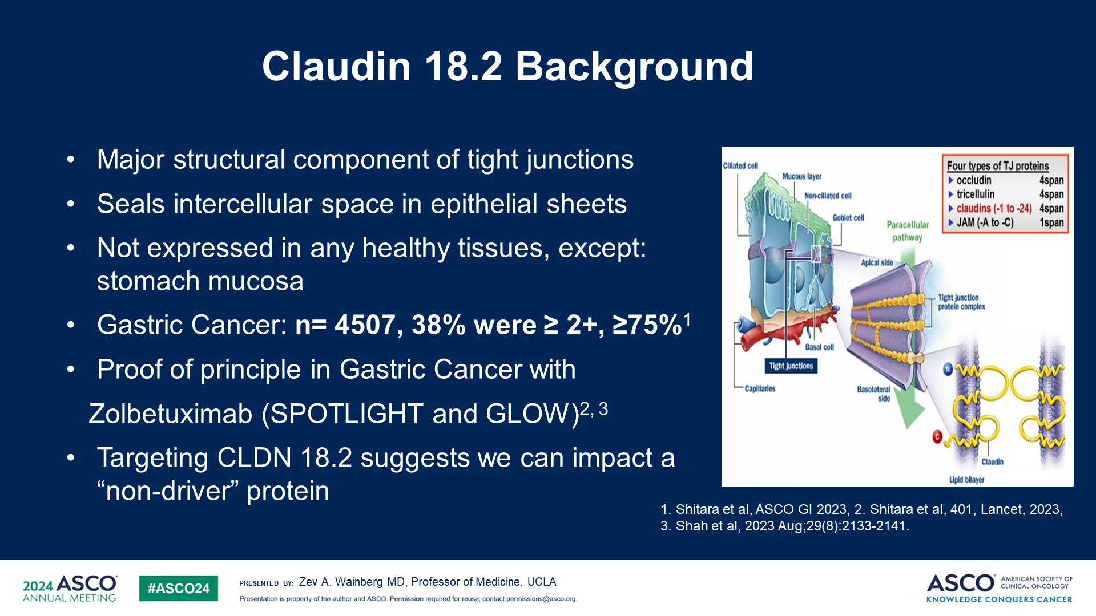
Claudin 18.2 Background
Content of this presentation is the property of the author, licensed by ASCO. Permission required for reuse.

Slide 12
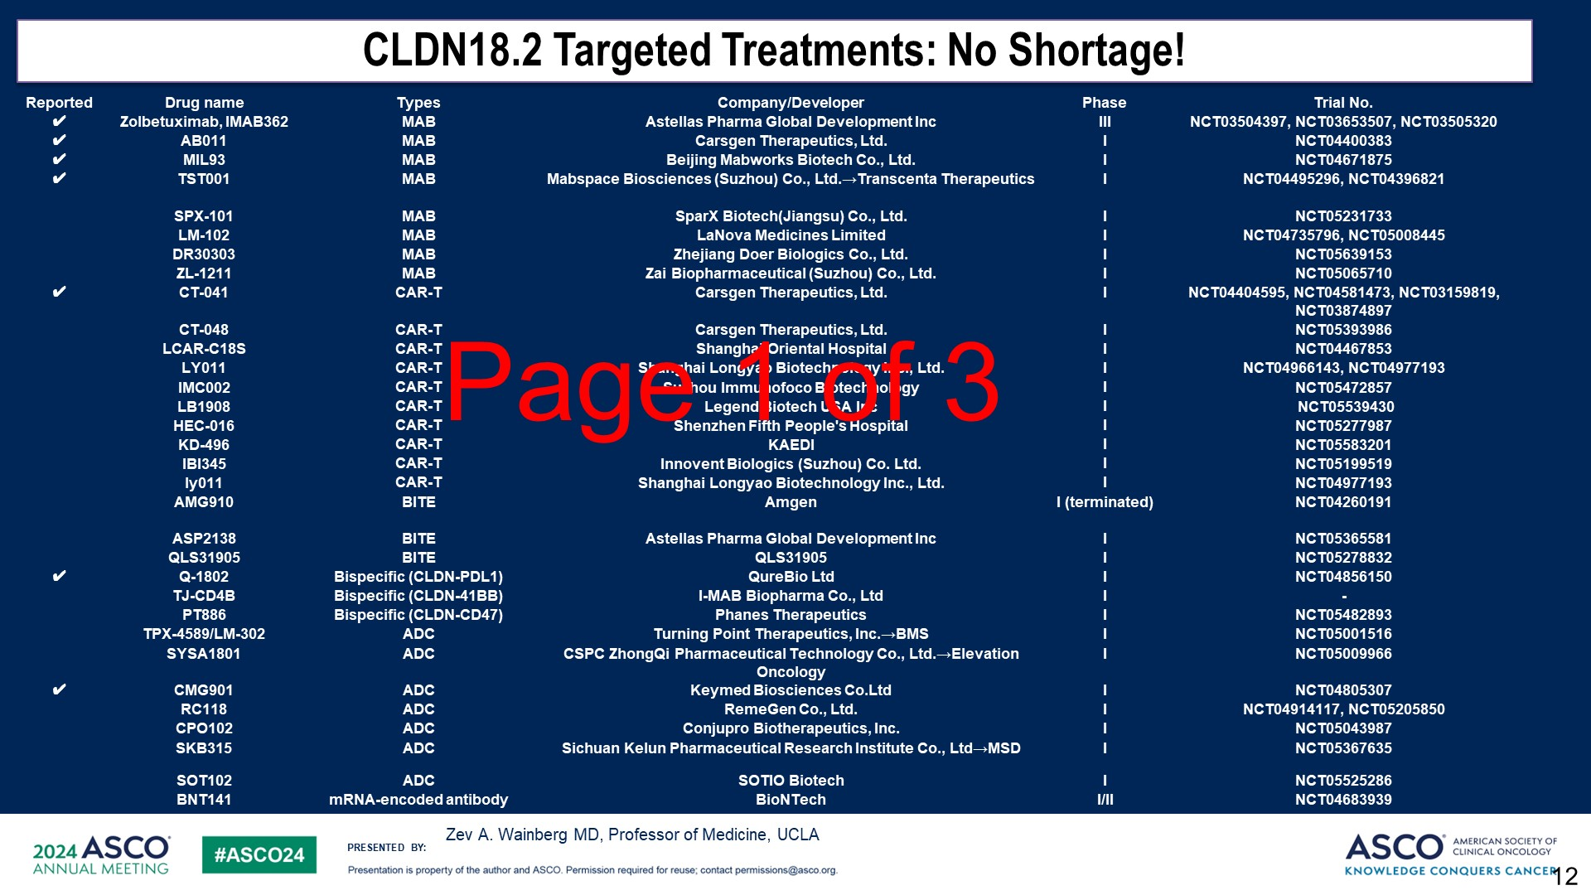
Slide 12
Content of this presentation is the property of the author, licensed by ASCO. Permission required for reuse.

Slide 13
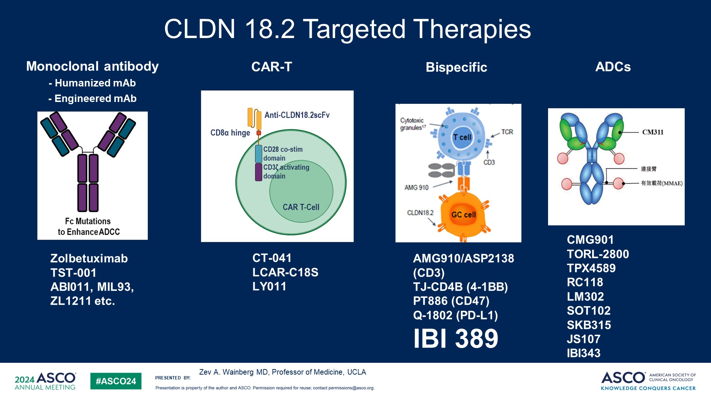
Slide 13
Content of this presentation is the property of the author, licensed by ASCO. Permission required for reuse.

Slide 14
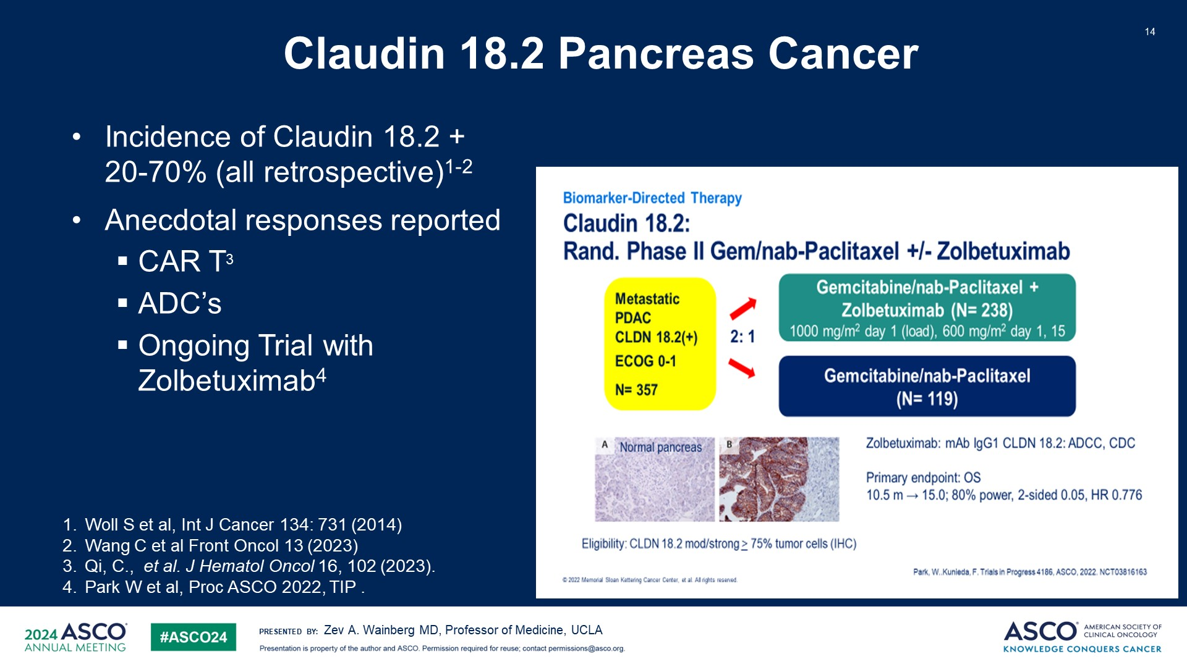
Claudin 18.2 Pancreas Cancer
Content of this presentation is the property of the author, licensed by ASCO. Permission required for reuse.

Slide 15
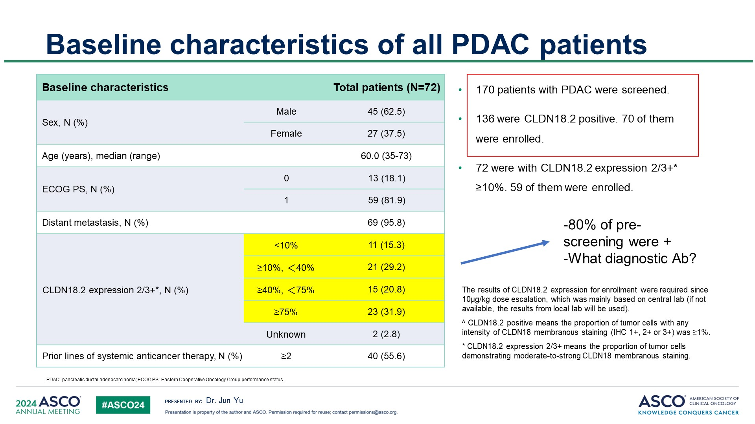
Slide 15
Content of this presentation is the property of the author, licensed by ASCO. Permission required for reuse.

Slide 16
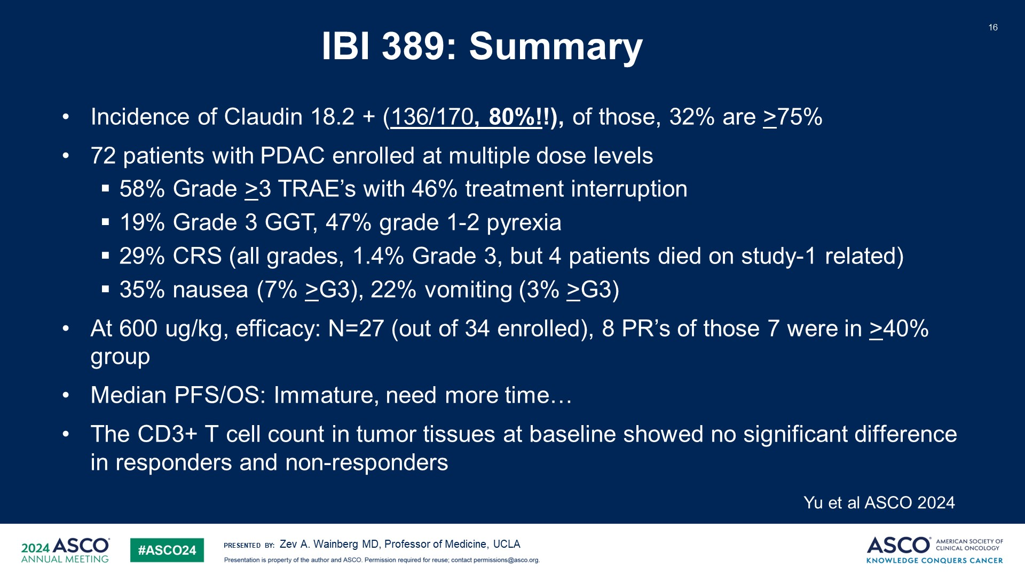
IBI 389: Summary
Content of this presentation is the property of the author, licensed by ASCO. Permission required for reuse.

Slide 17
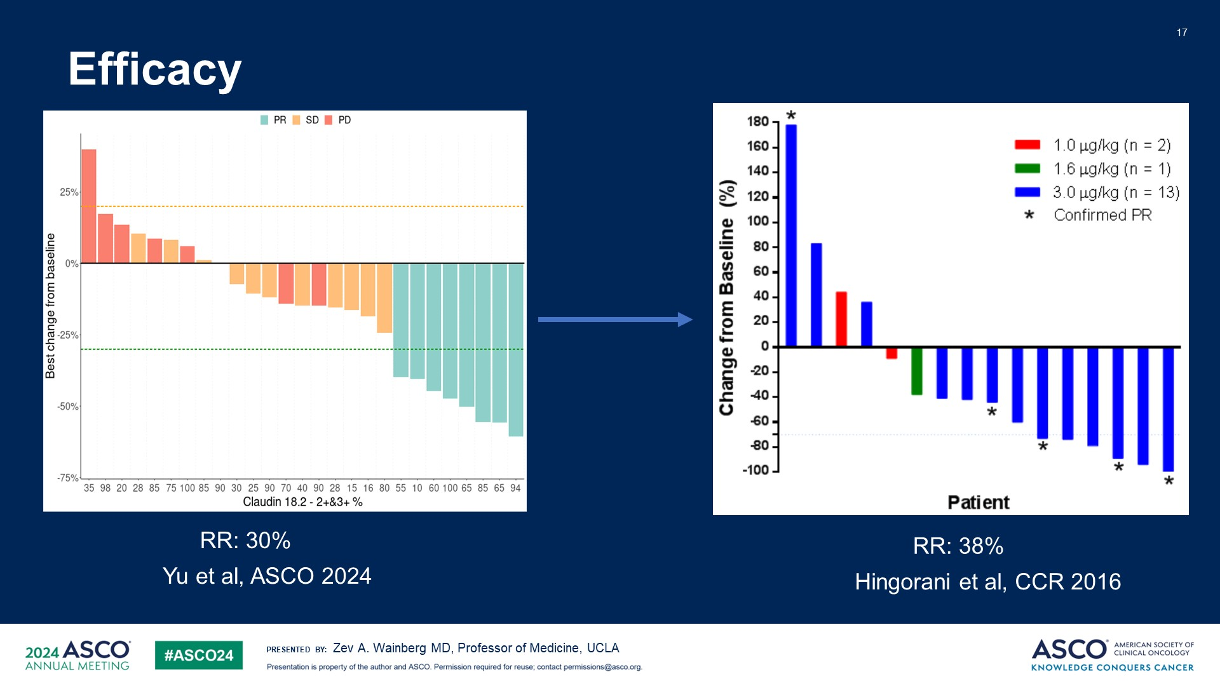
Efficacy
Content of this presentation is the property of the author, licensed by ASCO. Permission required for reuse.

Slide 18
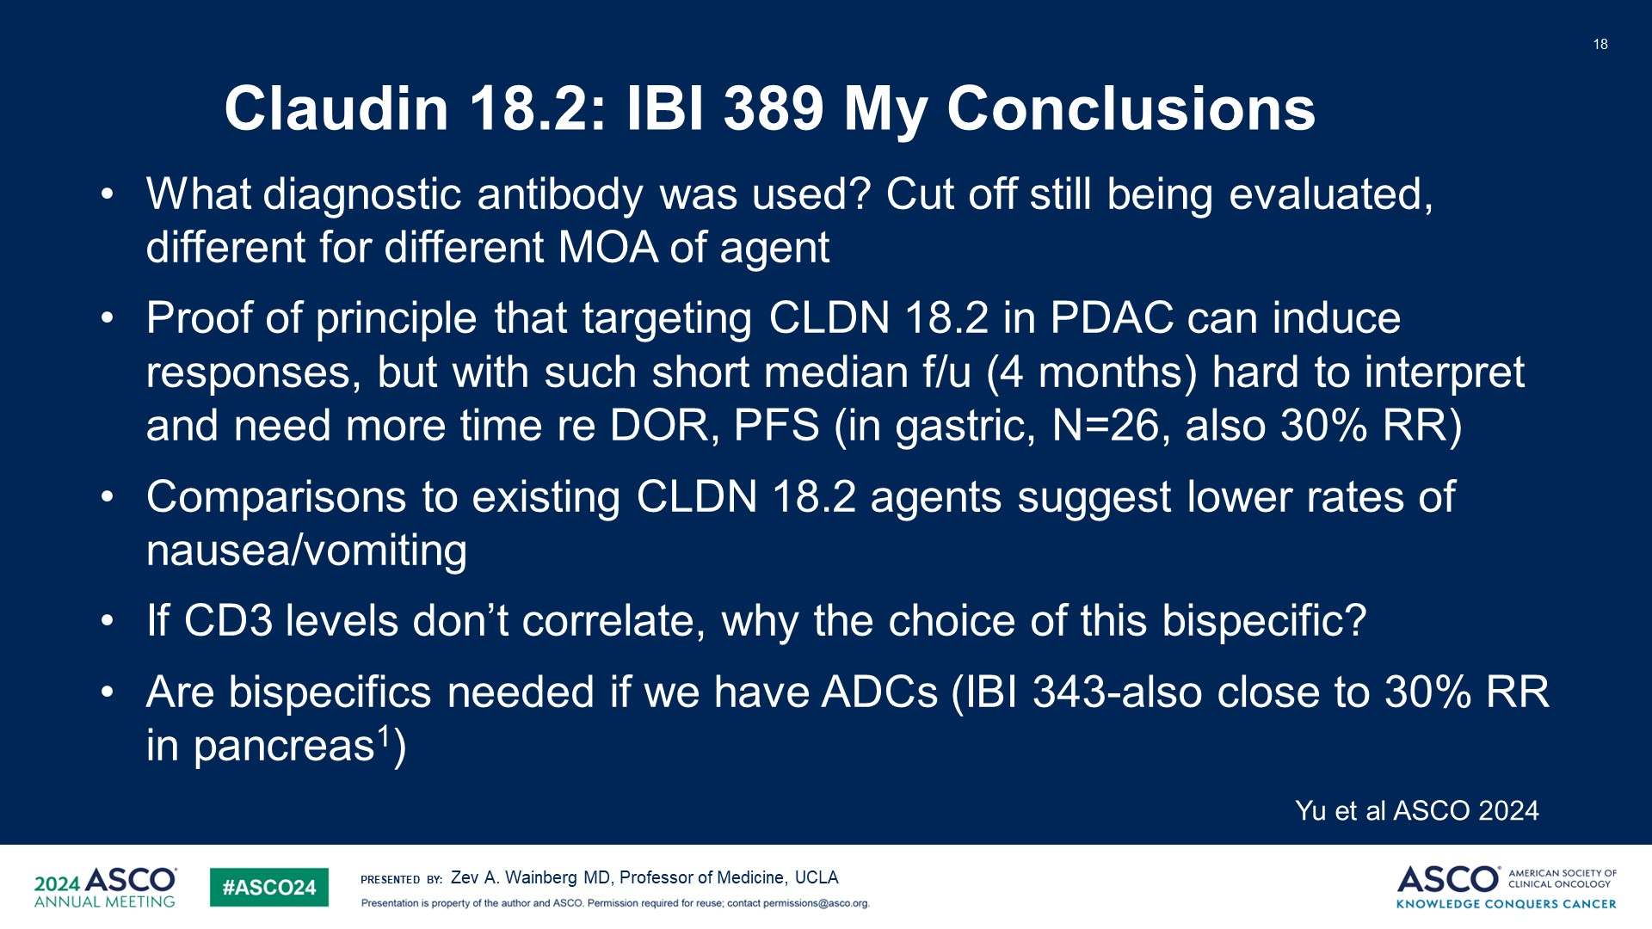
Claudin 18.2: IBI 389 My Conclusions
Content of this presentation is the property of the author, licensed by ASCO. Permission required for reuse.

Slide 19
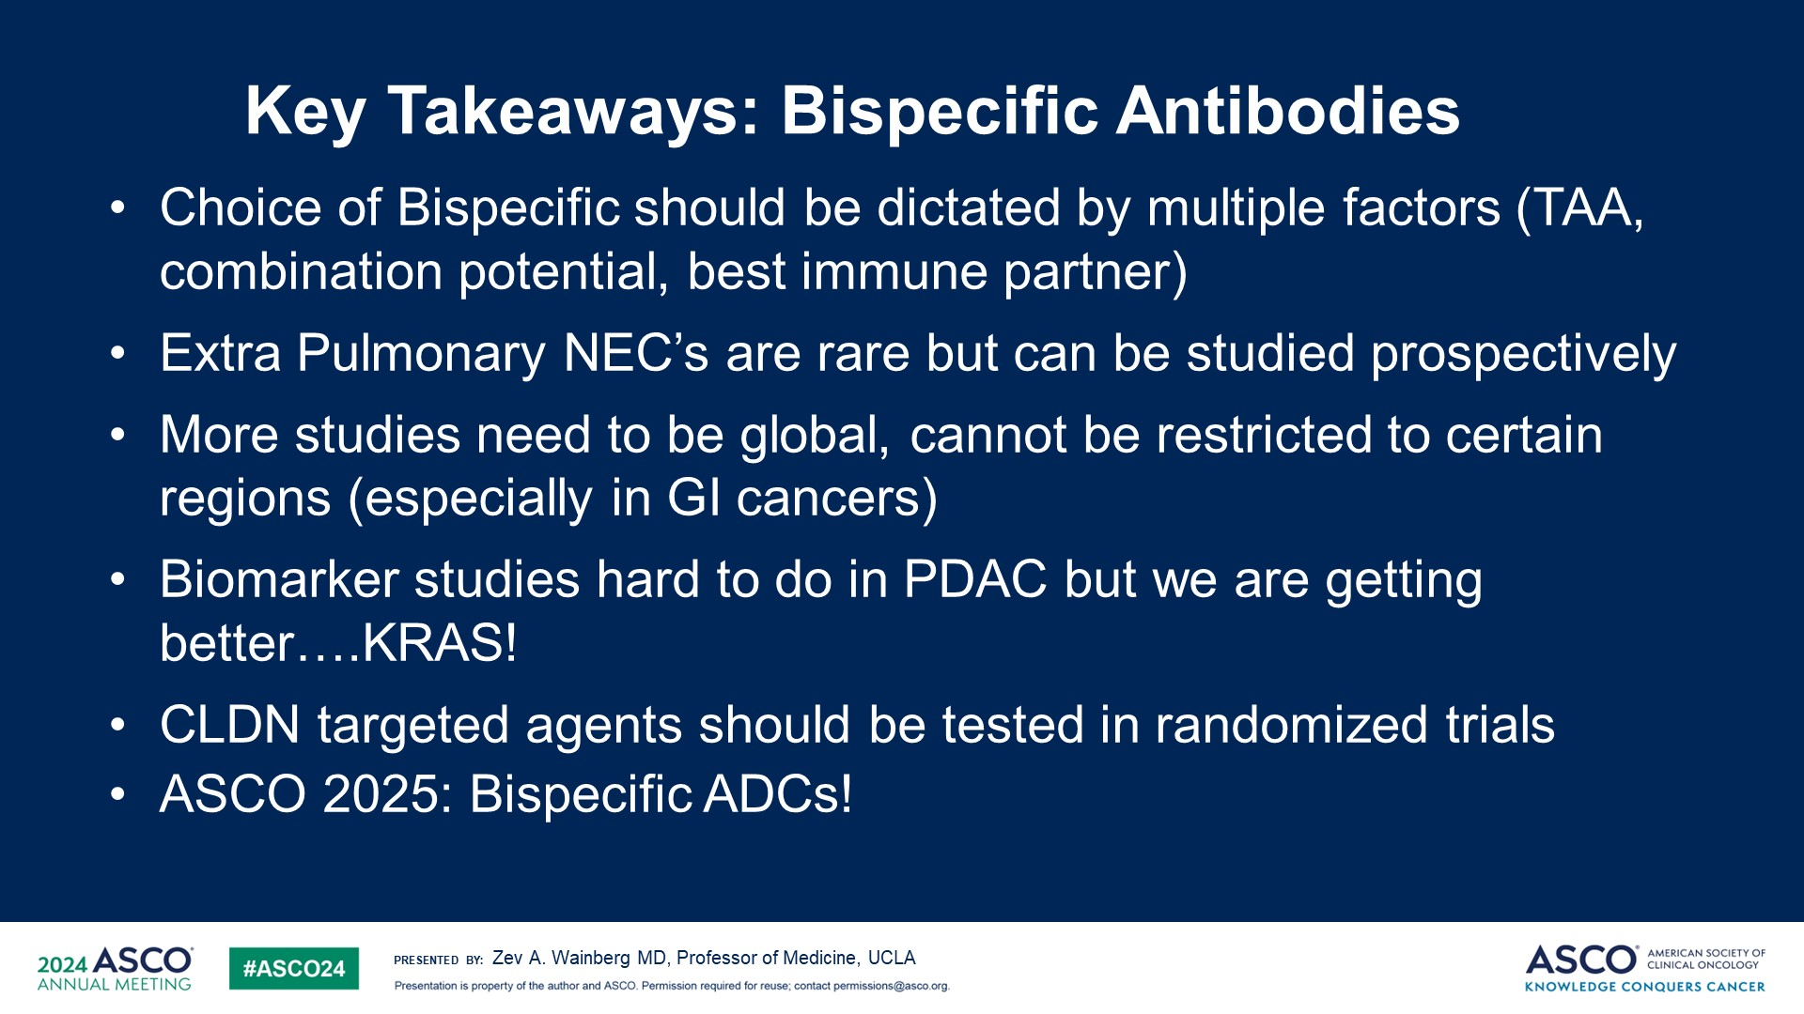
Key Takeaways: Bispecific Antibodies
Content of this presentation is the property of the author, licensed by ASCO. Permission required for reuse.

