Slide 1
Neoadjuvant chemotherapy in MSS colon cancer: Who, what and for how long?
Jenny Seligmann
Leeds, United Kingom

Slide 2
DECLARATION OF INTERESTS
Jenny Seligmann
Consultancy/ Advisory: Astra-Zeneca, Boehinger-Ellison, BMS, GSK, Pierre Fabre Medicament, Merck Serono, Seagen, Servier, Takeda,
Speaker Fees: GSK, Merck Serono, Pierre Fabre Medicament, Servier, Takeda
Research Funding: Amgen, Pierre Fabre Medicament, Merck-Serono, GSK
Travel: Takeda
CME: GI Connect, OncLive
Jenny Seligmann
Content of this presentation is copyright and responsibility of the author. Permission is required for re-use.

Slide 3
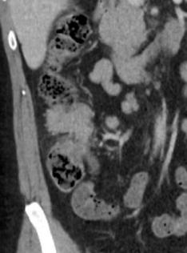
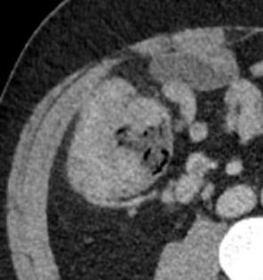
How should this patient be treated?
Jenny Seligmann
• 1st presentation
• Fit for surgery & systemic therapy
• No metastatic disease

Slide 4
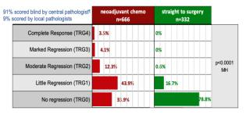
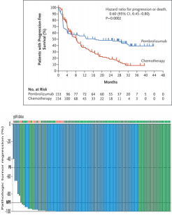
MSI status is critical in LACC
Immunotherapy works for MSI-H!
….Chemotherapy less helpful for MSI-H
MSS & MSI need
to be developed
separately … .
Andre, NEJM, 2021; Chalabi, NEJM, 2024; Morton, JCO, 2022; Deng, JCO, 2024

Slide 5
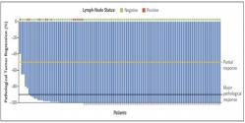
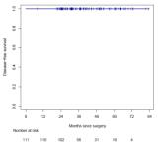
Neoadjuvant immunotherapy
Neoadjuvant chemotherapy

Slide 6
Neoadjuvant treatment for MSS LACC: from
evidence generation to implementation
• Why neoadjuvant chemotherapy can help make gains in the MSS population
• Who should we prioritise?
• What do we give and for how long?
• Implementation

Slide 7
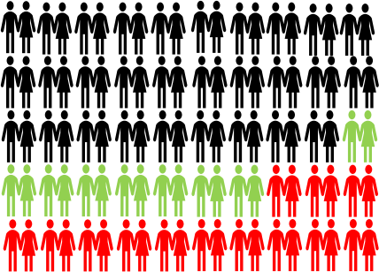
What is wrong with the status quo?
Stage III defined by post-operative TNM stage having
Surgery & adjuvant chemo by ESMO Guidance Standard
Problem
Have disease
recurrence despite current SOC
Need:
New treatment
strategies beyond current SOC
and
with
Can patient
beyond
Jenny Seligmann
Content of this presentation is copyright and responsibility of the author. Permission is required for re-use.

Slide 8
Could neoadjuvant treatment improve outcomes?
Potential advantages & disadvantages of a neoadjuvant therapy in LACC
• Positive experience in other cancers
• Early treatment of micro-metastases
• Downstaging for complete surgical resection
• Prime anti-tumour response when
tumour microenvironment intact and tumour antigen heterogeneity maybe minimal
^{Jenny} ^{Seligmann} Battaglin F,Clin Adv Hematol Oncol, 2018
• Will patients not proceed to surgical resection?
• PD in neoadjuvant window
• Chemotherapy toxicity
• Will NAC lead to an increase in peri-operative complications?
• Can we select appropriate patients for neoadjuvant therapy using
radiological staging assessment?
Content of this presentation is copyright and responsibility of the author. Permission is required for re-use.

Slide 9
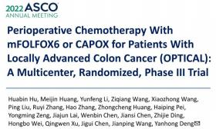
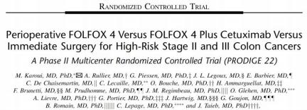
Neoadjuvant Chemotherapy in LACC
Morton et al, JCO 2023; Karoui et al, Ann Surg 2020; Hu et al, JCO, 2024, Jensen, ASCO Annual Meeting 2023

Slide 10
Delivery of NAC
Study | No of patients | Median age | % pts with rT4 | % pts with rN +ve | Completed NAC | Peri-op safety
FOxTROT | 1052 | 65 | 25.5% | 75.3% | 90% | ✅
PRODIGE -22 | 104 | 63.5 | 11.5% | 76.9% | 96% | ✅
OPTICAL | 738 | 56 | 75.4% | 77.2% | 62% | ✅
NEOCOL | 250 | 66 | 26% | - | - | ✅
Morton et al, JCO 2023; Karoui et al, Ann Surg 2020; Hu et al, JCO, 2024, Jensen, ASCO Annual Meeting 2023

Slide 11
Randomized trials of neoadjuvant chemo in LACC
Study | Downstaging |  | R0 resection (NAC vs STS) | 3 year DFS (NAC vs STS) | MSI/MMR data available
 | T
FOxTROT (n=1052) | ✅ | ✅ | 93%vs 88% | 80.7% vs 75.8%, (HR = 0.73 p=0.030) | ✅
PRODIGE-22 (n=104) | ✅ | ✅ | 94% vs 98% | 76.8% vs 69.2%
OPTICAL (n=744) | ✅ | ✅ | 98% vs 98%% | 77.5% vs 82.1% (HR = 0.74, p=0.07) | ✅
NEOCOL (n=250) | ✅ | ✅ | 93% vs 90% | P=0.98
N
Morton et al, JCO 2023; Karoui et al, Ann Surg 2020; Hu et al, JCO, 2024, Jensen, ASCO Annual Meeting 2023

Slide 12
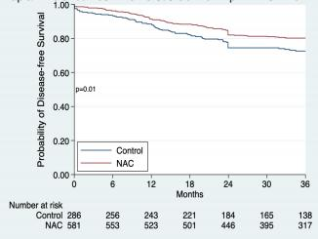
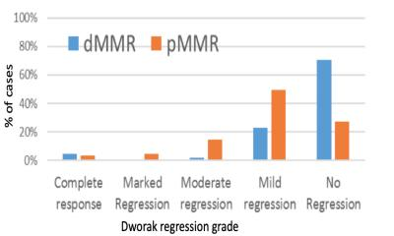
FOxTROT Trial: Outcomes for pMMR patients
• MMR status available for
914/1052 (86.8%) of patients
• 20.2% dMMR; 79.8% pMMR or unknown
3 year DFS: NAC vs Upfront surgery MSS pts (80.7% vs 75.8%)
HR=0.68 (0.51-0.92)
 | 44% 40%
10%
3%
3%
Morton et al, JCO, 2023

Slide 13
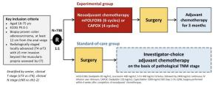
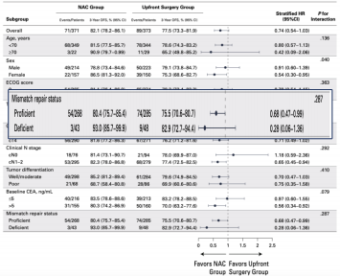
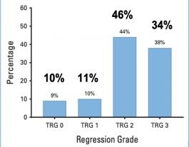
OPTICAL Trial: Outcomes for pMMR patients
3 year DFS for NAC vs upfront surgery in MSS pts = 79.9% vs 74.0% (HR = 0.68 [0.61-0.99])
• MMR status
available for 87% of patients
Pathological response rates in pMMR patients treated with NAC
11%
Hu et al, JCO, 2024

Slide 14
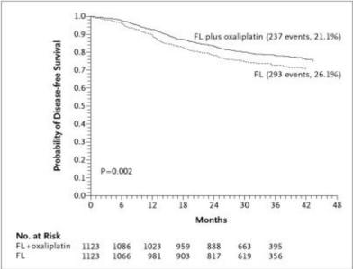
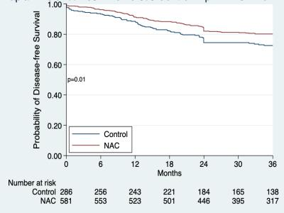
What effect is needed to change practice –
3 yr DFS?
NAC vs Upfront surgery MSS pts (5.3%)
Addition of oxaliplatin to 5FU (5.3%)
HR=0.68 (0.51-0.92)
Mortonetal, JCO 2023, Andre, NEJM, 2004

Slide 15
Do some patients benefit more from NAC?
Subgroup analysis from OPTICAL and FOxTROT
Favours NAC Favours upfront surgery
Highest risk clinically
staged tumors
appear to benefit
MOST from NAC

Slide 16
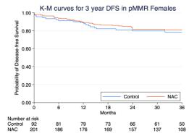
Do some patients benefit more from NAC?
Same effect not seen in FOxTROT
Pathological response post NAC by sex
Hu et al, JCO, 2024;

Slide 17
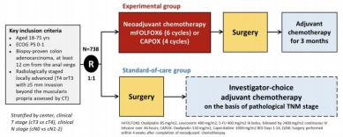
What NAC to give?
• 70% received FOLFOX
• 30% received CAPOX
Most common grade 3/4
were neutropenia (16%) &
anemia (11%)
Most common grade 3/4
were anemia (5%) &
hand-foot (5%)
Hu et al, JCO, 2024

Slide 18
What NAC to give?
• No results on differential efficacy No data on diarrhea rates
• All patients were planned to have
6 months duration of treatment
Delivering either drug reasonable, but:
• Consider baseline characteristics of patients as per adjuvant chemo choices
• Less confidence in applicability to older patients/ co-morbidities
• Consider duration of planned treatment as per IDEA recommendations
Hu et al, JCO, 2024

Slide 19
How much pre-operative treatment to give?
6 weeks (FOxTROT)
• pCR rate of 2.3%
• 44% no response
• 90% completed planned chemotherapy
• 3 year DFS = 81%
• Well tolerated
• Lower rates of pathological response
Stop/ start impact
12 weeks (OPTICAL)
• pCR rate of 10%
• 34% no response
• 62% completed planned chemotherapy
• 3 year DFS = 79.9%%
• Higher pCR rate for those who completed
Deliver total neoadjuvant treatment
• Poorer compliance
Higher rate of symptomatic progression

Slide 20
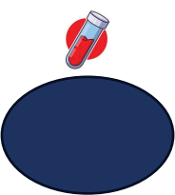
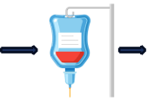
Duration of pre-operative treatment: speculation
Well tolerated
AND signs of
response
Clinical
assessment
of treatment
strategy
6 weeks
MDT review of
diagnosis &
staging
Poorly
tolerated OR no
signs of
response

Slide 21
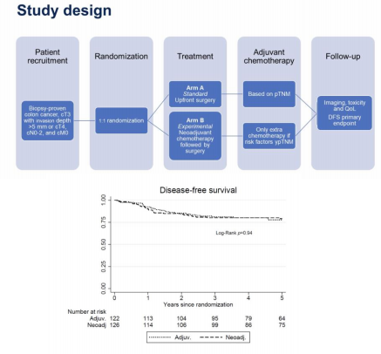
Adjuvant chemotherapy following NAC
• Can you de-escalate AC if good pathological response post NAC
• 41% of patients did not receive AC following NAC
• Elements of design limit interpretation
• Aim 10% improvement with NAC
• N = 250
• ctDNA may help this decision
My recommendation is to
complete planned chemotherapy duration based upon IDEA
recommendations
Larsson, ASCO Annual Meeting, 2023

Slide 22
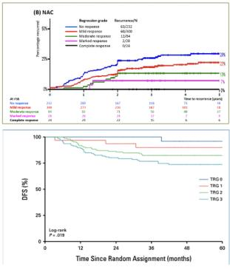
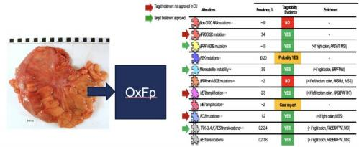
…Can we do better?
Morton et al, JCO, 2023; Hu et al, JCO, 2024

Slide 23
Strategies to improve neoadjuvant outcomes in MSS LACC
Intensify NAC to mFOLFOXIRI
FOxTROT 3, PROTECTOR
Targeted treatments for driver mutations
UNICORN, FOxTROT 4, NEO-screening
Next generation IO +/- chemo
NEST, NICHE, AZUR-4
HIPEC + NAC
TTD collaborative
Include obstructed patients
Concerto

Slide 24
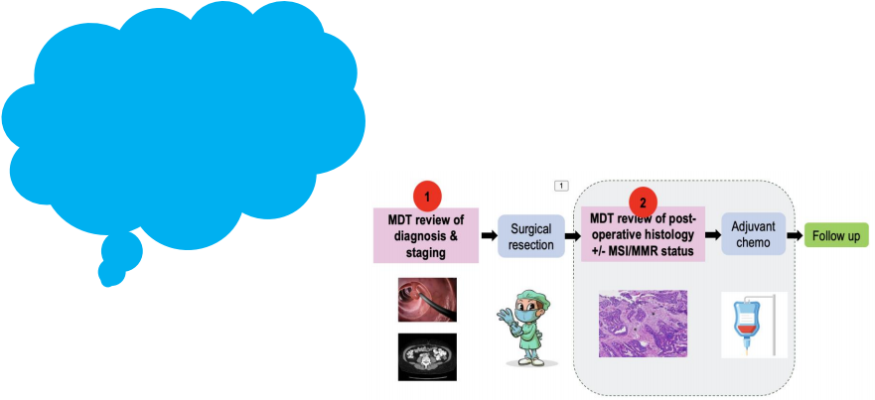
Implementation of neoadjuvant treatments
How do we
integrate this
into our
existing patient
pathways?
How do we
select patients
for
neoadjuvant
treatment?

Slide 25
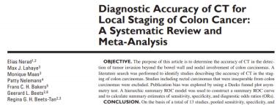
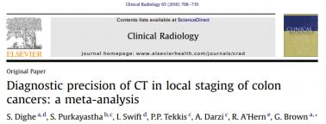
The Accuracy of Radiological Staging in Colon Cancer has been Well Studied
Hewish et al., AJRAm J Roentgenol. 2016 Nov;207(5):984-995 Dighe et al., Clin Radiol. 2010 Sep;65(9):708-19
In summary:
T stage accuracy = GOOD N stage accuracy = POOR
Slide courtesy of James Platt

Slide 26
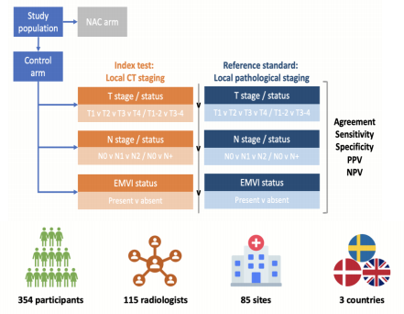
Comparison of radiological & pathological staging
• T stage
• Overall agreement = 60.0%
• T1/2 vsT 3/4 PPV = 94.5%
• N stage
• Overall agreement = 54.1%
• PPV for N0 vs N+ = 57.1%
• EMVI status
• PPV for EMVI +/- = 50.7%
Platt et al, ESGAR Congress, 2023

Slide 27
Do other factors influence performance?
MMR Proficient vs. MMR Deficient
 |  | MMR proficient | MMR deficient
N status | Sensitivity | 79.7 (71.9 – 86.2) | 89.3 (71 8 97.7)
 | NPV | 52.6 (39.0 – 66.0) | 78.6 (49.2 – 95.3)
 | PPV | 56.4 (49.0 – 63.6) | 46.3 (32.6 – 60.4)
Higher neutrophil count associated with N1/2 ‘status’ (P = 0.0077)²
Platt et al, ESGAR Congress, 2023

Slide 28
Can we identify the high risk patient on CT?
Radiological Feature |  | Hazard ratio (95% CI) or any recurrence | P value ^{c}
T stage ^{b} T3 |  | 1.0
T4 |  | 1.57 (1.19-2.07) | 0.001
Depth of extramural extension | Continuous | 1.03 (1.02-1.04) | 0.00001
≤7 |  | 1.0
>7 |  | 1.67 (1.29-2.18) | 0.0001
Maximum tumour thickness Continuous |  | 1.16 (1.06-1.27) | 0.001
≤25 |  | 1.0
>25 |  | 1.59 (1.21-2.09) | 0.001
Node ≥10mm No |  | 1.0
Yes |  | 1.40 (1.07-1.83) | 0.01
EMVI Absent |  | 1.0
Present |  | 1.41 (1.07-1.86) | 0.02
Platt et al, ESMO Congress, 2024

Slide 29
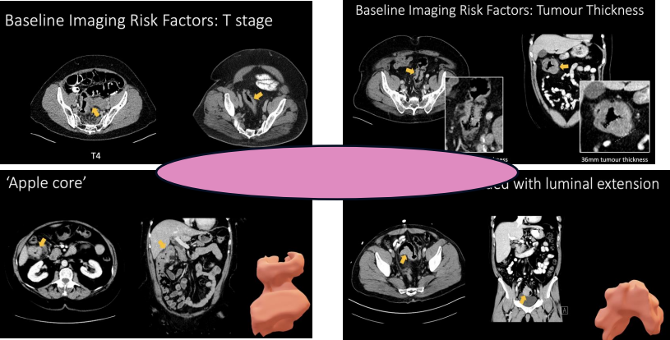
Beyond T stage
What do you measure?
Slide
courtesy
of Dr James Platt

Slide 30
Patientselection – how to move forward
• Engagement with radiology
• Prioritise training in planned studies
• Transition toward
radiological phenotyping – don’t limit to information
collected by TNM
• Future likely to involve
artificial intelligence
algorithms & multi-modal risk stratification

Slide 31
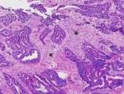
Decision points in the Treatment pathway
Pathway coordination
1
2
PATIENT
CHOICE
Assessment of post-rx response
MDT review diagnosis staging
Surgical resection
MDT review of post- operative histology
MSI/MMR status
Follow up
Upfront
MMR/MSI
Ability to
review &
treat
rapidly
Informed &
supportive
surgical
colleague
Radiology
call on T &
N stage
Jenny Seligmann
Content of this presentation is copyright and responsibility of the author. Permission is required for re-use.

Slide 32
Summary
• Clinical need to improve outcomes in MSS localized colon cancer
• Consistent moderate efficacy demonstrated with neoadjuvant chemotherapy
• 5% with just change in sequence!
• Most benefit likely with most advanced tumors
• 6 or 12 weeks NAC reasonable depending upon clinical situation
• Need for improvements in patientselection
• Ongoing development need rather than Stop/Go
• Implementation requires buy-in from multidisciplinary team

Slide 33
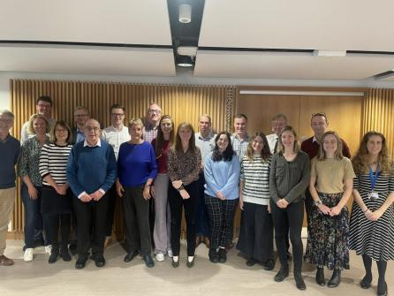
Acknowledgements
• To all the multidisciplinary FOxTROT collaborators from contributing
international centres
• To Yorkshire Cancer Research for FOxTROT Platform Core Funding
• Cancer Research UK and Yorkshire Cancer Research for core funding of the FOxTROT Trial and associated
laboratory research
• All of the patients and carers who participate in this research
• Pernille for administrative support

Slide 34
European Society for Medical Oncology (ESMO)
Via Ginevra 4, CH-6900 Lugano
T. +41 (0)91 973 19 00
esmo@esmo.org
esmo.org

