Slide 1


Evolving Treatment Paradigms in Rectal Cancer
Content of this presentation is the property of the author, licensed by ASCO. Permission required for reuse.

Slide 2
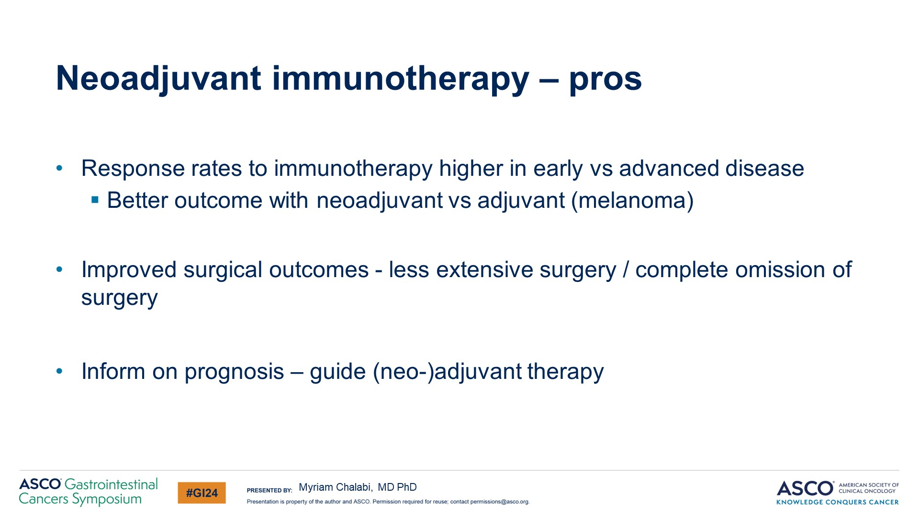
Neoadjuvant immunotherapy – pros
Content of this presentation is the property of the author, licensed by ASCO. Permission required for reuse.

Slide 3
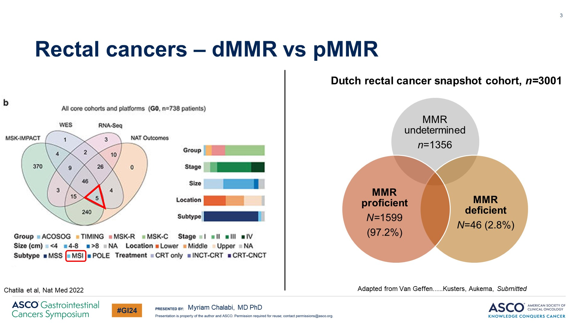
Rectal cancers – dMMR vs pMMR
Content of this presentation is the property of the author, licensed by ASCO. Permission required for reuse.

Slide 4
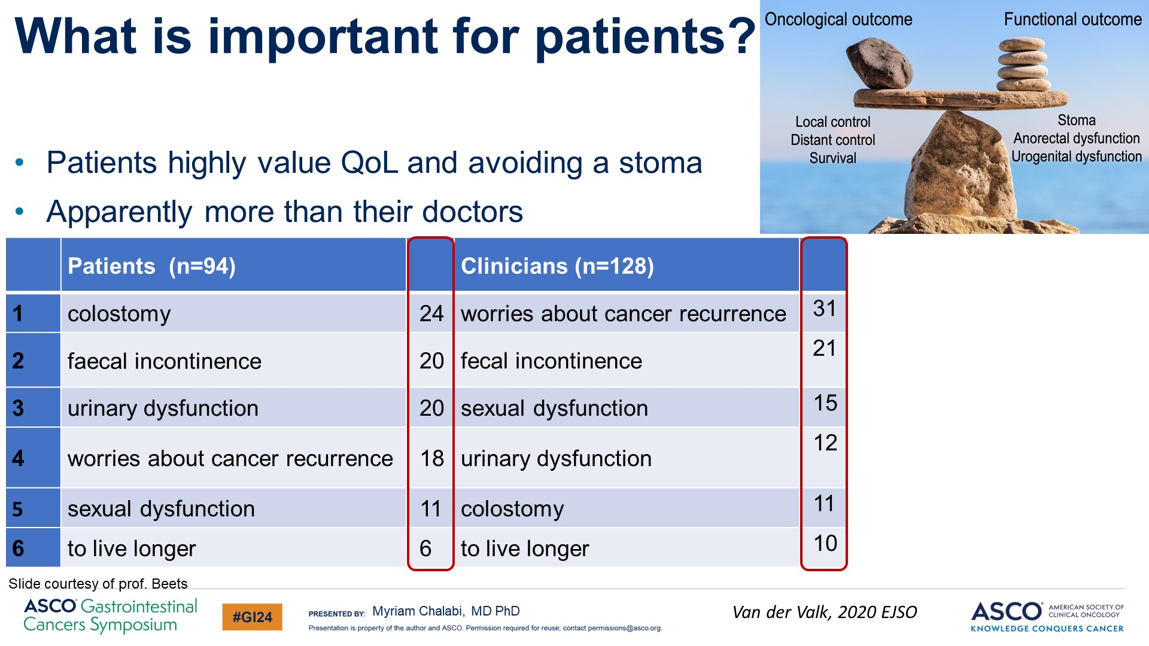
What is important for patients?<br /><br />
Content of this presentation is the property of the author, licensed by ASCO. Permission required for reuse.

Slide 5
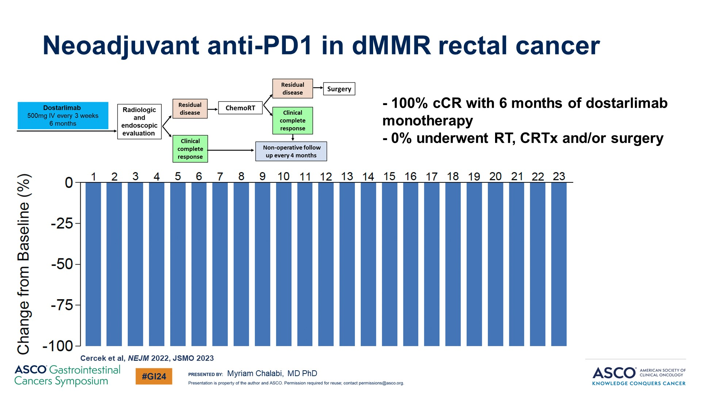
Neoadjuvant anti-PD1 in dMMR rectal cancer
Content of this presentation is the property of the author, licensed by ASCO. Permission required for reuse.

Slide 6
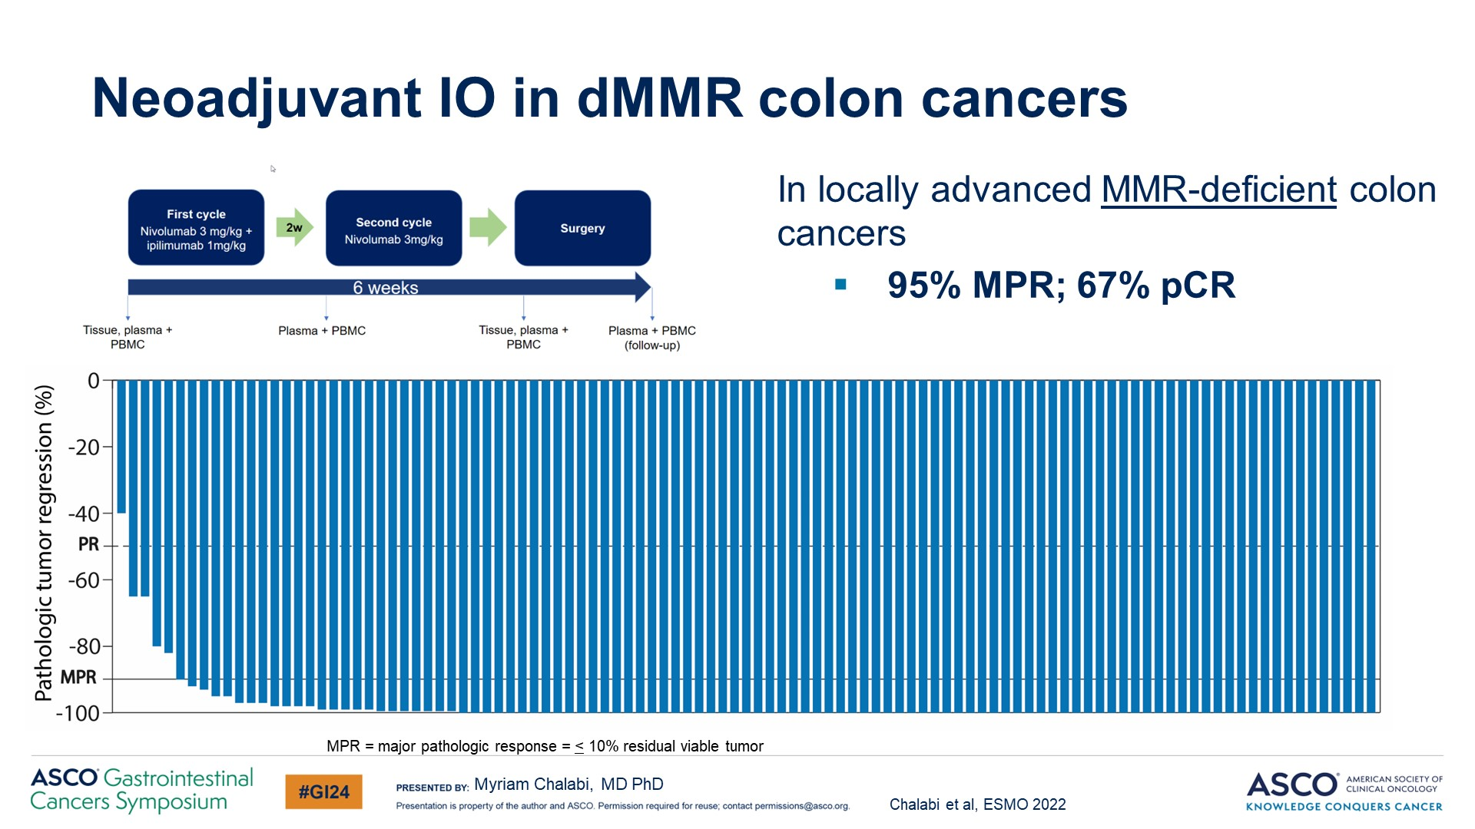
Neoadjuvant IO in dMMR colon cancers
Content of this presentation is the property of the author, licensed by ASCO. Permission required for reuse.

Slide 7
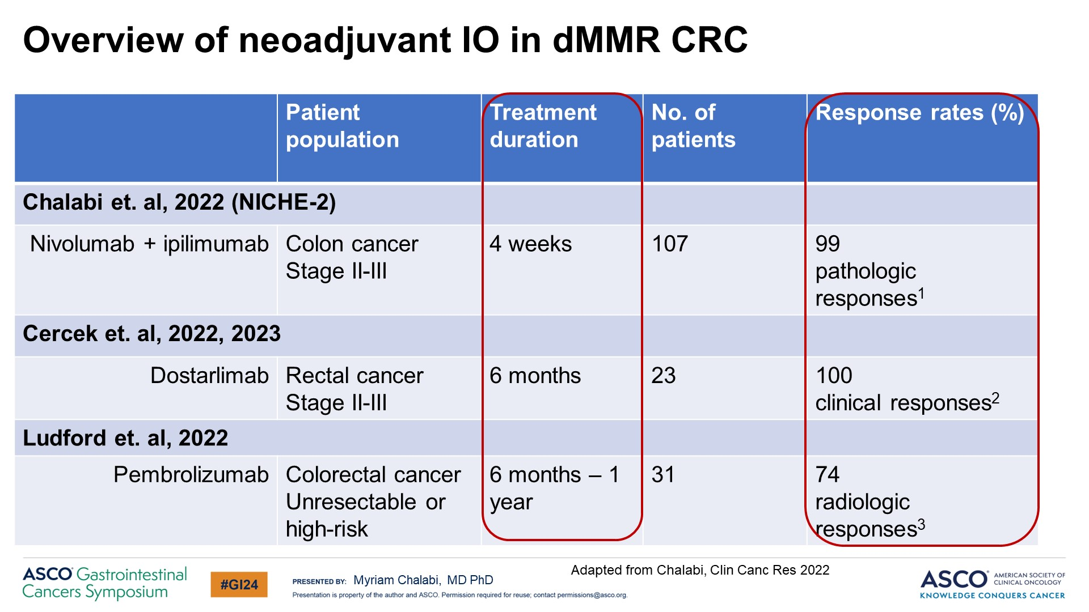
Slide 7
Content of this presentation is the property of the author, licensed by ASCO. Permission required for reuse.

Slide 8
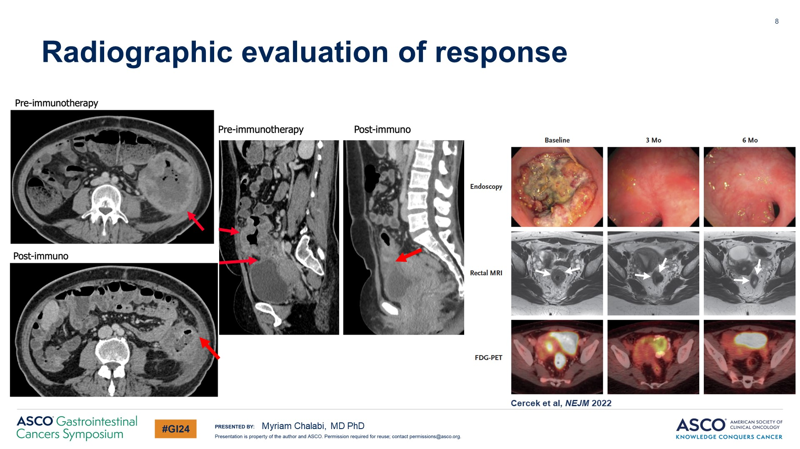
Radiographic evaluation of response
Content of this presentation is the property of the author, licensed by ASCO. Permission required for reuse.

Slide 9
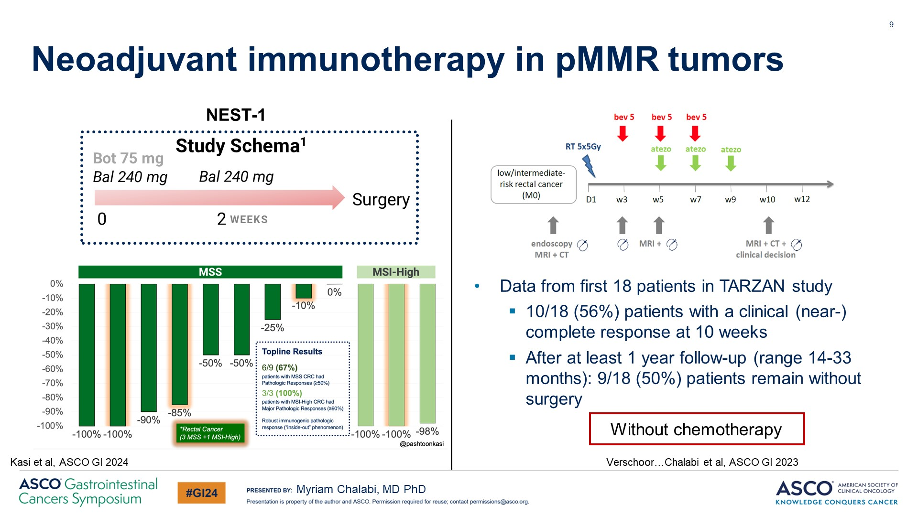
Neoadjuvant immunotherapy in pMMR tumors
Content of this presentation is the property of the author, licensed by ASCO. Permission required for reuse.

Slide 10
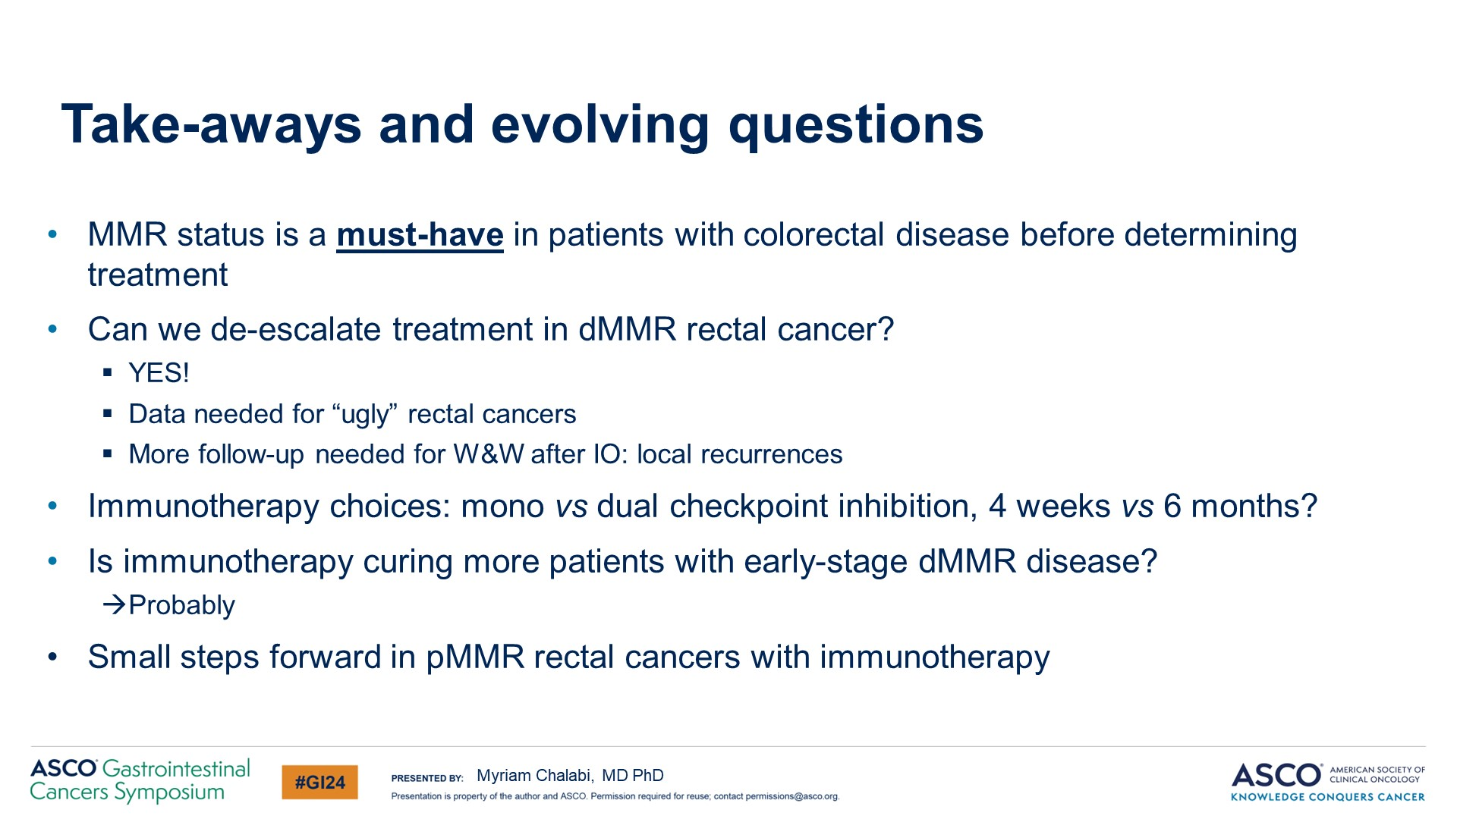
Take-aways and evolving questions
Content of this presentation is the property of the author, licensed by ASCO. Permission required for reuse.

